Slide 1

05 Network
Peter H. Chen

Slide 2
05 Network
https://github.com/PacktPublishing/Tkinter-GUI-Application-Development-Blueprints-Second-Edition
https://www.tutorialspoint.com/python/python_networking.htm
Network
Python provides two levels of access to network services.
At a low level, you can access the basic socket support in the underlying operating system, which allows you to implement clients and servers for both connection-oriented and connectionless protocols.
Python also has libraries that provide higher-level access to specific application-level network protocols, such as FTP, HTTP, and so on.
This section gives you understanding on most famous concept in Networking - Socket Programming.

Slide 3
05.01 Socket

Slide 4
05.01 Socket
https://github.com/PacktPublishing/Tkinter-GUI-Application-Development-Blueprints-Second-Edition
https://www.tutorialspoint.com/python/python_networking.htm
What is Socket?
Sockets are the endpoints of a bidirectional communications channel.
Sockets may communicate within a process, between processes on the same machine, or between processes on different continents.
Sockets may be implemented over a number of different channel types: Unix domain sockets, TCP, UDP, and so on. The socket library provides specific classes for handling the common transports as well as a generic interface for handling the rest.

Slide 5
05.01 Socket
https://github.com/PacktPublishing/Tkinter-GUI-Application-Development-Blueprints-Second-Edition
https://www.tutorialspoint.com/python/python_networking.htm
What is Socket?
Sockets have their own vocabulary
No | Term & Description
1 | Domain The family of protocols that is used as the transport mechanism. These values are constants such as AF_INET, PF_INET, PF_UNIX, PF_X25, and so on.
2 | type The type of communications between the two endpoints, typically SOCK_STREAM for connection-oriented protocols and SOCK_DGRAM for connectionless protocols.
3 | protocol Typically zero, this may be used to identify a variant of a protocol within a domain and type.

Slide 6
05.01 Socket
https://github.com/PacktPublishing/Tkinter-GUI-Application-Development-Blueprints-Second-Edition
https://www.tutorialspoint.com/python/python_networking.htm
What is Socket?
Sockets have their own vocabulary
No | Term & Description
4 | hostname The identifier of a network interface − A string, which can be a host name, a dotted-quad address, or an IPV6 address in colon (and possibly dot) notation A string "<broadcast>", which specifies an INADDR_BROADCAST address. A zero-length string, which specifies INADDR_ANY, or An Integer, interpreted as a binary address in host byte order.
5 | port Each server listens for clients calling on one or more ports. A port may be a Fixnum port number, a string containing a port number, or the name of a service.

Slide 7
05.02 Socket Module

Slide 8
05.02 Socket Module
https://github.com/PacktPublishing/Tkinter-GUI-Application-Development-Blueprints-Second-Edition
https://www.tutorialspoint.com/python/python_networking.htm
Socket Module
To create a socket, you must use the socket.socket() function available in socket module, which has the general syntax
s = socket.socket (socket_family, socket_type, protocol=0)
Here is the description of the parameters −
socket_family − This is either AF_UNIX or AF_INET, as explained earlier.
socket_type − This is either SOCK_STREAM or SOCK_DGRAM.
protocol − This is usually left out, defaulting to 0.
Once you have socket object, then you can use required functions to create your client or server program.
Following is the list of functions required.

Slide 9
05.03 Server Socket Method

Slide 10
05.03 Server Socket Method
https://github.com/PacktPublishing/Tkinter-GUI-Application-Development-Blueprints-Second-Edition
https://www.tutorialspoint.com/python/python_networking.htm
Socket Server Methods
No | Method & Description
1 | s.bind() This method binds address (hostname, port number pair) to socket.
2 | s.listen() This method sets up and start TCP listener.
3 | s.accept() This passively accept TCP client connection, waiting until connection arrives (blocking).

Slide 11
05.04 Client Socket Method

Slide 12
05.04 Client Socket Method
https://github.com/PacktPublishing/Tkinter-GUI-Application-Development-Blueprints-Second-Edition
https://www.tutorialspoint.com/python/python_networking.htm
Client Socket Methods
No | Method & Description
1 | s.connect() This method actively initiates TCP server connection

Slide 13
05.05 General Socket Method

Slide 14
05.05 General Socket Method
https://github.com/PacktPublishing/Tkinter-GUI-Application-Development-Blueprints-Second-Edition
https://www.tutorialspoint.com/python/python_networking.htm
Client Socket Methods
No | Method & Description
1 | s.recv() This method receives TCP message
2 | s.send() This method transmits TCP message
3 | s.recvfrom() This method receives UDP message
4 | s.sendto() This method transmits UDP message
5 | s.close() This method closes socket
6 | socket.gethostname() Returns the hostname.

Slide 15
05.06 A Simple Server

Slide 16
05.06 A Simple Server
https://github.com/PacktPublishing/Tkinter-GUI-Application-Development-Blueprints-Second-Edition
https://www.tutorialspoint.com/python/python_networking.htm
A Simple Server
To write Internet servers, we use the socket function available in socket module to create a socket object. A socket object is then used to call other functions to setup a socket server.
Now call bind (hostname, port) function to specify a port for your service on the given host.
Next, call the accept method of the returned object. This method waits until a client connects to the port you specified, and then returns a connection object that represents the connection to that client

Slide 17
05.06 A Simple Server
https://github.com/PacktPublishing/Tkinter-GUI-Application-Development-Blueprints-Second-Edition
https://www.tutorialspoint.com/python/python_networking.htm
A Simple Server code (1):
import socket: import socket package.
s = socket.socket (socket.AF_INET, socket.SAOCK_STREAM):
socket.SOCK_STREAM corresponds to TCP. This will be a streaming socket.
AF stands for address family. There are 29 address families. AF_INET (or AF_INET4) is address family for IPV4. AF_INET6 corresponds to IPV6. AF_IRDA (Infrared Data Association), AF_BLUETOOTH for Bluetooth.
s.bind((socket.gethostname (), 1234)): bind a tuple of type socket host name and port.
What is socket? Sockets are just the endpoints. Socket itself is not the communication. The communication is on that end point. Socket has an IP and a port.
s.listen (5): We have queue of 5 for this server. If there are busy on the port, we have queue of 5 for each port and can respond quickly.

Slide 18
05.06 A Simple Server
https://github.com/PacktPublishing/Tkinter-GUI-Application-Development-Blueprints-Second-Edition
https://www.tutorialspoint.com/python/python_networking.htm
A Simple Server code (2):
while True:
clientsocket, address = s.accept ()
print (f”connection from {address} has been established!”)
clientsocket.send (bytes(“Welcome to this server!”, “utf-8”))
If we get the data, we will get the client socket and address is where is the data coming from. Address is IP address.
clientsocket is an object will receive information.
Once we got connection, we can just print the information with (f”connection from {address} has been established!”) string.
clientsocket.send (bytes(“Welcome to this server!”, “utf-8”)): send byte information with “utf-8” format

Slide 19
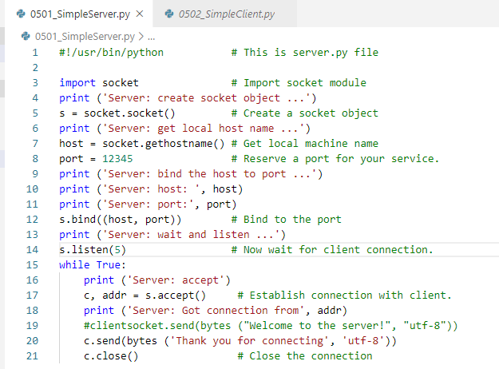
05.06 A Simple Server
https://github.com/PacktPublishing/Tkinter-GUI-Application-Development-Blueprints-Second-Edition
https://www.tutorialspoint.com/python/python_networking.htm
A Simple Server code:

Slide 20
05.07 A Simple Client

Slide 21
05.07 A Simple Client
https://github.com/PacktPublishing/Tkinter-GUI-Application-Development-Blueprints-Second-Edition
https://www.tutorialspoint.com/python/python_networking.htm
A Simple Client
write a very simple client program which opens a connection to a given port 12345 and given host. This is very simple to create a socket client using Python's socket module function.
The socket.connect(hosname, port ) opens a TCP connection to hostname on the port. Once you have a socket open, you can read from it like any IO object. When done, remember to close it, as you would close a file.
The following code is a very simple client that connects to a given host and port, reads any available data from the socket, and then exits

Slide 22
05.07 A Simple Client
https://github.com/PacktPublishing/Tkinter-GUI-Application-Development-Blueprints-Second-Edition
https://www.tutorialspoint.com/python/python_networking.htm
A Simple Client (1)
On the client side, similar to server. We copy two lines of import and socket code as follow:
import socket: import socket package.
s = socket.socket (socket.AF_INET, socket.SAOCK_STREAM)
In the client, rather than binding, we connect the socket.
s.connect((socket.gethostname(), 1234))
It connect the hostname and port name. The client is remote to your server. The client and server are not on the same machine.
With the socket, the python can be to and from on the same machine like locally networked set of machine or even remote networked machine. You can connect to an public IP or local IP. For now, we do everything on the same machine.

Slide 23
05.07 A Simple Client
https://github.com/PacktPublishing/Tkinter-GUI-Application-Development-Blueprints-Second-Edition
https://www.tutorialspoint.com/python/python_networking.htm
A Simple Client (2)
We will get the message:
msg = s.recv (1024)
Print (msg.decode (“utf-8”))
This data is from the remote data. How big of the chunk at a time? In this case, it is 1024 bytes.
We will receive these bytes stream.
We send as bytes and receive as byte, then we decode the bytes.
Then, we run server.py and then run client.py.

Slide 24
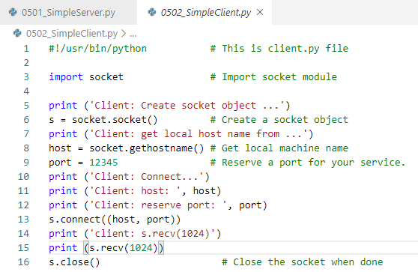
05.07 A Simple Client
https://github.com/PacktPublishing/Tkinter-GUI-Application-Development-Blueprints-Second-Edition
https://www.tutorialspoint.com/python/python_networking.htm
A Simple Client code:

Slide 25
05.08 Run Server/Client

Slide 26
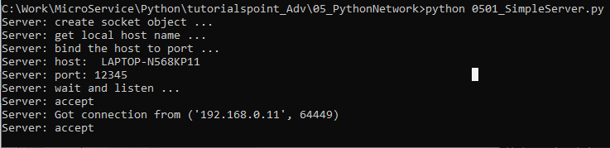
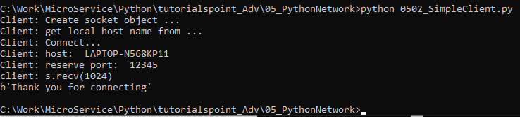
05.08 Run Server/Client
https://github.com/PacktPublishing/Tkinter-GUI-Application-Development-Blueprints-Second-Edition
https://www.tutorialspoint.com/python/python_networking.htm
Run Server:
Run Client:

Slide 27
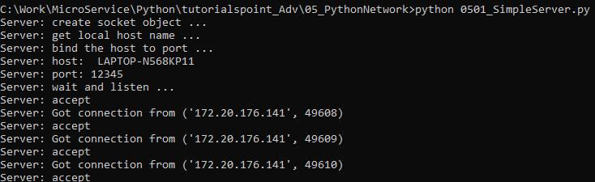
05.08 Run Server/Client
https://github.com/PacktPublishing/Tkinter-GUI-Application-Development-Blueprints-Second-Edition
https://www.tutorialspoint.com/python/python_networking.htm
Every time, we get the different ports connection from client:

Slide 28
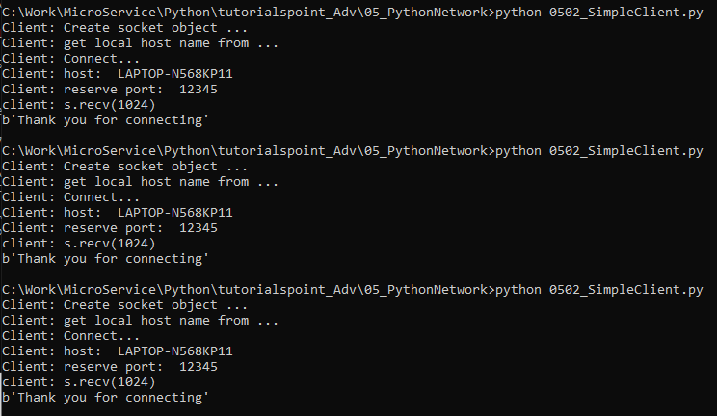
05.08 Run Server/Client
https://github.com/PacktPublishing/Tkinter-GUI-Application-Development-Blueprints-Second-Edition
https://www.tutorialspoint.com/python/python_networking.htm
Start client:
Each time, get response from server. Server runs forever.

Slide 29
05.09 Store All Messages

Slide 30
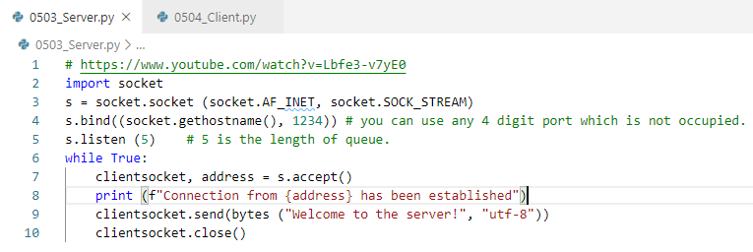
05.09 Store All Messages
https://github.com/PacktPublishing/Tkinter-GUI-Application-Development-Blueprints-Second-Edition
https://www.tutorialspoint.com/python/python_networking.htm
Server Code:
Note: Need close() each time socket send a string.
Missing close() will cause infinity loop.

Slide 31
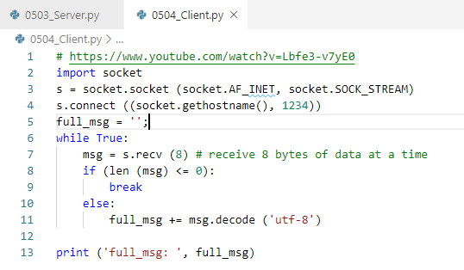
05.09 Store All Messages
https://github.com/PacktPublishing/Tkinter-GUI-Application-Development-Blueprints-Second-Edition
https://www.tutorialspoint.com/python/python_networking.htm
Client Code:
Concatenate the message.

Slide 32

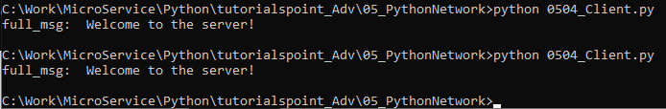
05.09 Store All Messages
https://github.com/PacktPublishing/Tkinter-GUI-Application-Development-Blueprints-Second-Edition
https://www.tutorialspoint.com/python/python_networking.htm
Run Server:
Run Client:

Slide 33
End of Chapter

