Slide 1

0502 Buffer Stream
Peter H. Chen

Slide 2
0502 Buffer Stream
https://github.com/PacktPublishing/Tkinter-GUI-Application-Development-Blueprints-Second-Edition
https://www.youtube.com/watch?v=8A4dqoGL62E
Buffer Stream:
Buffer Stream
Send Buffer with timestamp

Slide 3
0502.01 Buffer Stream

Slide 4
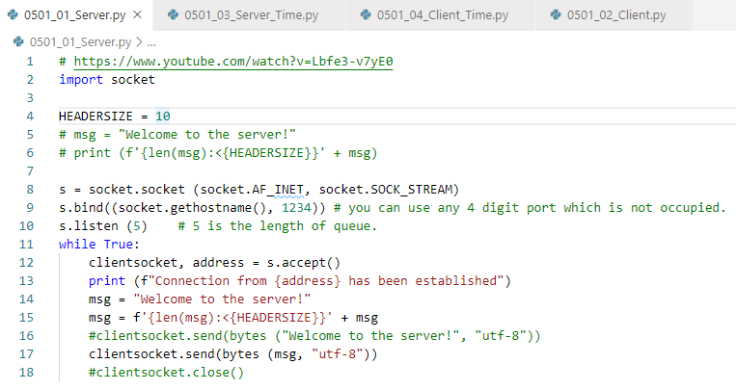
0502.01 Buffer Stream
https://github.com/PacktPublishing/Tkinter-GUI-Application-Development-Blueprints-Second-Edition
https://www.youtube.com/watch?v=8A4dqoGL62E
0502_01_Server.py

Slide 5
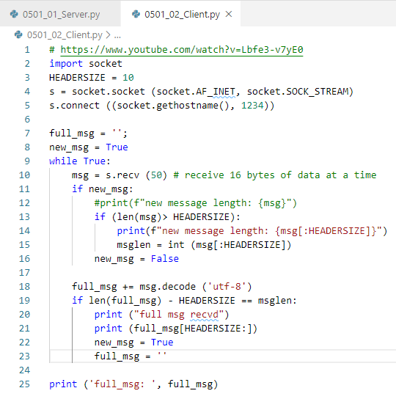
0502.01 Buffer Stream
https://github.com/PacktPublishing/Tkinter-GUI-Application-Development-Blueprints-Second-Edition
https://www.youtube.com/watch?v=8A4dqoGL62E
0502_02_Client.py

Slide 6
0502.01 Buffer Stream
https://github.com/PacktPublishing/Tkinter-GUI-Application-Development-Blueprints-Second-Edition
https://www.youtube.com/watch?v=8A4dqoGL62E
> python 0502_01_Server.py
> python 0502_02_Client.py

Slide 7
0502.02 Buffer Stream with Timestamp

Slide 8
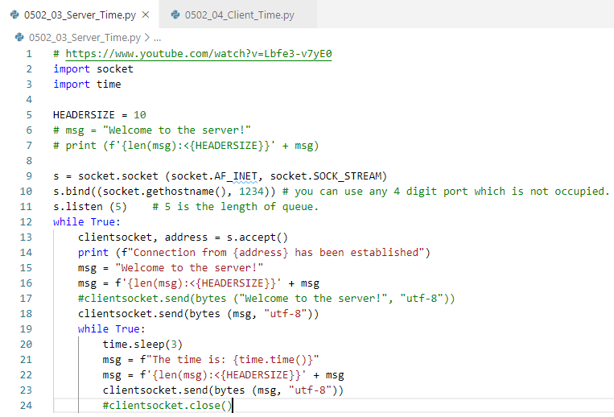
0502.02 Buffer Stream with Timestamp
https://github.com/PacktPublishing/Tkinter-GUI-Application-Development-Blueprints-Second-Edition
https://www.youtube.com/watch?v=8A4dqoGL62E
0502_01_Server.py

Slide 9
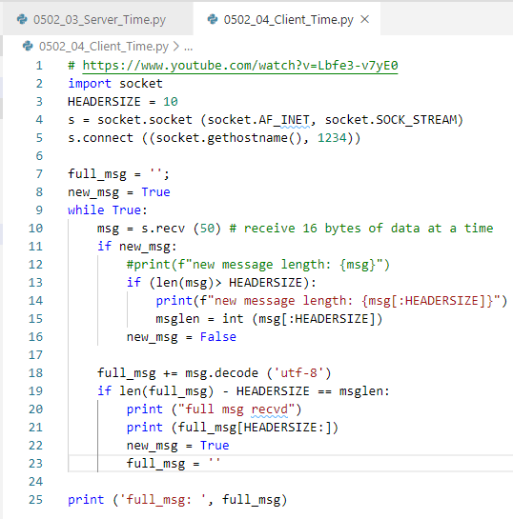
0502.02 Buffer Stream with Timestamp
https://github.com/PacktPublishing/Tkinter-GUI-Application-Development-Blueprints-Second-Edition
https://www.youtube.com/watch?v=8A4dqoGL62E
0502_02_Client.py

Slide 10
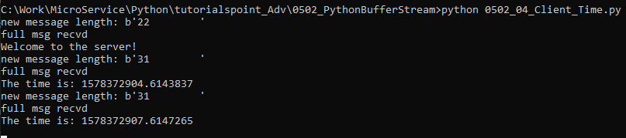
0502.02 Buffer Stream with Timestamp
https://github.com/PacktPublishing/Tkinter-GUI-Application-Development-Blueprints-Second-Edition
https://www.youtube.com/watch?v=8A4dqoGL62E
> python 0502_03_Server_Time.py
> python 0502_04_Client_Time.py

Slide 11
End of Chapter

