Slide 1

0503 Send Receive by Pickle
Peter H. Chen

Slide 2
0503 Send Receive by Pickle
https://github.com/PacktPublishing/Tkinter-GUI-Application-Development-Blueprints-Second-Edition
https://www.youtube.com/watch?v=8A4dqoGL62E
Buffer Stream:
You can send and receive the object with pickle.

Slide 3
0503.01 Send Receive by Pickle

Slide 4
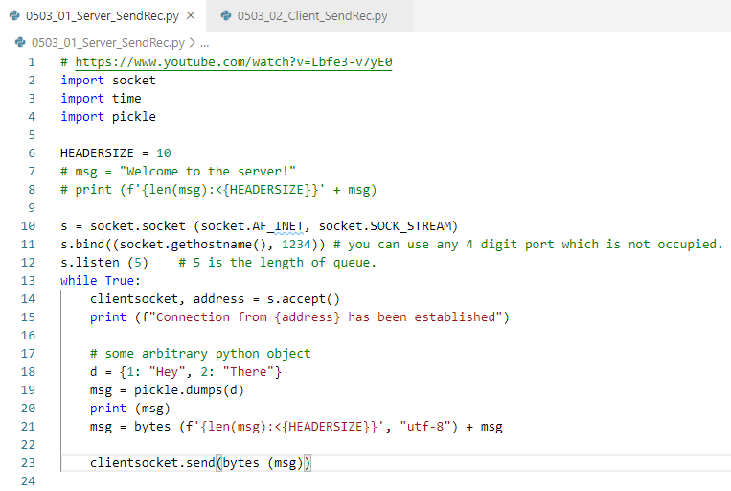
0503.01 Send Receive by Pickle
https://github.com/PacktPublishing/Tkinter-GUI-Application-Development-Blueprints-Second-Edition
https://www.youtube.com/watch?v=8A4dqoGL62E
0503_01_Server_SendRec.py

Slide 5
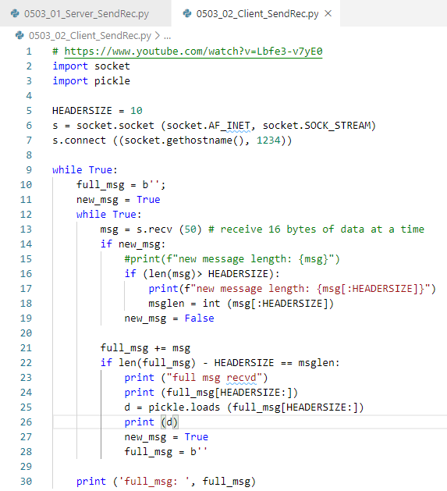
0503.01 Send Receive by Pickle
https://github.com/PacktPublishing/Tkinter-GUI-Application-Development-Blueprints-Second-Edition
https://www.youtube.com/watch?v=8A4dqoGL62E
0503_02_Client_SendRec.py

Slide 6

0503.01 Send Receive by Pickle
https://github.com/PacktPublishing/Tkinter-GUI-Application-Development-Blueprints-Second-Edition
https://www.youtube.com/watch?v=8A4dqoGL62E
> python 0503_01_Server_SendRec.py
> python 0502_02_Client_SendRec.py

Slide 7
End of Chapter

