Slide 1

6 Data Type and Variable
Peter H. Chen

Slide 2
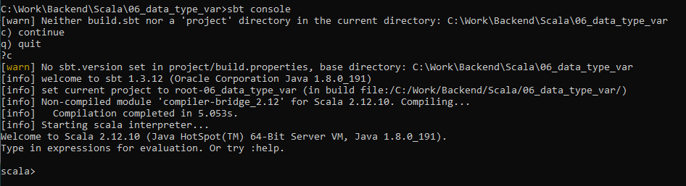
6 Data Type and Variable
https://www.youtube.com/watch?v=6xRsw_6fc18&list=PLS1QulWo1RIagob5D6kMIAvu7DQC5VTh3&index=6
Data Type and Variable
To start the scala.
> sbt console
scala 2.12.10
scala >

Slide 3

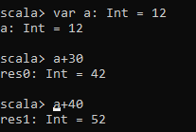

6 Data Type and Variable
https://www.youtube.com/watch?v=6xRsw_6fc18&list=PLS1QulWo1RIagob5D6kMIAvu7DQC5VTh3&index=6
Data Type and Variable
Var is mutable. Variable-name: Data type = value
> var a: Int = 12
> a+ 30
> a+ 40

Slide 4
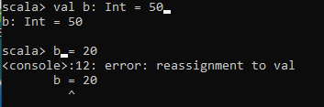

6 Data Type and Variable
https://www.youtube.com/watch?v=6xRsw_6fc18&list=PLS1QulWo1RIagob5D6kMIAvu7DQC5VTh3&index=6
Data Type and Variable
Val is immutable. The variable cannot be changed.
> val b: Int =50
> b = 20
b is immutable and cannot be changed.
The target folder is created to store the compile result.

Slide 5
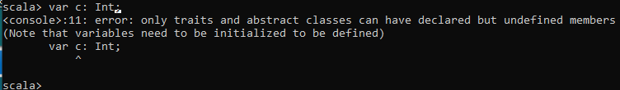
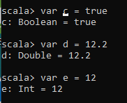
6 Data Type and Variable
https://www.youtube.com/watch?v=6xRsw_6fc18&list=PLS1QulWo1RIagob5D6kMIAvu7DQC5VTh3&index=6
Data Type and Variable
Scala > var c: Int;
Error: Need to initialize the value.
Initialize c to Boolean.
> var c = true
> var d = 12.2
> e = 12

Slide 6
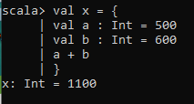
6 Data Type and Variable
https://www.youtube.com/watch?v=6xRsw_6fc18&list=PLS1QulWo1RIagob5D6kMIAvu7DQC5VTh3&index=6
Data Type and Variable
scala > val x = { val a: Int = 200; val b: Int = 300; a + b }
x: Int = 500
Multiple lines assignment
Note: when “val x = …”. The x is re-declared and previous immutable has no effect of re-declaration.
scala > val x = {
| val a: Int = 500
| val b: Int = 600
| a + b
|}
x: Int = 1100

Slide 7
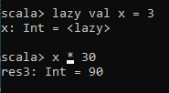
6 Data Type and Variable
https://www.youtube.com/watch?v=6xRsw_6fc18&list=PLS1QulWo1RIagob5D6kMIAvu7DQC5VTh3&index=6
Data Type and Variable
scala > lazy val x =3
Variable never assign by lazy. Unless you resue it.

Slide 8
6.1 Quiz

Slide 9
6.1 Quiz
https://www.youtube.com/watch?v=6xRsw_6fc18&list=PLS1QulWo1RIagob5D6kMIAvu7DQC5VTh3&index=6
Quiz
1. How to start the sbt console?
Ans: > sbt console
2. How to declare the mutable variable a = 5?
Ans: > var a: Int 5
3. How to declare the immutable variable b = 10?
Ans: > val b: int 10

Slide 10
End of Chapter

