Slide 1

7 IDE
Peter H. Chen

Slide 2
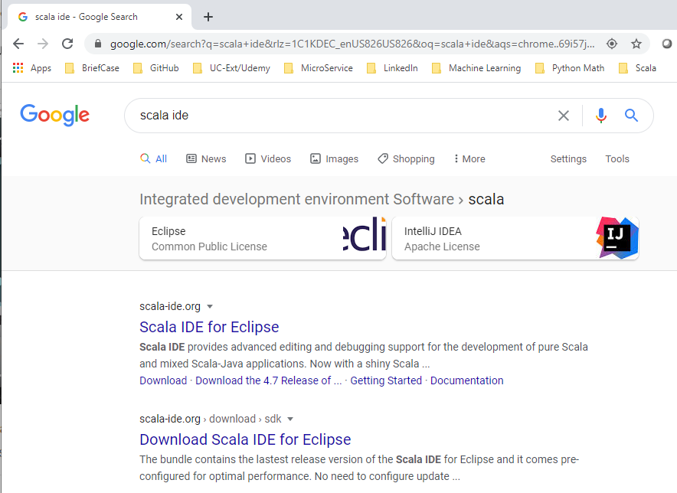
7 IDE
https://www.youtube.com/watch?v=wvsxOedxQRo&list=PLS1QulWo1RIagob5D6kMIAvu7DQC5VTh3&index=7
IDE
Scala is Eclipse-based IDE. We need Java installed before we use Scala IDE.
Click “scala-ide.org”

Slide 3
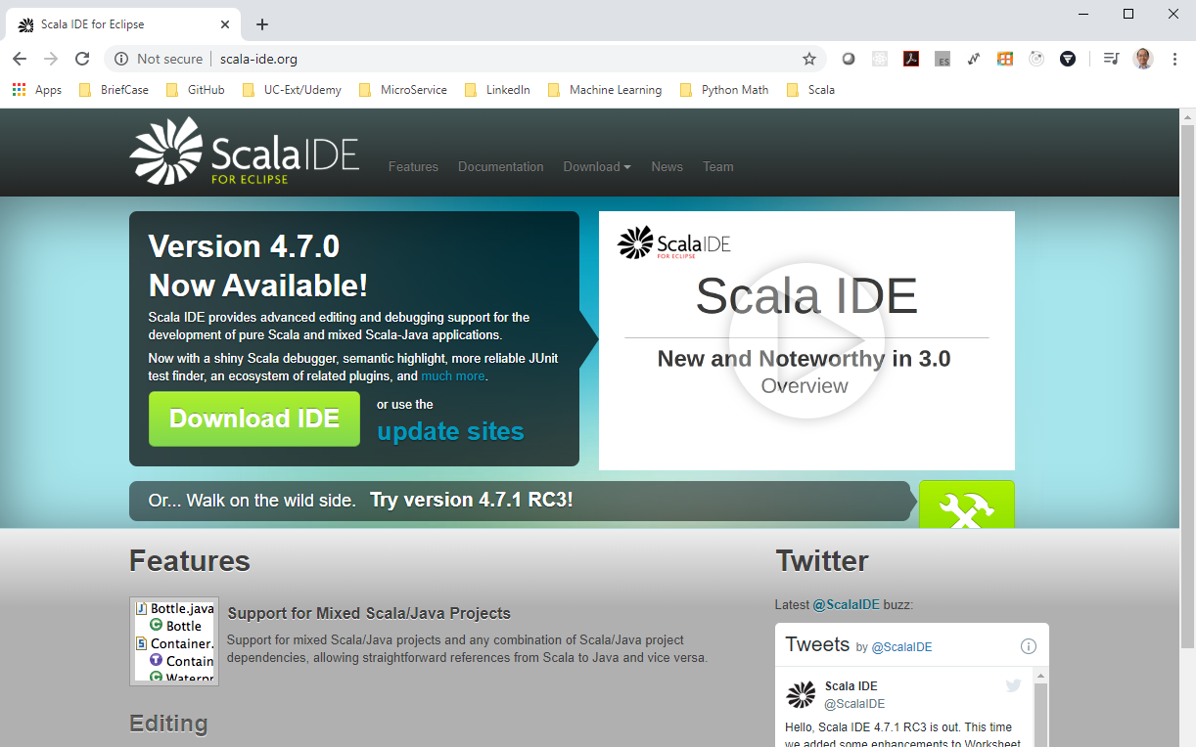
7 IDE
https://www.youtube.com/watch?v=wvsxOedxQRo&list=PLS1QulWo1RIagob5D6kMIAvu7DQC5VTh3&index=7
IDE
Scala is Eclipse-based IDE. We need Java installed before we use Scala IDE.
Click “scala-ide.org”. Download and installed it.

Slide 4
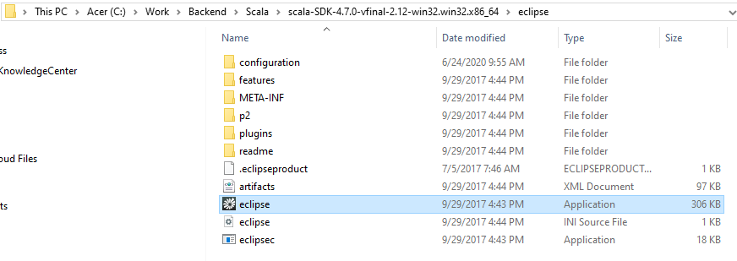
7 IDE
https://www.youtube.com/watch?v=wvsxOedxQRo&list=PLS1QulWo1RIagob5D6kMIAvu7DQC5VTh3&index=7
IDE
Unzipped and find the folder eclipse.
Double click “eclipse” Application.

Slide 5
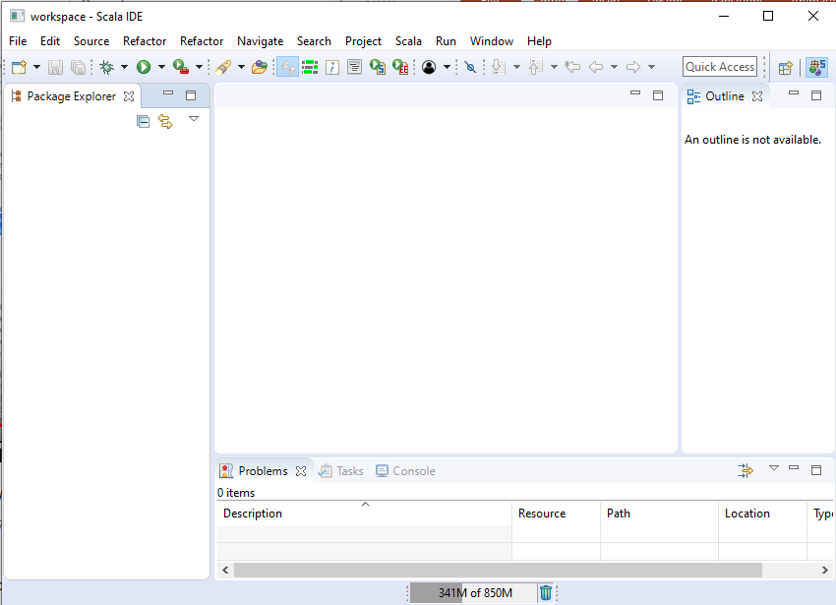
7 IDE
https://www.youtube.com/watch?v=wvsxOedxQRo&list=PLS1QulWo1RIagob5D6kMIAvu7DQC5VTh3&index=7
IDE
Unzipped and find the folder eclipse.
Double click “eclipse” Application.

Slide 6
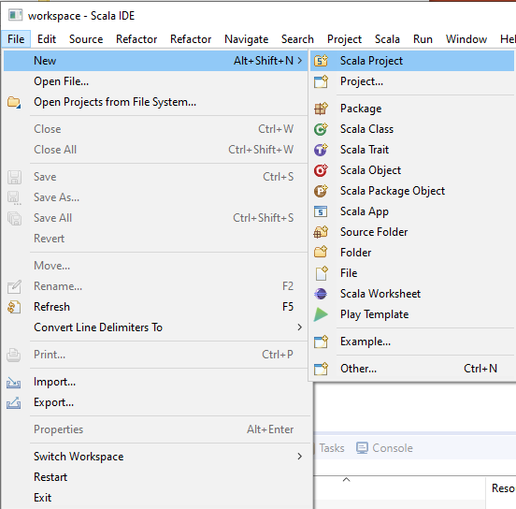
7 IDE
https://www.youtube.com/watch?v=wvsxOedxQRo&list=PLS1QulWo1RIagob5D6kMIAvu7DQC5VTh3&index=7
IDE
File > New > Scala Project

Slide 7
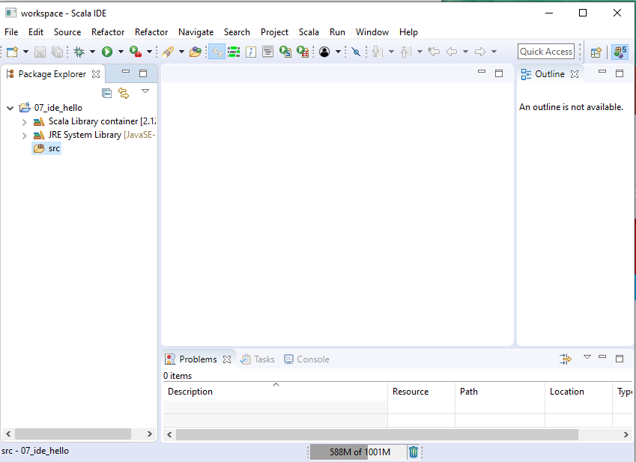
7 IDE
https://www.youtube.com/watch?v=wvsxOedxQRo&list=PLS1QulWo1RIagob5D6kMIAvu7DQC5VTh3&index=7
IDE
07_ide_hello > src and libraries.

Slide 8
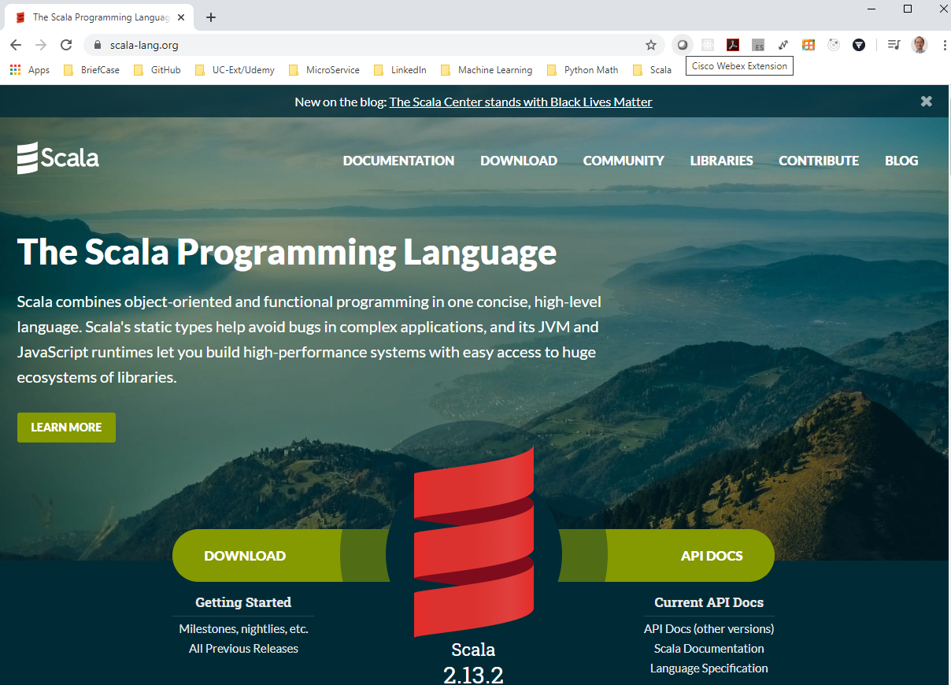
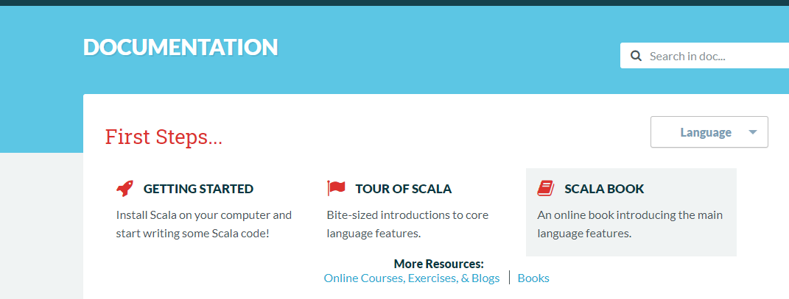
7 IDE
https://www.youtube.com/watch?v=wvsxOedxQRo&list=PLS1QulWo1RIagob5D6kMIAvu7DQC5VTh3&index=7
IDE
Copy the scala code from official web site.
Click “documentation”.
Click “SCALA BOOK”.

Slide 9
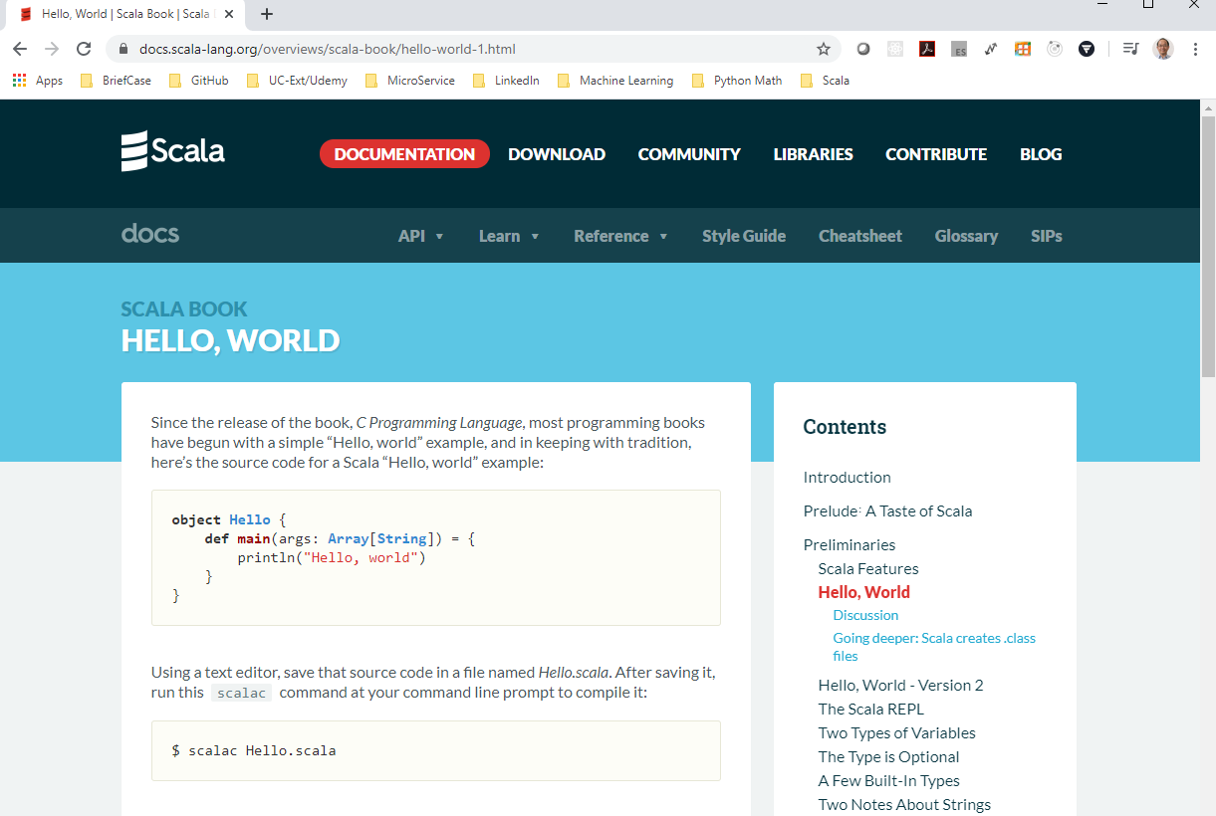
7 IDE
https://www.youtube.com/watch?v=wvsxOedxQRo&list=PLS1QulWo1RIagob5D6kMIAvu7DQC5VTh3&index=7
IDE
Click “Hello, World”.
Copy the source code.

Slide 10
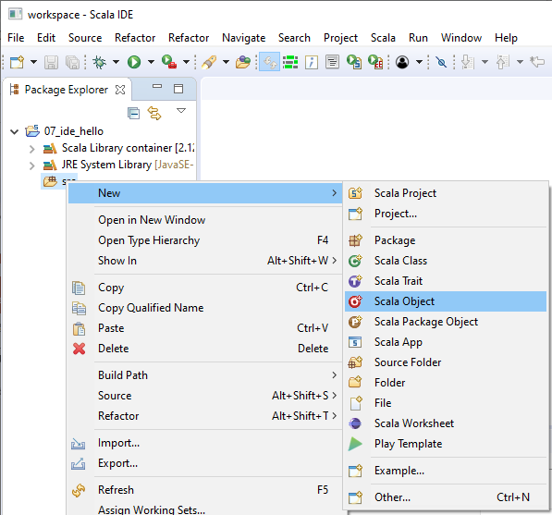
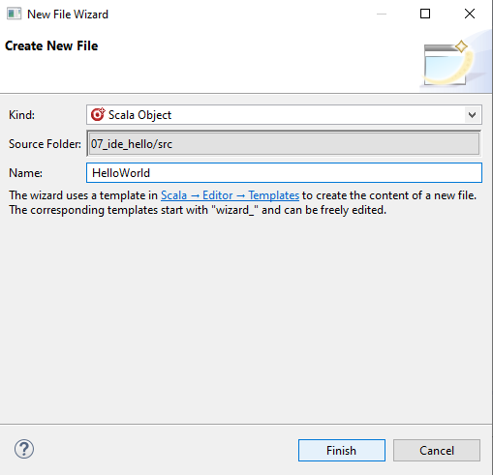
7 IDE
https://www.youtube.com/watch?v=wvsxOedxQRo&list=PLS1QulWo1RIagob5D6kMIAvu7DQC5VTh3&index=7
IDE
src: Right Mouse Button: New > Scala Object
Name: HelloWorld
Click Finish Button.

Slide 11
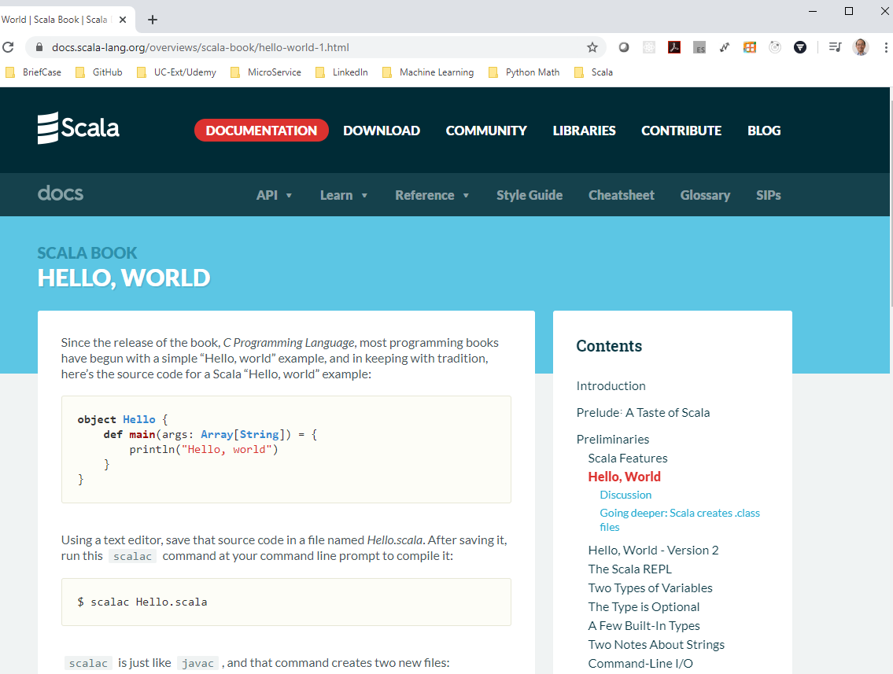
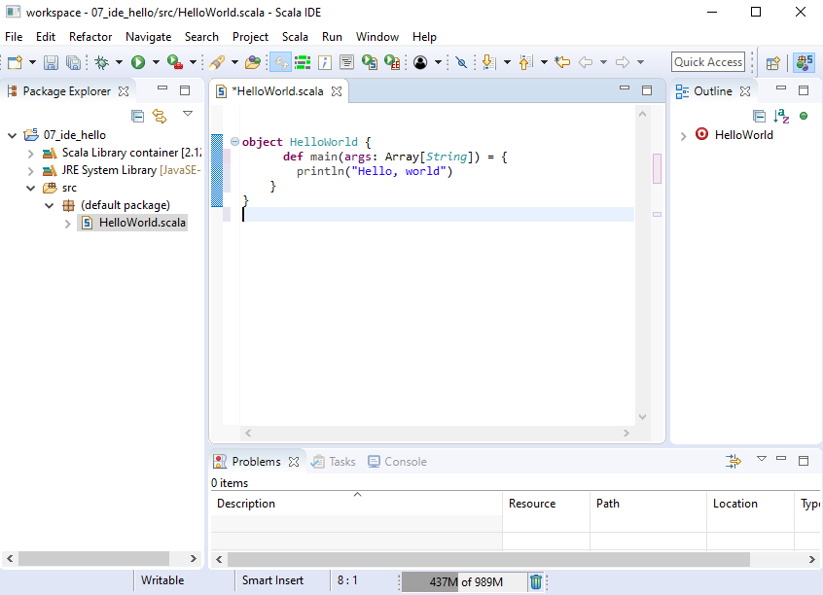
7 IDE
https://www.youtube.com/watch?v=wvsxOedxQRo&list=PLS1QulWo1RIagob5D6kMIAvu7DQC5VTh3&index=7
IDE
Copy and paste the Scala code inside the object HelloWorld {}.

Slide 12
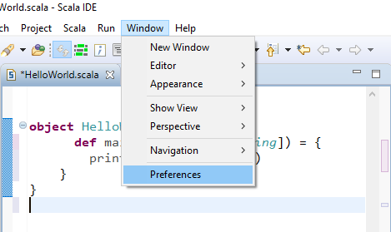
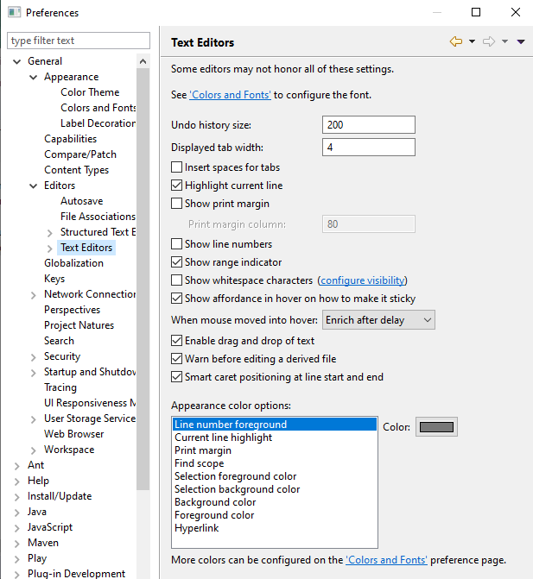
7 IDE
https://www.youtube.com/watch?v=wvsxOedxQRo&list=PLS1QulWo1RIagob5D6kMIAvu7DQC5VTh3&index=7
IDE
How to change the font size?
Window > Preference
General > Editors > Text Editors > Set “Colors and Fonts”

Slide 13
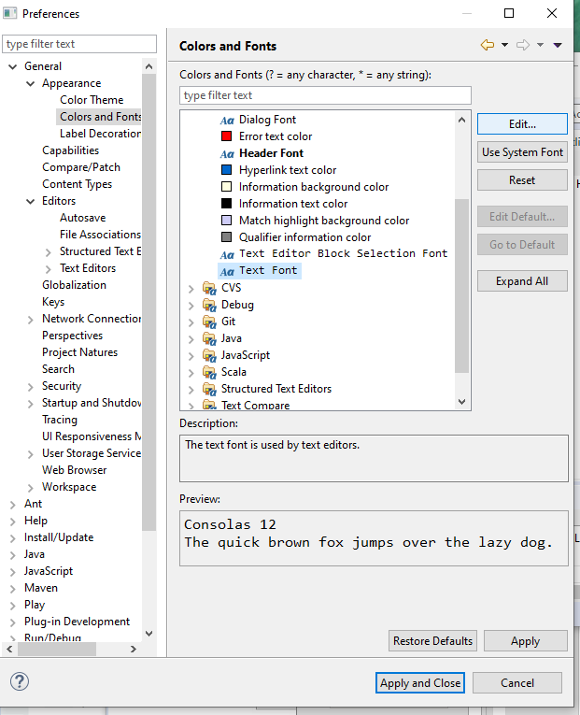
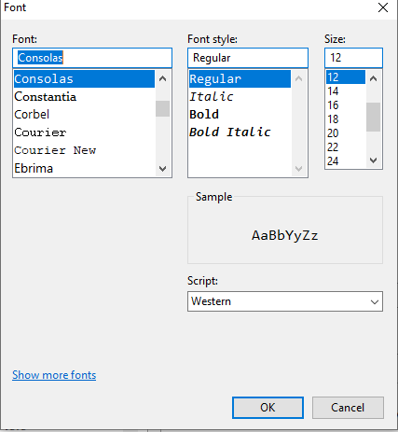
7 IDE
https://www.youtube.com/watch?v=wvsxOedxQRo&list=PLS1QulWo1RIagob5D6kMIAvu7DQC5VTh3&index=7
IDE
Text Font
Edit
> Set to “12”

Slide 14
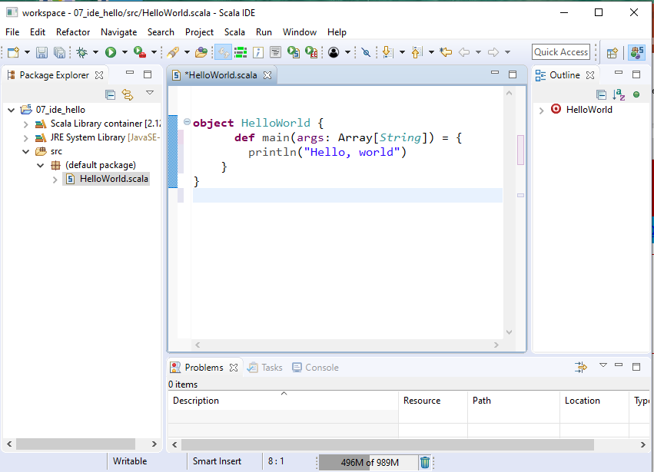
7 IDE
https://www.youtube.com/watch?v=wvsxOedxQRo&list=PLS1QulWo1RIagob5D6kMIAvu7DQC5VTh3&index=7
IDE
The object is a class that already created as an instance.
Java create an object using new class-name.
The object key world followed by object name “HelloWolrd”

Slide 15
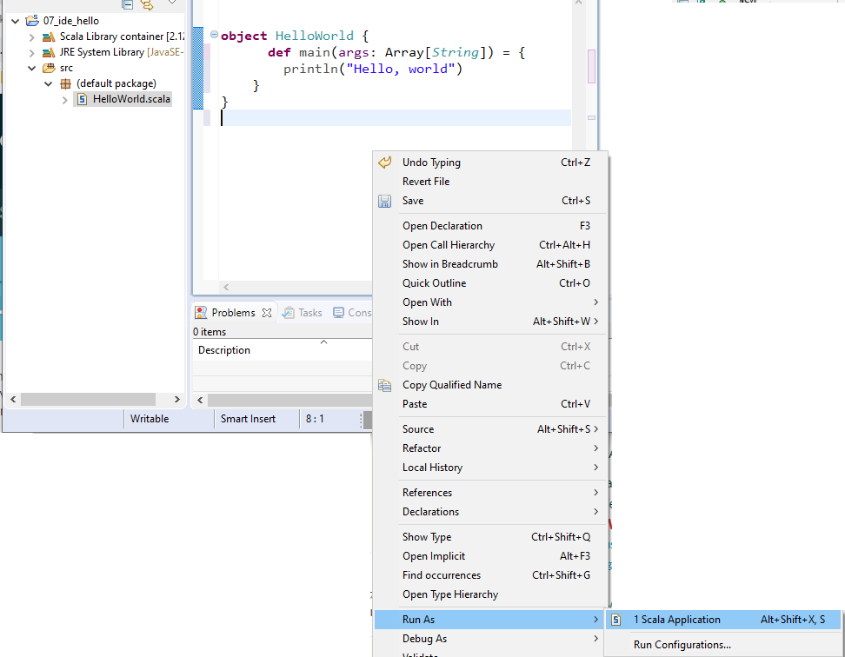
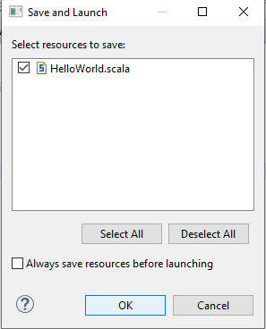
7 IDE
https://www.youtube.com/watch?v=wvsxOedxQRo&list=PLS1QulWo1RIagob5D6kMIAvu7DQC5VTh3&index=7
IDE
To run, in the file, RMB, and click. Rub As > Scala Application
Click OK.

Slide 16
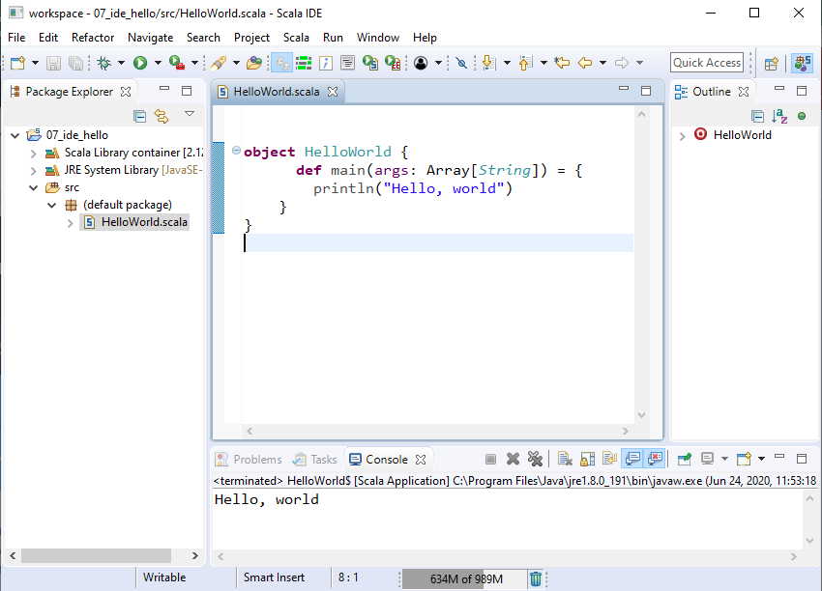
7 IDE
https://www.youtube.com/watch?v=wvsxOedxQRo&list=PLS1QulWo1RIagob5D6kMIAvu7DQC5VTh3&index=7
IDE
We see “Hello World” in the Console.

Slide 17
7.1 Quiz

Slide 18
7.1 Quiz
https://www.youtube.com/watch?v=wvsxOedxQRo&list=PLS1QulWo1RIagob5D6kMIAvu7DQC5VTh3&index=7
Quiz
1. What is Scala IDE?
Ans: Scala IDE for Eclipse. It is a bundle IDE for Scala.
2. How to start scala eclipse IDE?
Ans: In the bin folder of download Scala IDE, find the “eclipse” application. Double click to start.
3. How to create a new scala project?
Ans: File > New > Project, Give the project name.
4. How to create a new scala file?
Ans: Under the src folder. Right Mouse Button to new a file and give the file name

Slide 19
7.1 Quiz
https://www.youtube.com/watch?v=wvsxOedxQRo&list=PLS1QulWo1RIagob5D6kMIAvu7DQC5VTh3&index=7
Quiz
5. How to create a new scala object?
Ans: In the new scala file, there is an “object HelloWorld { }”. Write the scala code insde.
6. How to run the scala applcaiiton?
Ans: In the file, RMB, select “Run As” and then selection the Application to run.

Slide 20
End of Chapter

