Slide 1

3 Setup SBT
Peter H. Chen

Slide 2

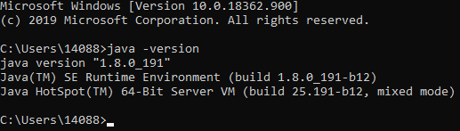
3 Setup SBT
https://www.youtube.com/watch?v=haMI6uoMKs0&list=PLS1QulWo1RIagob5D6kMIAvu7DQC5VTh3&index=3
Setup SBT
First install Java: Download Java from Oracle.
> javac -version
> java -version
Next install SBT.

Slide 3
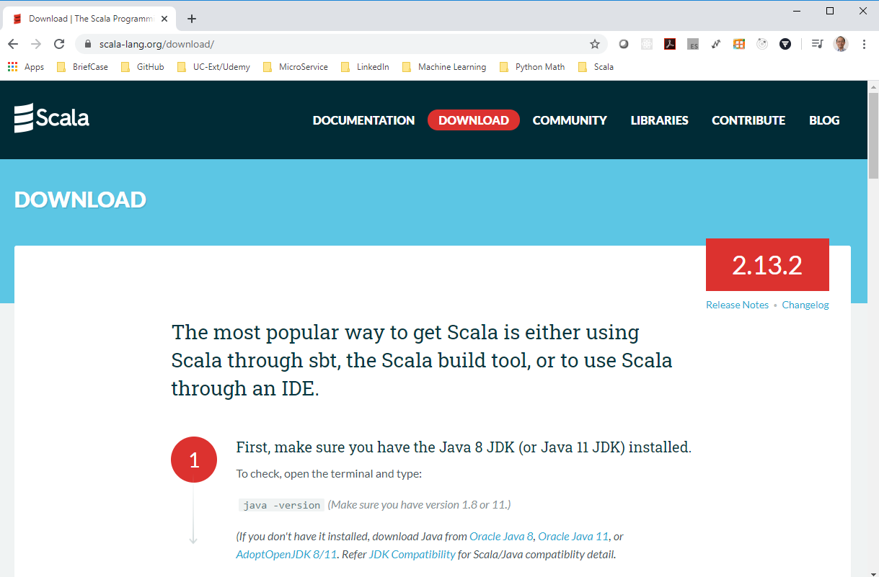
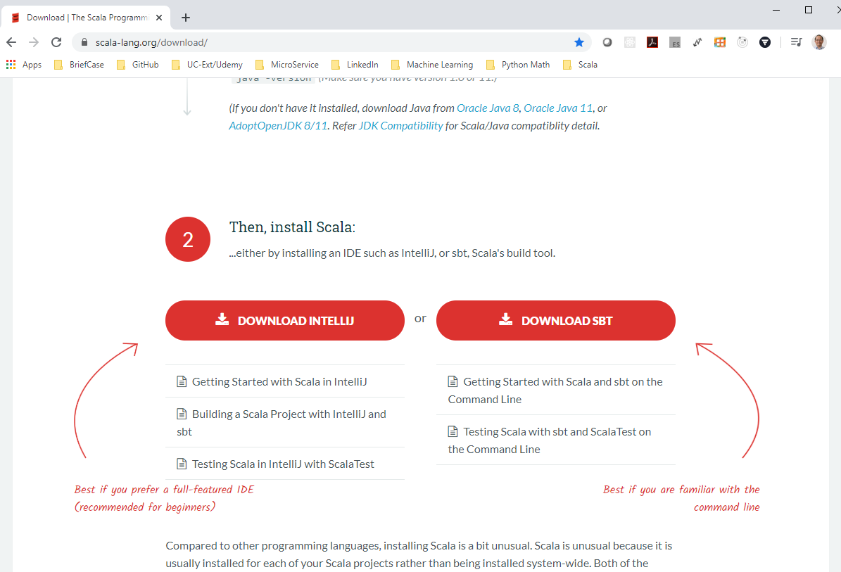
3 Setup SBT
https://www.youtube.com/watch?v=haMI6uoMKs0&list=PLS1QulWo1RIagob5D6kMIAvu7DQC5VTh3&index=3
Setup SBT
Search for “Download Scala”
Two ways to install Scala.
One way use IntelliJ.
The second way use SBT.

Slide 4
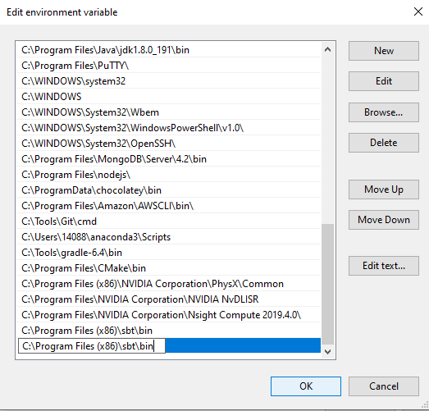
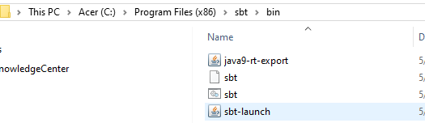
3 Setup SBT
https://www.youtube.com/watch?v=haMI6uoMKs0&list=PLS1QulWo1RIagob5D6kMIAvu7DQC5VTh3&index=3
Setup SBT
Setup the environment for SBT.
After sbt is installed.
Setup the environment %PATH% to include “C:\Program Files (x86)\sbt\bin”
Go the the project folder and type:
> sbt

Slide 5
3.1 Quiz

Slide 6
3.1 Quiz
https://www.youtube.com/watch?v=haMI6uoMKs0&list=PLS1QulWo1RIagob5D6kMIAvu7DQC5VTh3&index=3
Quiz
1. What are two ways to install scala?
Ans:
a) IDE: initelliJ
b) Install SBT (Scala Build Tool or Simple Build Tool)

Slide 7
End of Chapter

