Slide 1

1 Get Started
Peter H. Chen

Slide 2
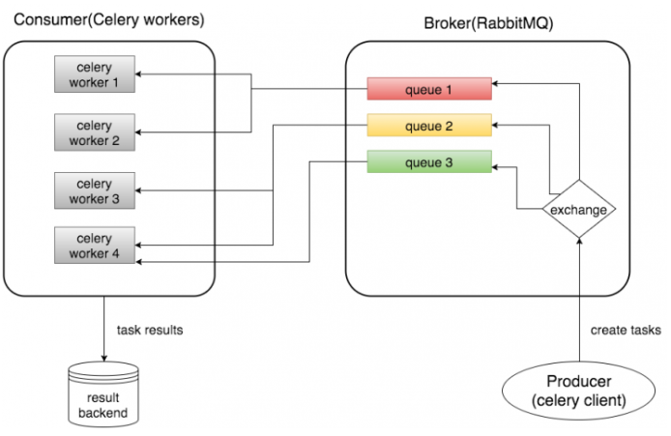
1 Get Started
https://www.youtube.com/watch?v=fg-JfZBetpM&list=PL4uZgY9g0XkfTXZ3uh5jOByL8oSYFnKR7
Get Started
We discussed how to run Asynchronous Task for Celery.
Celery is the producer and consumer for the Message Broker RabbitMQ.

Slide 3
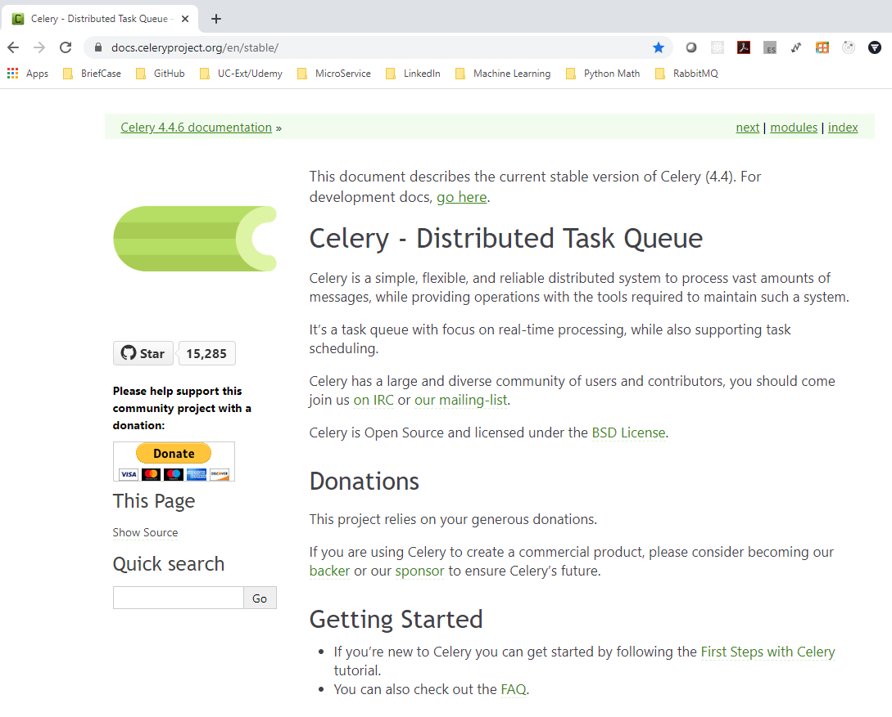
1 Get Started
https://www.youtube.com/watch?v=fg-JfZBetpM&list=PL4uZgY9g0XkfTXZ3uh5jOByL8oSYFnKR7
Get Started
https://docs.celeryproject.org/en/stable/
Celery: Distributed Task Queue

Slide 4
1 Get Started
https://www.youtube.com/watch?v=fg-JfZBetpM&list=PL4uZgY9g0XkfTXZ3uh5jOByL8oSYFnKR7
Message Brokers
https://docs.celeryproject.org/en/stable/getting-started/brokers/index.html
We use Celery to run Asynchronous tasks from a Python App.
Celery is very easy to use:
Celery consists of three things:
1. Client app: The app have to call asynchronously.
2. Message queue: Whenever the app want to call something, the app will place the something on the message queue.
3. Celery: Celery will listen to the message queue. Looking for new tasks to execute and once celery has one to run, celery will run task outside of your app.
Basically, you have your app running, your message queue running, and your celery running.
Three things will be running at the same time to make everything work.

Slide 5
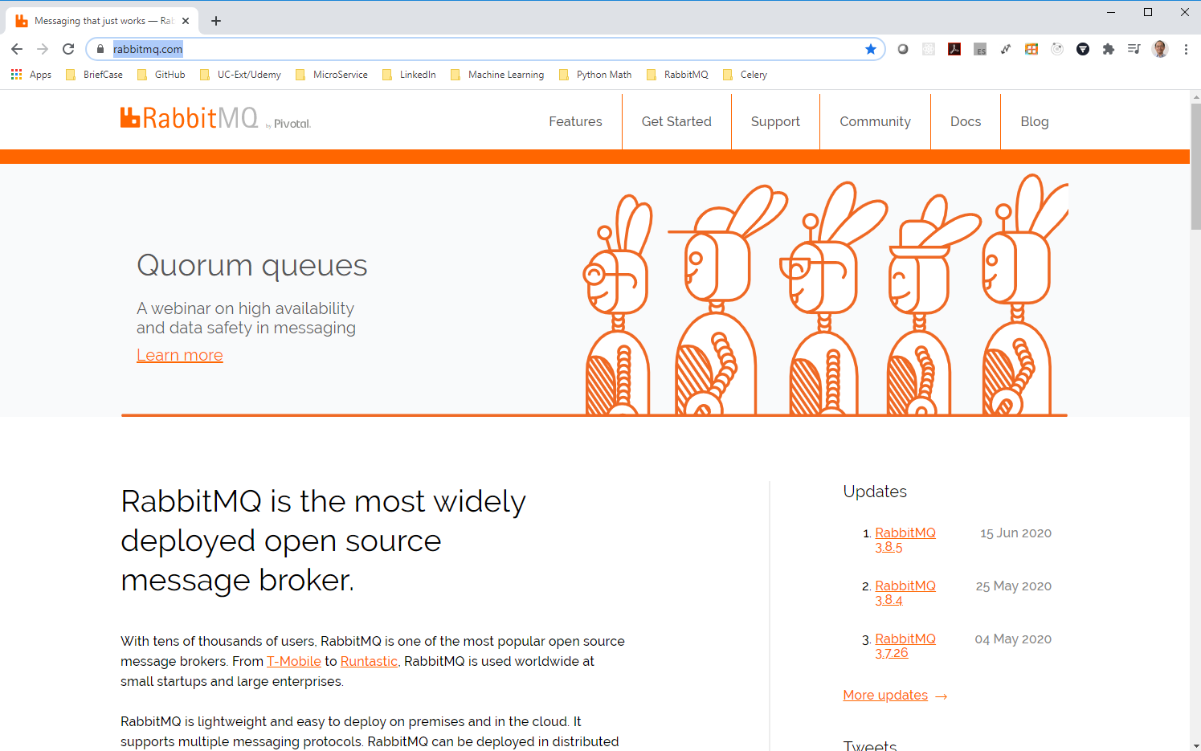
1 Get Started
https://www.youtube.com/watch?v=fg-JfZBetpM&list=PL4uZgY9g0XkfTXZ3uh5jOByL8oSYFnKR7
Message Brokers
https://www.rabbitmq.com/
In addition to Celery, we will be using RabbitMQ as the message Queue.

Slide 6
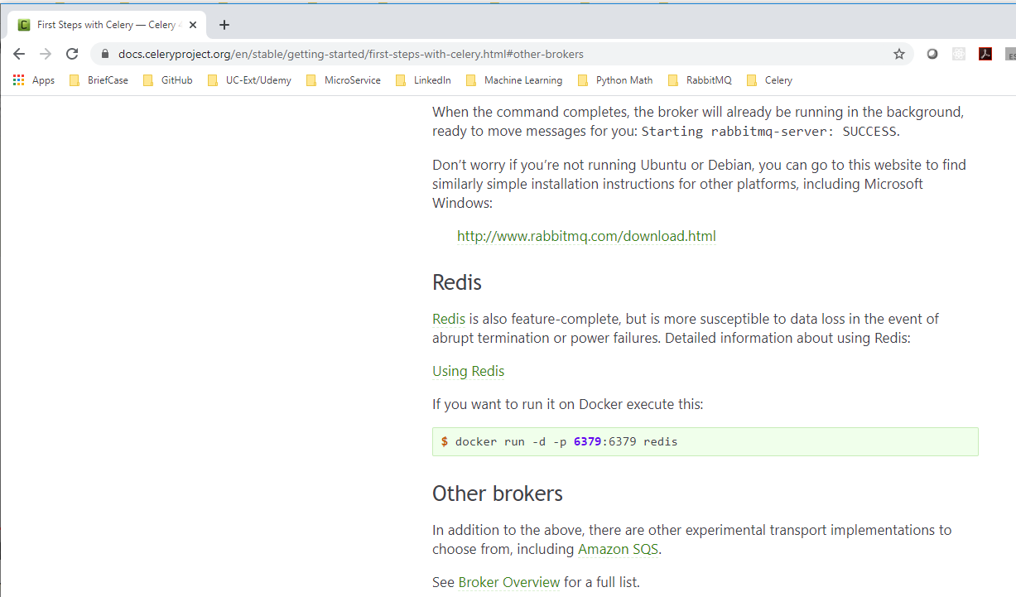
1 Get Started
https://www.youtube.com/watch?v=fg-JfZBetpM&list=PL4uZgY9g0XkfTXZ3uh5jOByL8oSYFnKR7
Message Brokers
https://docs.celeryproject.org/en/stable/getting-started/first-steps-with-celery.html#other-brokers
We can use other options, such as, Redis is available for message queue.
Add Links to both Celery and RabbitMQ.

Slide 7
1.1 Install RabbitMQ

Slide 8
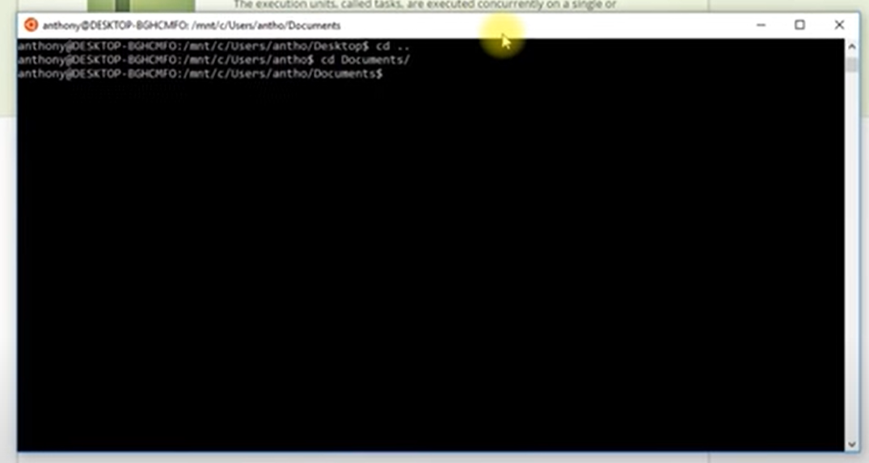
1.1 Install RabbitMQ
https://www.youtube.com/watch?v=fg-JfZBetpM&list=PL4uZgY9g0XkfTXZ3uh5jOByL8oSYFnKR7
Installation
In the command line:

Slide 9
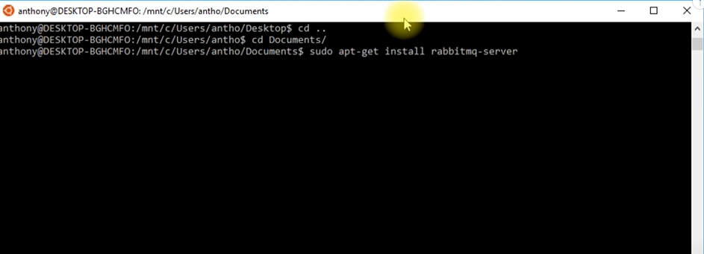
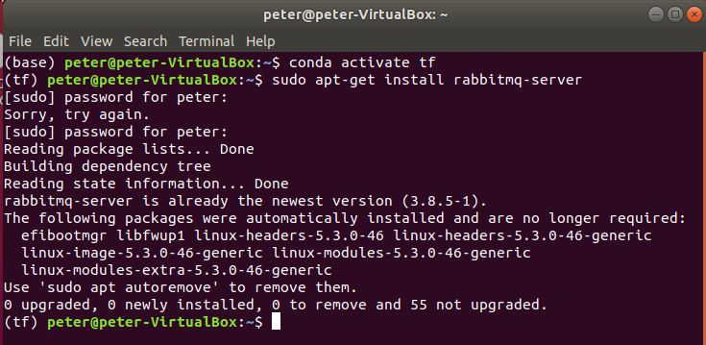
1.1 Install RabbitMQ
https://www.youtube.com/watch?v=fg-JfZBetpM&list=PL4uZgY9g0XkfTXZ3uh5jOByL8oSYFnKR7
Install RabbitMQ first
> conda activate tf # Get into the Anaconda environment first.
> sudo apt-get install rabbitmq-server

Slide 10
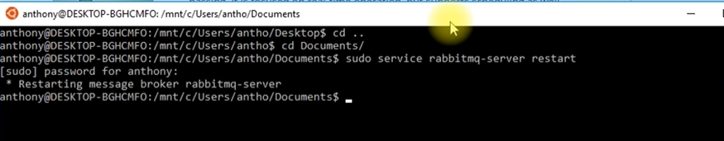

1.1 Install RabbitMQ
https://www.youtube.com/watch?v=fg-JfZBetpM&list=PL4uZgY9g0XkfTXZ3uh5jOByL8oSYFnKR7
Re-start the rabbitmq server
After the RabbitMQ is installed, if encounter the RabbitMQ does not run, you can restart the server and everything will be working correctly.
It you run into the problem, restart the server:
> sudo service rabbitmq-server restart
Once the server restart it, we should able to use that.

Slide 11
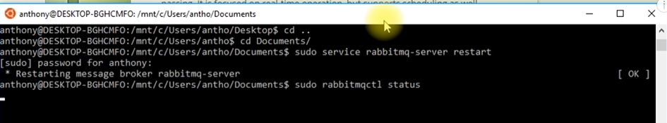
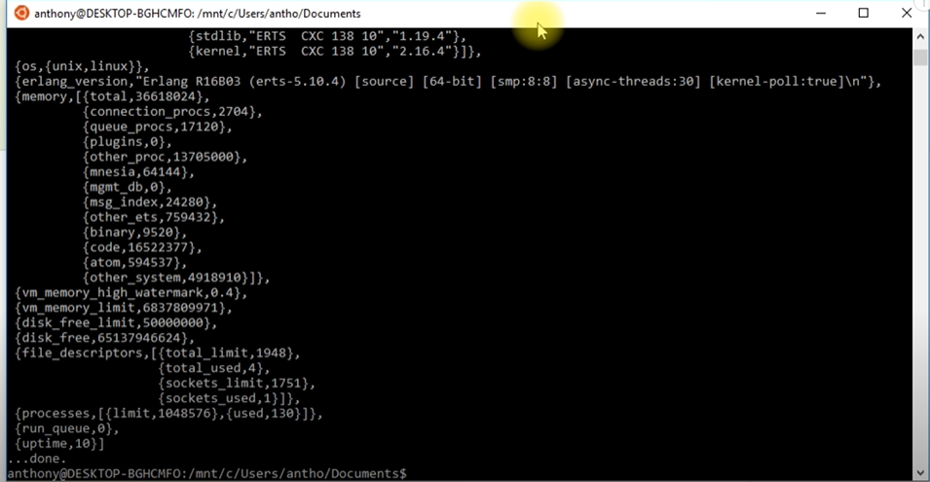
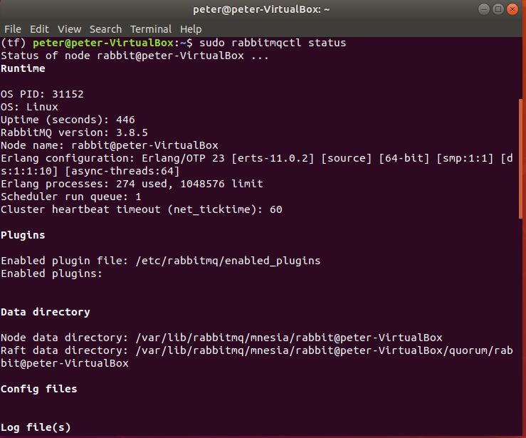
1.1 Install RabbitMQ
https://www.youtube.com/watch?v=fg-JfZBetpM&list=PL4uZgY9g0XkfTXZ3uh5jOByL8oSYFnKR7
Re-start the rabbitmq server
I will check status of server.
> sudo rabbitmqctl status

Slide 12
1.1 Install RabbitMQ
https://www.youtube.com/watch?v=fg-JfZBetpM&list=PL4uZgY9g0XkfTXZ3uh5jOByL8oSYFnKR7
Re-start the rabbitmq server
I will check status of server.
> sudo rabbitmqctl status

Slide 13
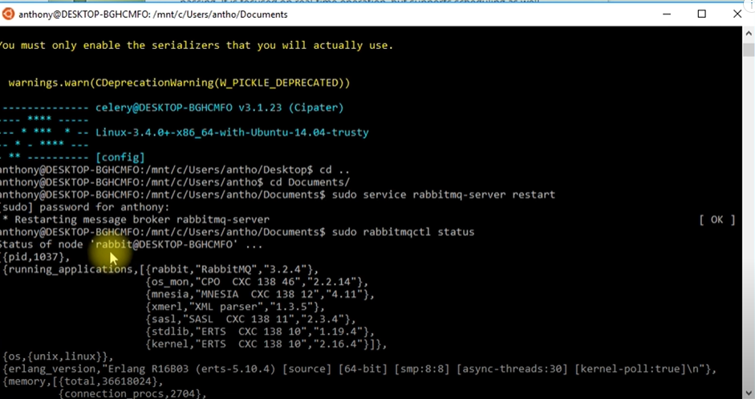
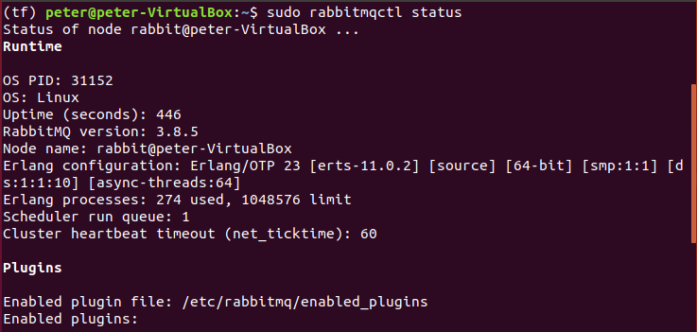
1.1 Install RabbitMQ
https://www.youtube.com/watch?v=fg-JfZBetpM&list=PL4uZgY9g0XkfTXZ3uh5jOByL8oSYFnKR7
Re-start the rabbitmq server
Check the message:
‘rabbit@DESKTOP-BGHCMFG’ (‘rabbit@peter-VirtualBox’)

Slide 14
1.1 Install RabbitMQ
https://www.youtube.com/watch?v=fg-JfZBetpM&list=PL4uZgY9g0XkfTXZ3uh5jOByL8oSYFnKR7
Verify RabbitMQ Version
> dpkg –s rabbitmq-server | grep Version

Slide 15
1.2 Install Celery

Slide 16

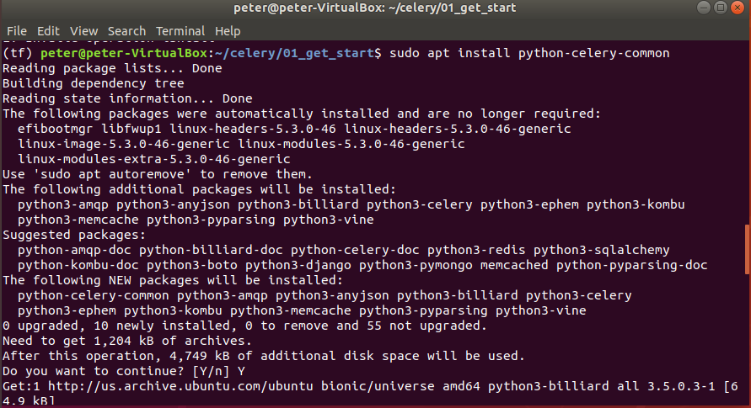
1.2 Install Celery
https://www.youtube.com/watch?v=fg-JfZBetpM&list=PL4uZgY9g0XkfTXZ3uh5jOByL8oSYFnKR7
Install Celery
Next, we install Celery
(tf) > pip install celery
(tf) > sudo apt python-celery-common

Slide 17
1.2 Install Celery
https://www.youtube.com/watch?v=fg-JfZBetpM&list=PL4uZgY9g0XkfTXZ3uh5jOByL8oSYFnKR7
Install Celery
Verify Celery installation
> celery --version

Slide 18
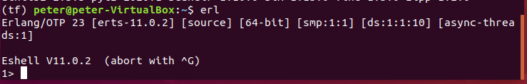
1.2 Install Celery
https://www.youtube.com/watch?v=fg-JfZBetpM&list=PL4uZgY9g0XkfTXZ3uh5jOByL8oSYFnKR7
Install Celery
After the RabbitMQ and Celery install, we can start to write the application.
Note:
1. For window-10, wee need to install Erlang.
2. For Ubuntu Linux, Erlang already included, we do not need to install the Erlang. Just verify
> erl

Slide 19
1.3 Write Celery Application

Slide 20
1.3 Write Celery Application
https://www.youtube.com/watch?v=fg-JfZBetpM&list=PL4uZgY9g0XkfTXZ3uh5jOByL8oSYFnKR7
Write Celery Application
We need to specify a list of tasks that can be run by Celery.
To do so, we need to create a file called tasks.py.

Slide 21
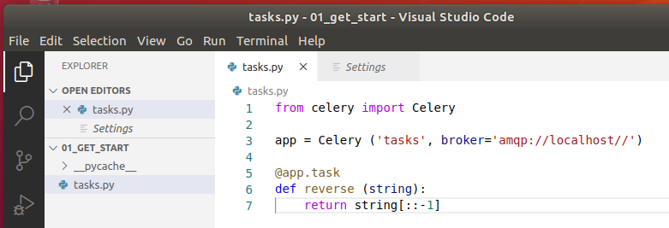
1.3 Write Celery Application
https://www.youtube.com/watch?v=fg-JfZBetpM&list=PL4uZgY9g0XkfTXZ3uh5jOByL8oSYFnKR7
Write Celery Application
After the RabbitMQ and Celery installed, we can start to write our application.
> from celery import Celery
> app = Celery (‘tasks’, broker=‘amqp://localhost//’)
> @app.task
> def reverse(string):
> return string[::-1]

Slide 22
1.4 Run reverse() without Celery

Slide 23
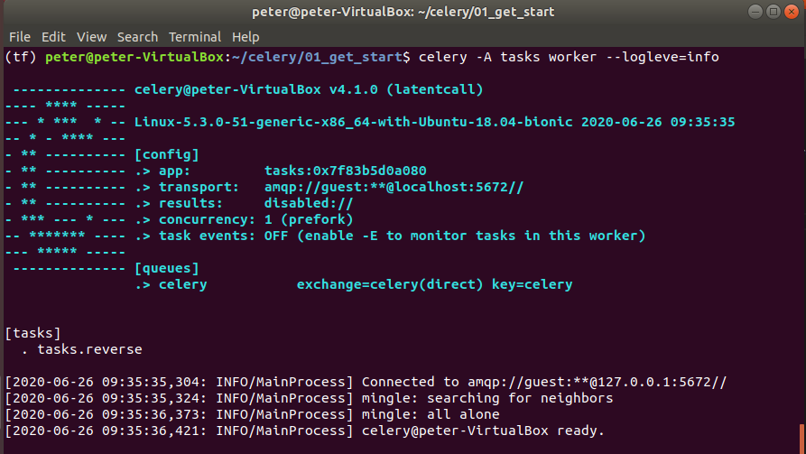
1.4 Run reverse() without Celery
https://www.youtube.com/watch?v=fg-JfZBetpM&list=PL4uZgY9g0XkfTXZ3uh5jOByL8oSYFnKR7
Run reverse() without Celery
Start celery and tell which task to be executed.
> celery -A task-name worker log-information
> celery -A tasks worker --loglevel=info
This will be the background Celery server.
Keep the Celery remote server open

Slide 24
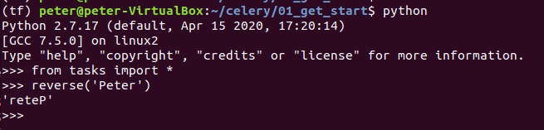
1.4 Run Reverse() without Celery
https://www.youtube.com/watch?v=fg-JfZBetpM&list=PL4uZgY9g0XkfTXZ3uh5jOByL8oSYFnKR7
Run reverse() without Celery
Open another terminal
> conda activate tf
(tf) [work-path] > python
(rf) >>> from tasks import *
(tf) >>> reverse (‘Peter’)
‘reteP’
>>>
In this case, we did not use Celery to execute the reverse() function.

Slide 25
1.5 Run reverse() With Celery

Slide 26
1.5 Run reverse() With Celery
https://www.youtube.com/watch?v=fg-JfZBetpM&list=PL4uZgY9g0XkfTXZ3uh5jOByL8oSYFnKR7
Run reverse() with Celery
Function reverse() can ebe very expensive process and cane be take minutes to run.
You will not want the user of your application just sit there and wait for it to complete before they can continue doing something.
That is why the celery is used in this place.
Currently, the reverse() does not do anything intensive but you have something, such as, sending an emails or adding a bunch of data to database, then you will want to use celery for put these tasks into background process.
To put this tasks into background process, instead of just calling reverse(), instead, we use reverse.delay().
The reserve() has nothing to do with Celery, however, revers.delay() is related to Celery. Celery put reverse.delay() into the background process, i.e., run background process asynchronously.

Slide 27
1.5 Run reverse() With Celery
https://www.youtube.com/watch?v=fg-JfZBetpM&list=PL4uZgY9g0XkfTXZ3uh5jOByL8oSYFnKR7
Run reverse() with Celery
The Celery @app.task adds the delay method to your function reverse() and allows you to call delay method.
The Celery will pick reverse() up and put reverse.delay() and associated message to the message queue.
So, reverse.delay() add into the message queue and then Celery will pick up that message and execute the task.

Slide 28
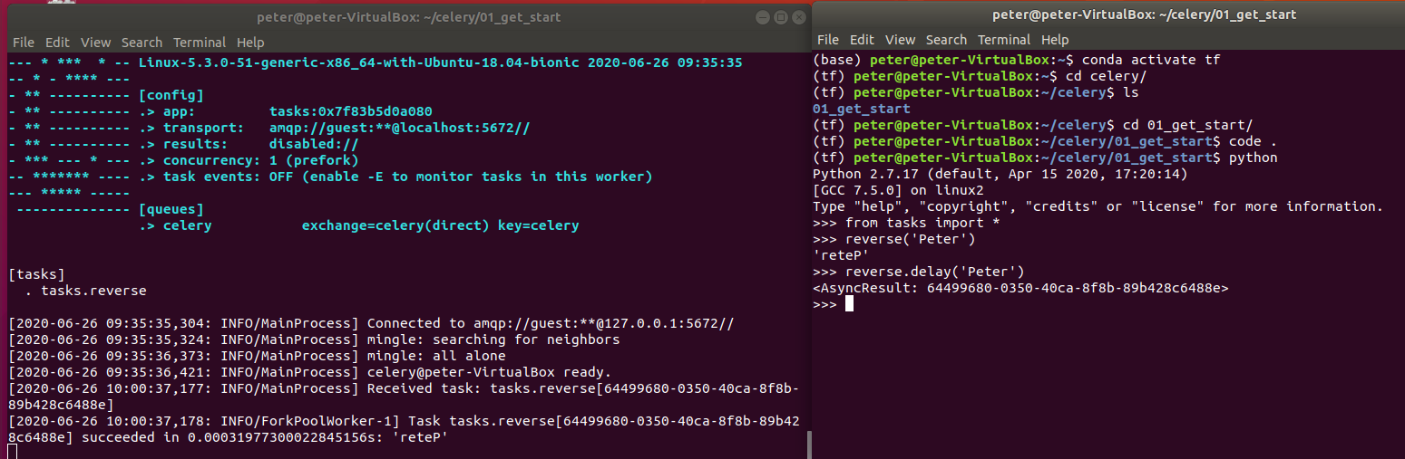
1.5 Run reverse() With Celery
https://www.youtube.com/watch?v=fg-JfZBetpM&list=PL4uZgY9g0XkfTXZ3uh5jOByL8oSYFnKR7
Run reverse() with Celery
So, we will call this again. The revers.delay (‘Peter’).
We are calling the function. All the parameters are inside the a delay but it passed to the reverse(). That is a little bit strange.
Everything that you can pass into the function you create. It just goes as an argument to delay().

Slide 29
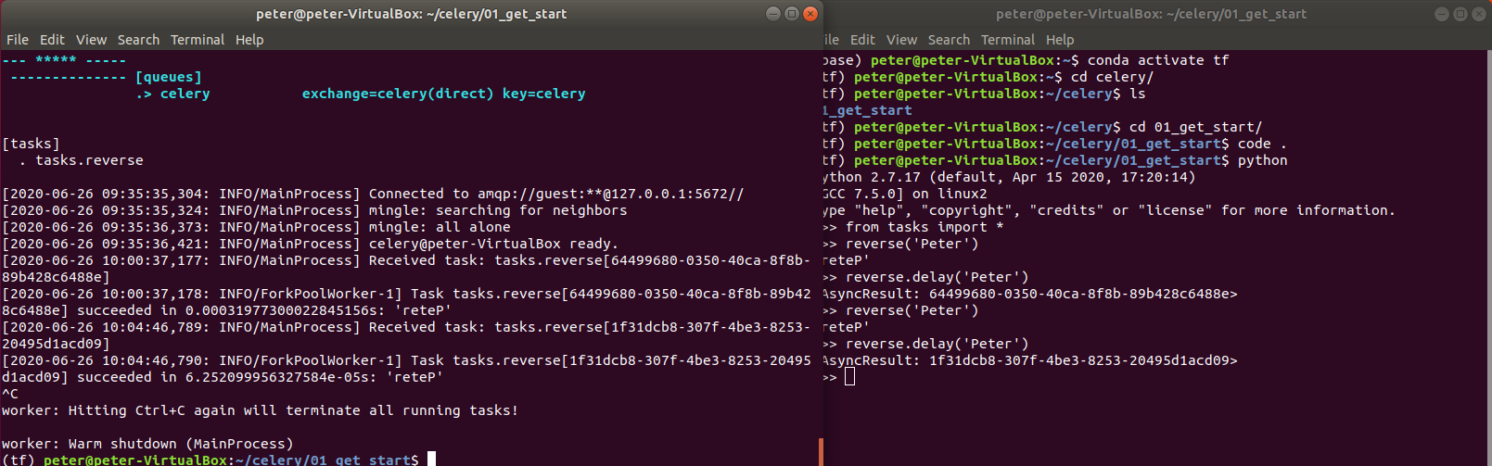
1.5 Run reverse() With Celery
https://www.youtube.com/watch?v=fg-JfZBetpM&list=PL4uZgY9g0XkfTXZ3uh5jOByL8oSYFnKR7
Run reverse() with Celery
Once we run this, it gets sent to the message queue and then celery will pick it up.
We see this async result and it has an ID for it.
We are not worry about the ID.
We do not see the result of reverse.delay(), we can control-C to see the result.

Slide 30
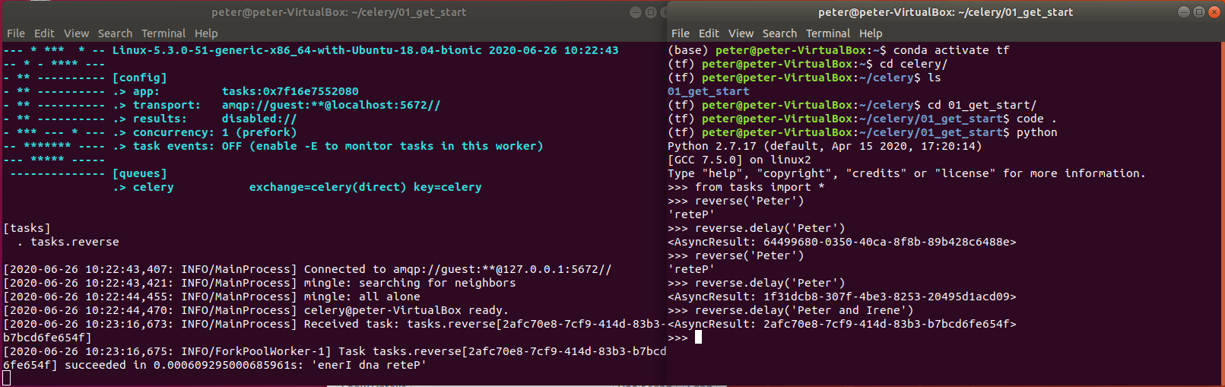
1.5 Run reverse() With Celery
https://www.youtube.com/watch?v=fg-JfZBetpM&list=PL4uZgY9g0XkfTXZ3uh5jOByL8oSYFnKR7
Run reverse() with Celery
We can send reverse.delay (‘Peter and Irene’)
We can see result on the let hand side: ‘enerI dna reterP’

Slide 31
1.5 Run reverse() With Celery
https://www.youtube.com/watch?v=fg-JfZBetpM&list=PL4uZgY9g0XkfTXZ3uh5jOByL8oSYFnKR7
Run reverse() with Celery
This function does not store any queue yet.
We need to do control-C once and then we can see the result.
We will save the result and verify in the next discussion.

Slide 32
1.6 Quiz

Slide 33
1.6 Quiz
https://www.youtube.com/watch?v=fg-JfZBetpM&list=PL4uZgY9g0XkfTXZ3uh5jOByL8oSYFnKR7
Quiz
1. What are the three components to run Celery?
Ans: Celery needs three things:
a). Client App: Call asynchronously.
b). Message queue: Whenever you have a call something, it will put on the message queue.
c). Celery: Celery will listen to message queue. Looking for new tasks to execute and once it has one, celery will run it outside your app.
2. Which component is the message broker?
Ans: RabbitMQ
3. What is Celery do?
Ans: Put your task to the message broker RabbitMQ.

Slide 34
1.6 Quiz
https://www.youtube.com/watch?v=fg-JfZBetpM&list=PL4uZgY9g0XkfTXZ3uh5jOByL8oSYFnKR7
Quiz
4. What is the command to install rabbitmq server?
Ans: sudo apt-get install rabbitmq-server
5. What is command to verify the rabbitmq-server?
Ans: dpkg –s rabbitmq-server | grep Version

Slide 35
1.6 Quiz
https://www.youtube.com/watch?v=fg-JfZBetpM&list=PL4uZgY9g0XkfTXZ3uh5jOByL8oSYFnKR7
Quiz
6. Do we need to install Erlang in Window-10 before Celery installation?
Ans: Yes
7. Do we need to install Erlang in Ubuntu Linux before Celery installation?
Ans: No
8. What command is used to check Erlang installation?
Ans: erl
9. What is the command to install Celery server?
Ans: sudo apt python-celery-common
10. What command is used to verify the Celery version?
Ans: celery --version

Slide 36
End of Chapter

