Slide 1

34 Normal Distribution
Peter H. Chen

Slide 2
34 Normal Distribution
https://www.tutorialspoint.com/python_data_science/python_normal_distribution.htm
Normal Distribution
The normal distribution is a form presenting data by arranging the probability distribution of each value in the data.
Most values remain around the mean value making the arrangement symmetric.

Slide 3
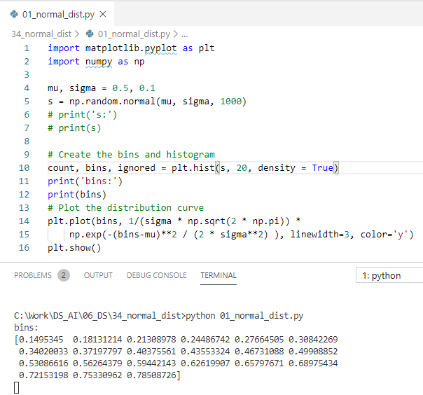
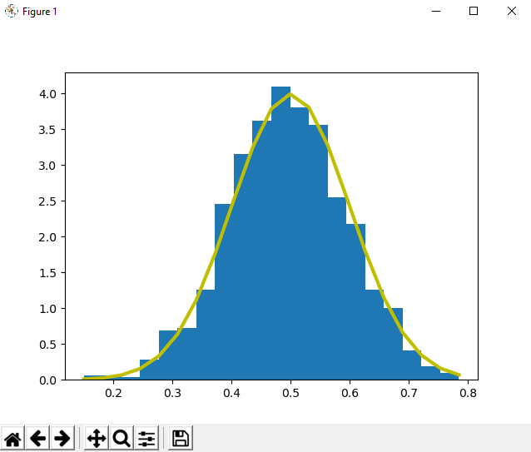
34 Normal Distribution
https://www.tutorialspoint.com/python_data_science/python_normal_distribution.htm
Normal Distribution
Plot normalized bin for hist().
Plot pdf (probability density function) curve.

Slide 4
End of Chapter

