Slide 1

37 Bernoulli Distribution
Peter H. Chen

Slide 2
37 Bernoulli Distribution
https://www.tutorialspoint.com/python_data_science/python_bernoulli_distribution.htm
Bernoulli Distribution
The Bernoulli distribution is a special case of the Binomial distribution where a single experiment is conducted so that the number of observation is 1.
So, the Bernoulli distribution therefore describes events having exactly two outcomes.
We use various functions in numpy library to mathematically calculate the values for a bernoulli distribution.
Histograms are created over which we plot the probability distribution curve.

Slide 3
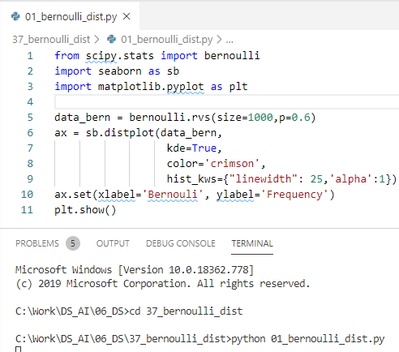
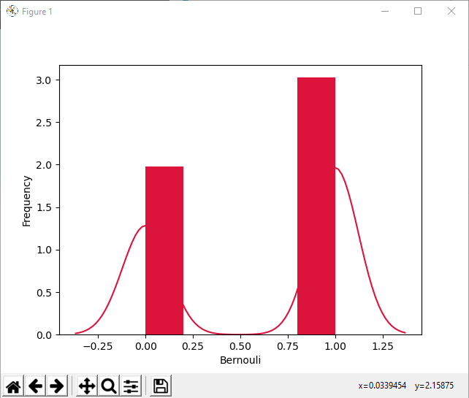
37 Bernoulli Distribution
https://www.tutorialspoint.com/python_data_science/python_bernoulli_distribution.htm
Bernoulli Distribution

Slide 4
End of Chapter

