Slide 1

31 Graph Data
Peter H. Chen

Slide 2
31 Graph Data
https://www.tutorialspoint.com/python_data_science/python_graph_data.htm
Graph Data
CSGraph stands for Compressed Sparse Graph, which focuses on Fast graph algorithms based on sparse matrix representations.
Graph Representations
What is a sparse graph?
A graph is just a collection of nodes, which have links between them.
Graphs can represent nearly anything − social network connections, where each node is a person and is connected to acquaintances;
images, where each node is a pixel and is connected to neighboring pixels; points in a high-dimensional distribution, where each node is connected to its nearest neighbors and practically anything else you can imagine.
One very efficient way to represent graph data is in a sparse matrix: let us call it G. The matrix G is of size N x N, and G[i, j] gives the value of the connection between node ‘i' and node ‘j’. A sparse graph contains mostly zeros − that is, most nodes have only a few connections.
This property turns out to be true in most cases of interest.

Slide 3
31 Graph Data
https://www.tutorialspoint.com/python_data_science/python_graph_data.htm
Graph Data
The creation of the sparse graph submodule was motivated by several algorithms used in scikit-learn that included the following:
Isomap − A manifold learning algorithm, which requires finding the shortest paths in a graph.
Hierarchical clustering − A clustering algorithm based on a minimum spanning tree.
Spectral Decomposition − A projection algorithm based on sparse graph laplacians.

Slide 4
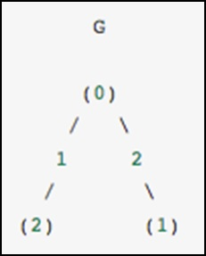
31 Graph Data
https://www.tutorialspoint.com/python_data_science/python_graph_data.htm
Graph Data
This graph has three nodes, where node 0 and 1 are connected by an edge of weight 2, and nodes 0 and 2 are connected by an edge of weight 1.
We can construct the dense, masked and sparse representations as shown in the following example, keeping in mind that an undirected graph is represented by a symmetric matrix.

Slide 5
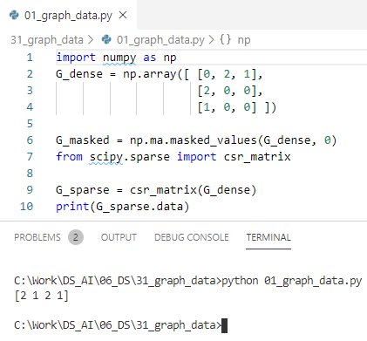
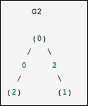
31 Graph Data
https://www.tutorialspoint.com/python_data_science/python_graph_data.htm
Graph Data
This code output [ 2 1 2 1], same as the graph.

Slide 6
End of Chapter

