Slide 1

12 XLSX Data
Peter H. Chen

Slide 2
12 XLSX Data
https://www.tutorialspoint.com/python_data_science/python_processing_xls_data.htm
Read XLSX Data
XLSX (EXceL Spreadsheet XML) Format is Microsoft Excel Spreadsheet XML format.
XLSX supports multiple spreadsheets (tables/relations). Each spreadsheet is a table (relation).
Pandas uses read_excel function to read XLSX format.
Note:
XLSX is a binary file format created by eXcel.
XLSX is not readable in text editor.

Slide 3
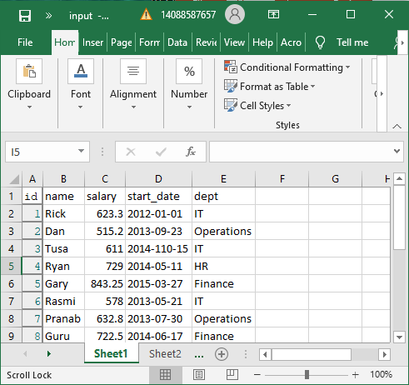
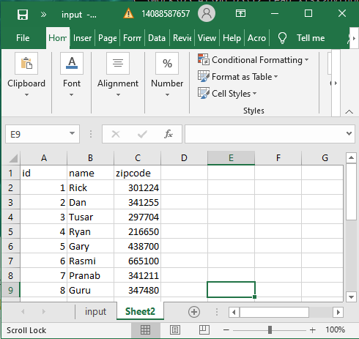
12 XLSX Data
https://www.tutorialspoint.com/python_data_science/python_processing_xls_data.htm
Create XLSX File
Create xlsx_data/input.xlsx file: Sheet1 and Sheet2

Slide 4
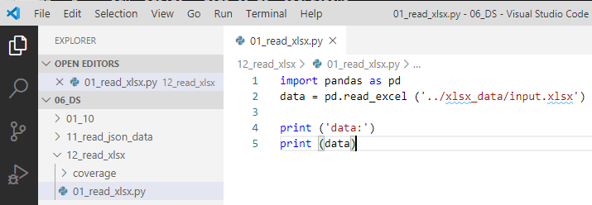
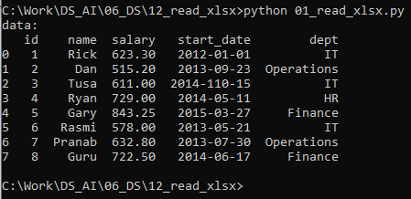
12 XLSX Data
https://www.tutorialspoint.com/python_data_science/python_processing_xls_data.htm
Read XLSX File
> import pandas as pd
> data = pd.read_excel (‘../xlsx_data/file_example_XLSX_10.xlsx)
> print (data)

Slide 5
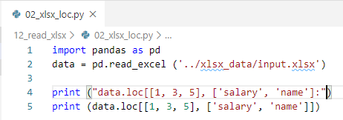
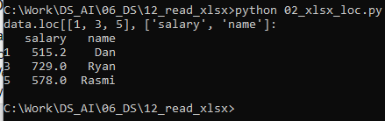
12 XLSX Data
https://www.tutorialspoint.com/python_data_science/python_processing_xls_data.htm
Select Rows and columns by loc
> import pandas as pd
> data = pd.read_excel (‘../xlsx_data/file_example_XLSX_10.xlsx)
> print (data.loc[[1, 3, 5], ['salary', 'name']])

Slide 6
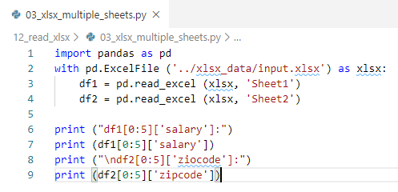
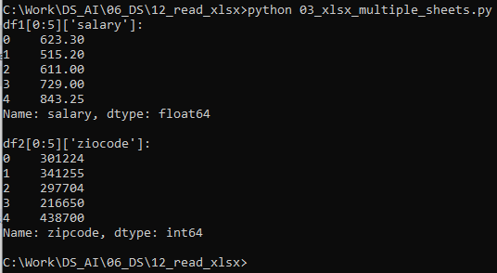
12 XLSX Data
https://www.tutorialspoint.com/python_data_science/python_processing_xls_data.htm
Read Multiple Excell Sheets
> import pandas as pd
> data = pd.read_excel (‘../xlsx_data/file_example_XLSX_10.xlsx)
> print (data.loc[[1, 3, 5], ['salary', 'name']])

Slide 7
End of Chapter

