Slide 1

23 Chart Styling
Peter H. Chen

Slide 2
23 Chart Styling
https://www.tutorialspoint.com/python_data_science/python_chart_styling.htm
Chart Styling
The charts created in python can have style by using some appropriate methods from the libraries.
We discuss the implementation of Annotation, legends, and chart background.

Slide 3
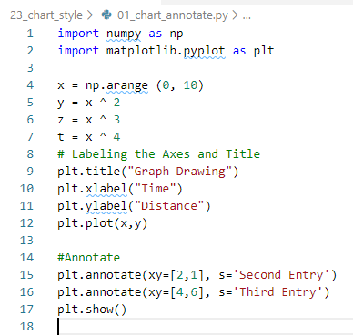
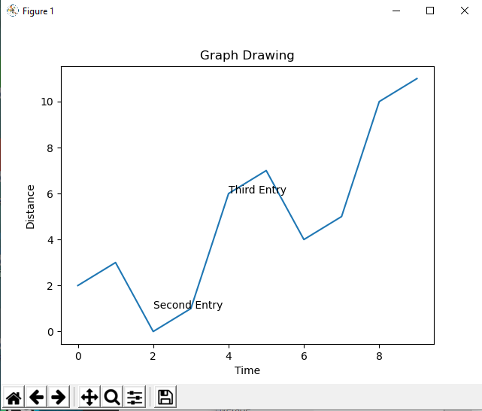
23 Chart Styling
https://www.tutorialspoint.com/python_data_science/python_chart_styling.htm
Add Annotation
Annotate the chart by specific location at xy=[2,1] and xy=[4,6]

Slide 4
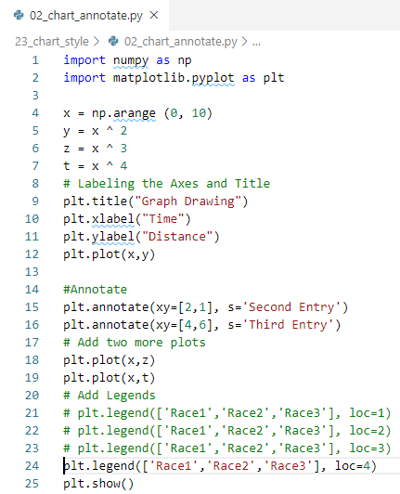
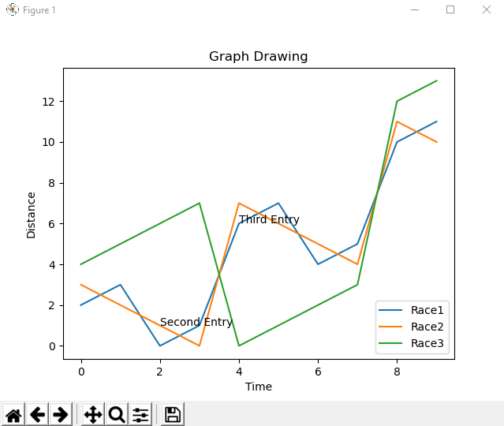
23 Chart Styling
https://www.tutorialspoint.com/python_data_science/python_chart_styling.htm
Add Legend
Legend corner: loc = 1 (right-top), loc = 2 (left-top), loc = 3 (left-bottom), loc = 4 (right-bottom)

Slide 5
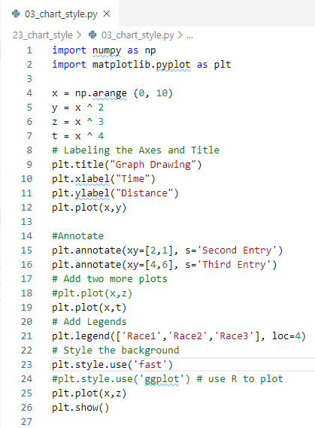
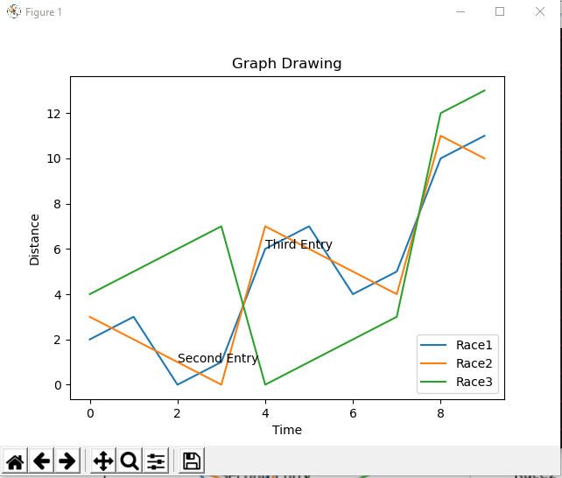
23 Chart Styling
https://www.tutorialspoint.com/python_data_science/python_chart_styling.htm
Plot by Style
plt.style.use (‘fast’) # exploratory graph
plt.style.use(‘ggplot’) # plot by R

Slide 6
End of Chapter

