Slide 1

22 Chart Property
Peter H. Chen

Slide 2
22 Chart Property
https://www.tutorialspoint.com/python_data_science/python_chart_properties.htm
Chart Properties
Python has excellent libraries for data visualization.
A combination of Pandas, numpy, and matplotlib create visualizations charts.

Slide 3
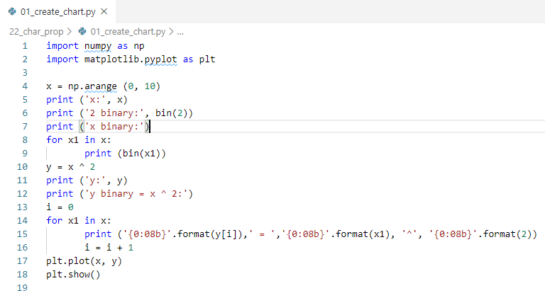
22 Chart Property
https://www.tutorialspoint.com/python_data_science/python_chart_properties.htm
Create a Chart
> python 01_create_chart.py

Slide 4
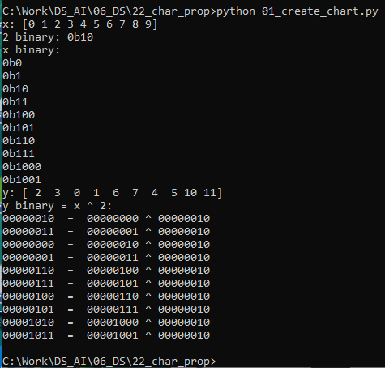
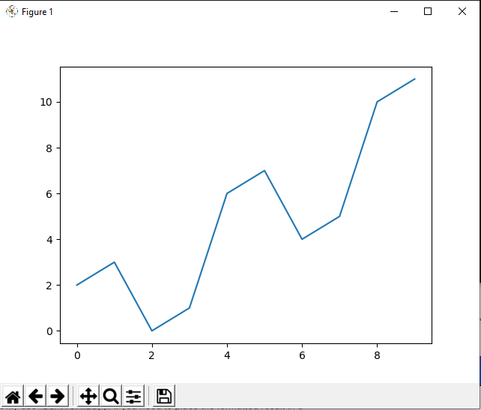
22 Chart Property
https://www.tutorialspoint.com/python_data_science/python_chart_properties.htm
Create a Chart
> python 01_create_chart.py

Slide 5
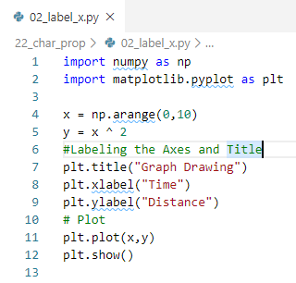
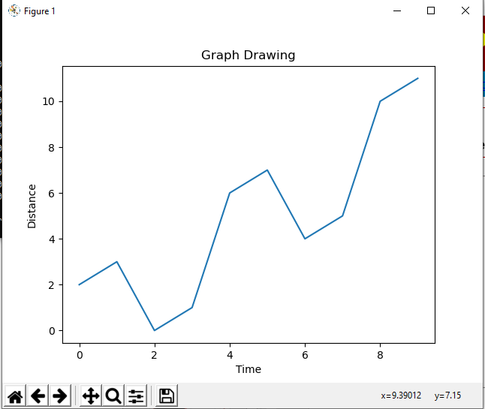
22 Chart Property
https://www.tutorialspoint.com/python_data_science/python_chart_properties.htm
Label
> python 02_label_axes.py

Slide 6
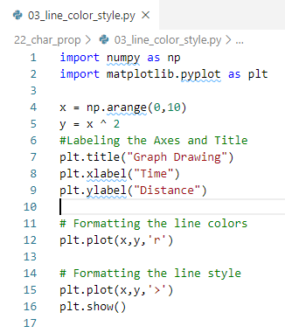
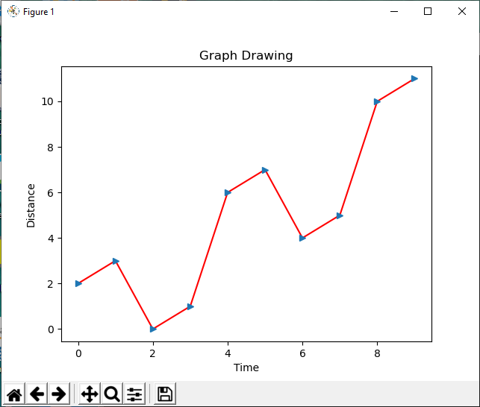
22 Chart Property
https://www.tutorialspoint.com/python_data_science/python_chart_properties.htm
Label
> python 03_line_color_style.py

Slide 7
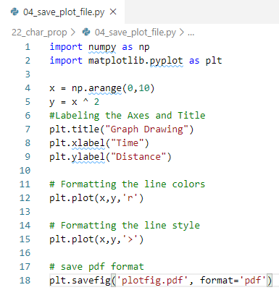
22 Chart Property
https://www.tutorialspoint.com/python_data_science/python_chart_properties.htm
Label
> python 04_save_plot_file.py

Slide 8
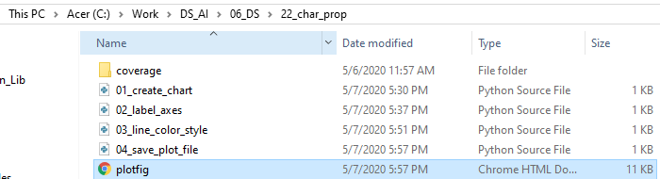
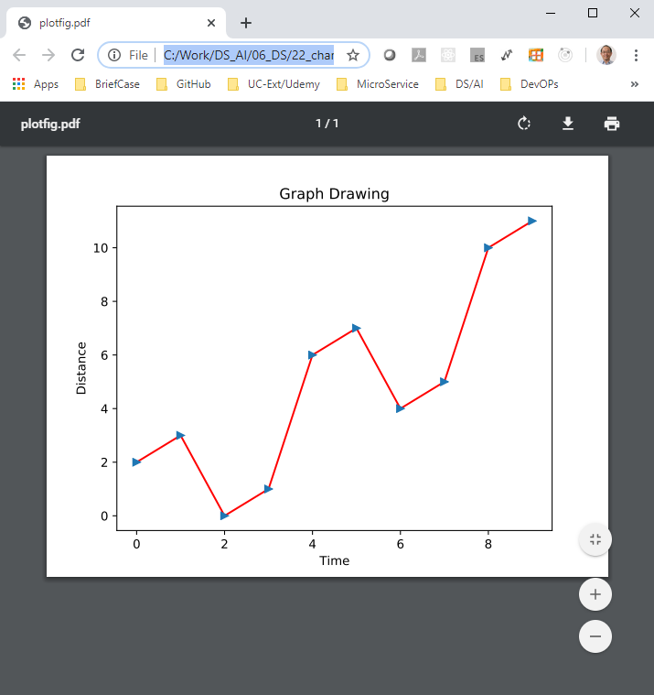
22 Chart Property
https://www.tutorialspoint.com/python_data_science/python_chart_properties.htm
Label
> python 04_save_plot_file.py

Slide 9
End of Chapter

