Slide 1

28 3D Chart
Peter H. Chen

Slide 2
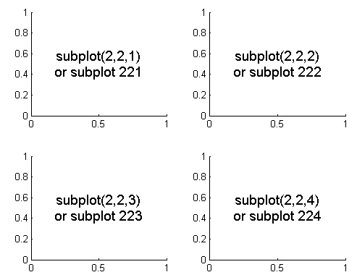
28 3D Chart
https://www.tutorialspoint.com/python_data_science/python_3d_charts.htm
3D Chart
3D plot by 3dPlot
# https://stackoverflow.com/questions/3584805/in-matplotlib-what-does-the-argument-mean-in-fig-add-subplot111
# 111: 1x1 grid, first subplot
# 234: 2x3 grid, 4th subplot
chart3d = chart.add_subplot(111, projection='3d')

Slide 3
28 3D Chart
https://www.tutorialspoint.com/python_data_science/python_3d_charts.htm
3D Chart
https://www.programcreek.com/python/example/106542/mpl_toolkits.mplot3d.axes3d.get_test_data
https://rallion.bitbucket.io/hortators/the_tuna/explorations/api/mpl_toolkits.mplot3d.axes3d.get_test_data.html
> axes3d.Get_test_data (delta=0.05)
https://matplotlib.org/mpl_toolkits/mplot3d/tutorial.html
Wire frame plot (rstride and cstride)
The rstride (row stride) and cstride (column stride) set the stride used to sample the input data to generate the graph.

Slide 4
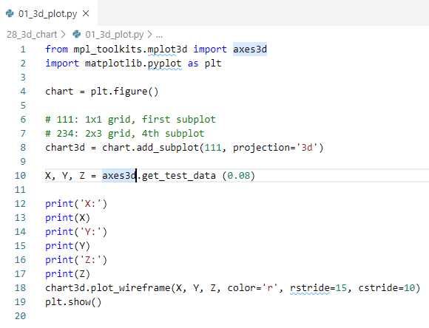
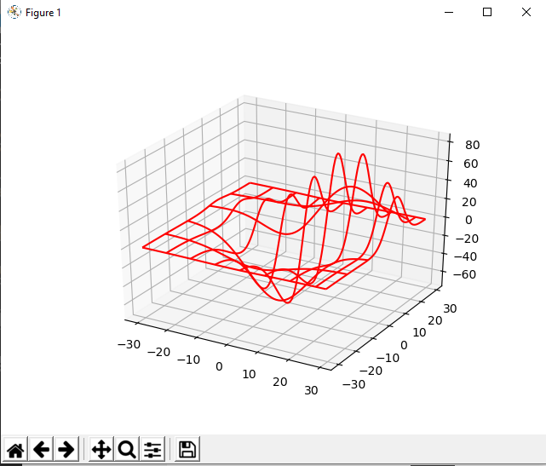
28 3D Chart
https://www.tutorialspoint.com/python_data_science/python_3d_charts.htm
3D Chart
3D plot by 3dPlot

Slide 5
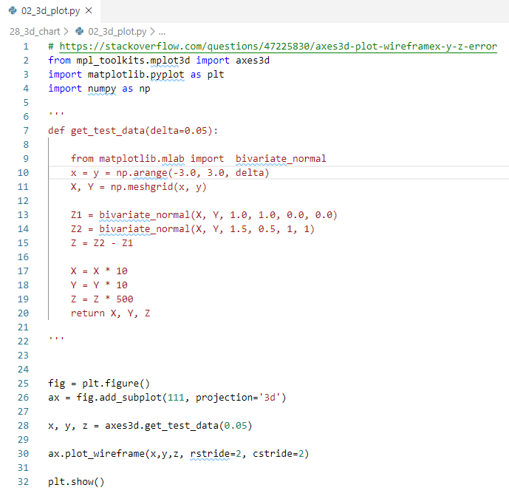
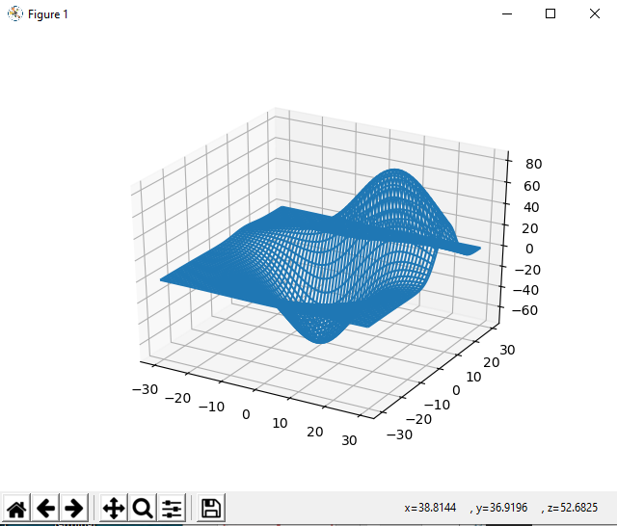
28 3D Chart
https://www.tutorialspoint.com/python_data_science/python_3d_charts.htm
3D Chart
3D plot by 3dPlot

Slide 6
End of Chapter

