Slide 1

21 Stemming and Lemmatization
Peter H. Chen

Slide 2
21 Stemming and Lemmatization
https://www.tutorialspoint.com/python_data_science/python_stemming_and_lemmatization.htm
Stemming and Lemmatization
Stemming: two or more words have a common root. For example, the three words - agreed, agreeing and agreeable have the same root word agree. A search involving any of these words should treat them as the same word which is the root word. So it becomes essential to link all the words into their root word. The NLTK library has methods to do this linking and give the output showing the root word.
Lemmatization: Link words with similar meaning to one word. For example, if a paragraph has words like cars, trains, and automobile, then it will link all of them to automobile.

Slide 3
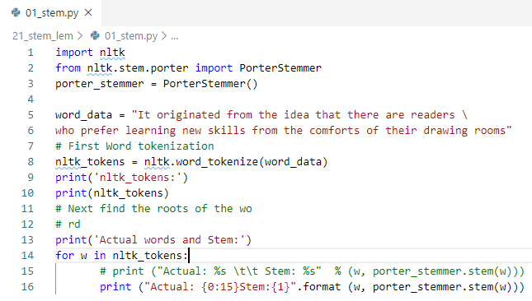
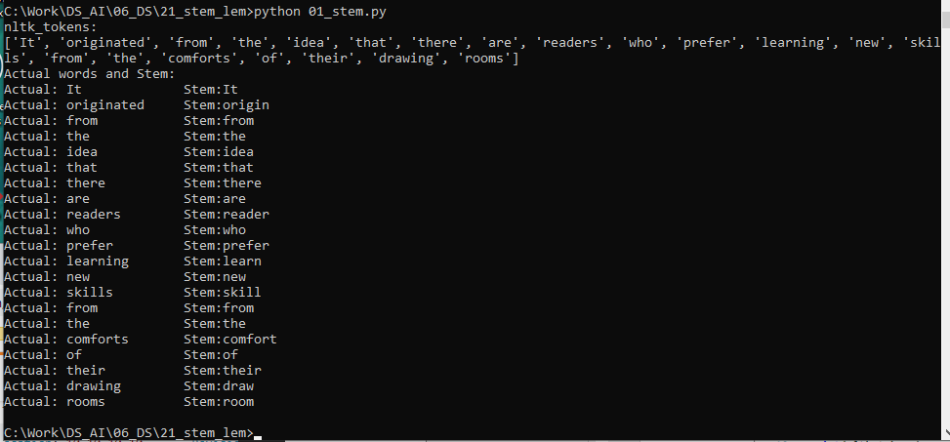
21 Stemming and Lemmatization
https://www.tutorialspoint.com/python_data_science/python_stemming_and_lemmatization.htm
Stemming by PoerStemmer

Slide 4
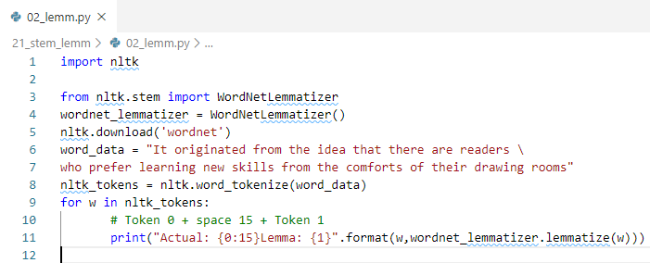
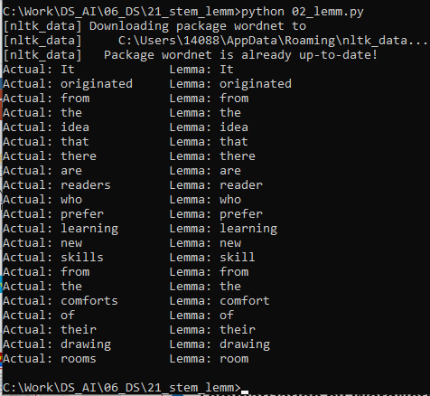
21 Stemming and Lemmatization
https://www.tutorialspoint.com/python_data_science/python_stemming_and_lemmatization.htm
Lemmatization by WordNetLemmatizer

Slide 5
End of Chapter

