Slide 1

24 Box Plot
Peter H. Chen

Slide 2
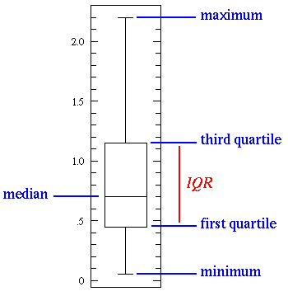
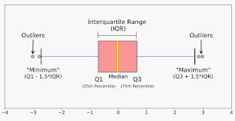
24 Box Plot
https://www.tutorialspoint.com/python_data_science/python_box_plots.htm
Box Plot
Box Plots are a measure the distribution of the data in a data set.
Box Plots are divided into three quartiles (4-separated parts).
The graph represents the minimum, maximum, median, first quartile, and third quartile in the data set.
(InterQuartile Range)

Slide 3
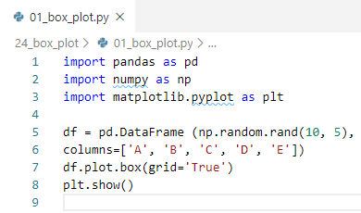
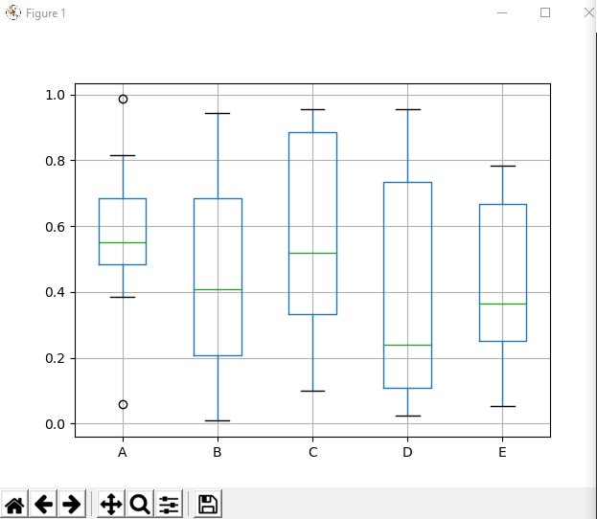
23 Chart Styling
https://www.tutorialspoint.com/python_data_science/python_chart_styling.htm
Add Annotation
Annotate the chart by specific location at xy=[2,1] and xy=[4,6]

Slide 4
End of Chapter

