Slide 1

30 Geographical Data
Peter H. Chen

Slide 2
30 Geographical Data
https://www.tutorialspoint.com/python_data_science/python_geographical_data.htm
Geographical Data
Many open source python libraries now have been created to represent the geographical maps.
These libraries are highly customizable and offer a variety of maps depicting areas in different shapes and colors.
Cartopy is a Python package designed for geospatial data processing in order to produce maps and other geospatial data analyses.
https://github.com/SciTools/cartopy
Download cartopy from github, unzipped.
> cd cartopy
> pip install proj
> pip install Cpython
> pip install catopy
Cartopy documents:
https://scitools.org.uk/cartopy/docs/latest/

Slide 3
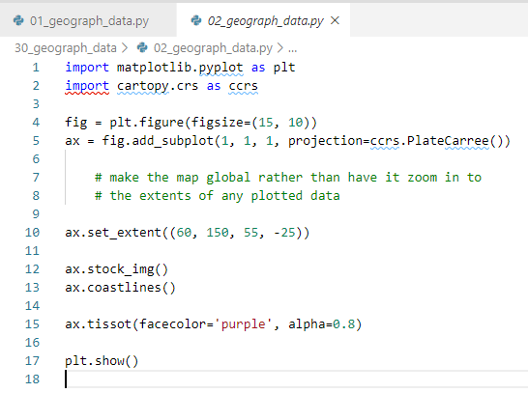
30 Geographical Data
https://www.tutorialspoint.com/python_data_science/python_geographical_data.htm
Geographical Data
The following import of cartopy.crs does not work under window and Linux.
Download from github does not work either.
The following code is not ready. Do not try it.

Slide 4
End of Chapter

