Slide 1

33 Variance
Peter H. Chen

Slide 2
33 Variance
https://www.tutorialspoint.com/python_data_science/python_measuring_variance.htm
Measure Variance
In statistics, variance is a measure of how far a value in a data set lies from the mean value.
In other words, the variance indicates how dispersed the values are. It is measured by using standard deviation. The other method commonly used is skewness.
Both of these are calculated by using functions available in pandas library.

Slide 3
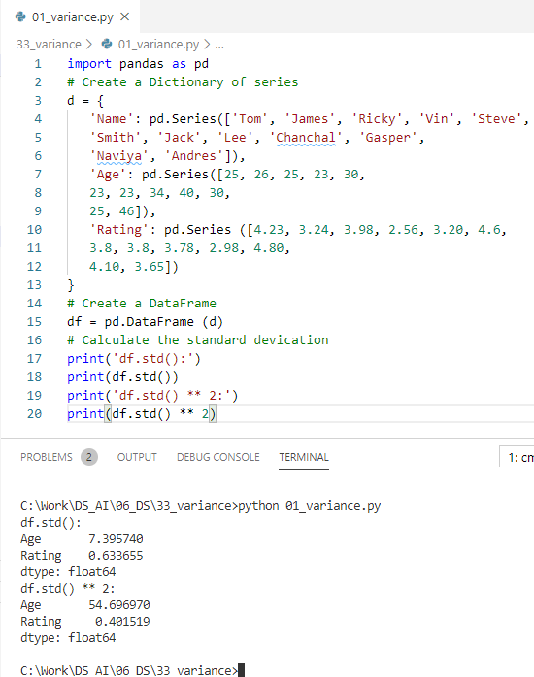
33 Variance
https://www.tutorialspoint.com/python_data_science/python_measuring_variance.htm
Measure Variance
Standard deviation: sd
Variance = (sd) ** 2

Slide 4
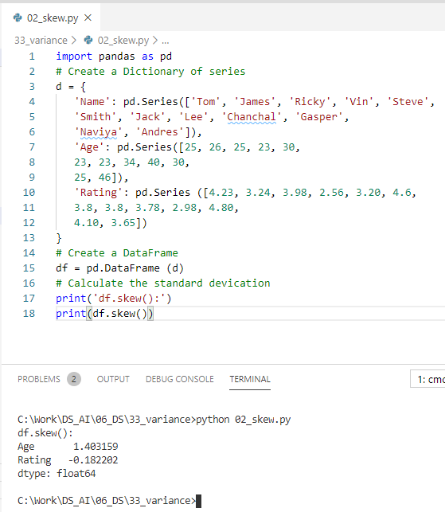

33 Variance
https://www.tutorialspoint.com/python_data_science/python_measuring_variance.htm
Measure Variance
Skewness

Slide 5
End of Chapter

