Slide 1
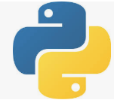
13 Relational Database
Peter H. Chen

Slide 2
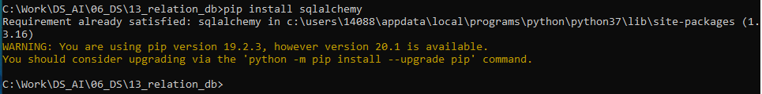
13 Relational Database
https://www.tutorialspoint.com/python_data_science/python_relational_databases.htm
Relational Database
Install Realtional Database framework sqlalchemy:
> pip install sqlalchemy
Or
> conda install sqlalchemy

Slide 3
13 Relational Database
https://www.tutorialspoint.com/python_data_science/python_relational_databases.htm
Reading Tables from Relational Database
We use sqlite3 as the relational database.
The sqlite3 is a light weight database.
The sqlalchemy connect the variety of relational database including MySQL, Oracle, Postgresql, and Mssql.
We first create a database engine and then connect to database engine using to_sql function of SQLAlchemy.

Slide 4
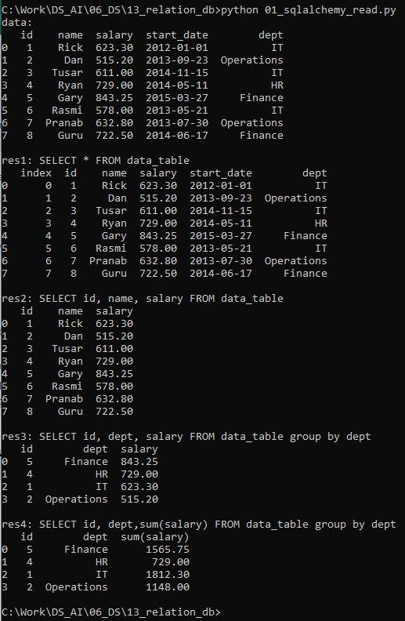
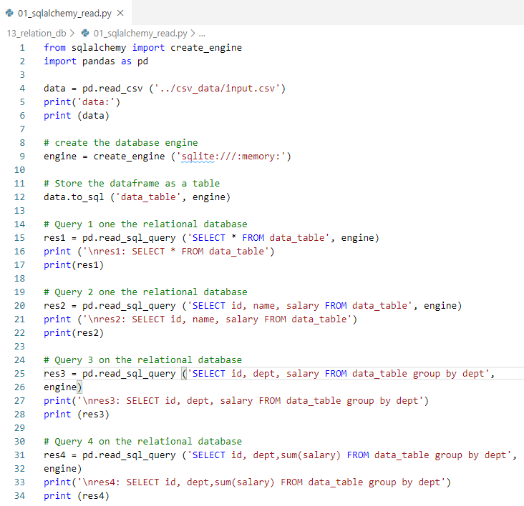
13 Relational Database
https://www.tutorialspoint.com/python_data_science/python_relational_databases.htm
Reading Tables from Relational Database

Slide 5
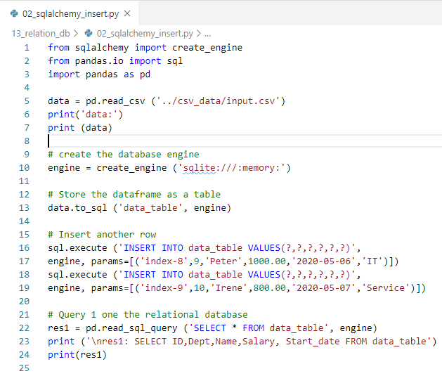
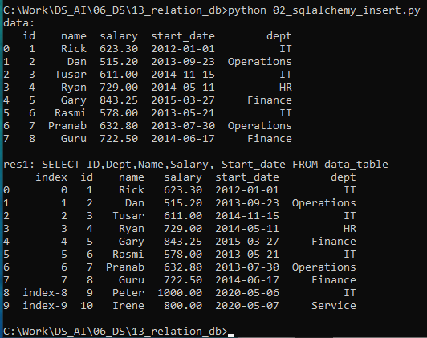
13 Relational Database
https://www.tutorialspoint.com/python_data_science/python_relational_databases.htm
Insert Data to Tables of Relational Database

Slide 6
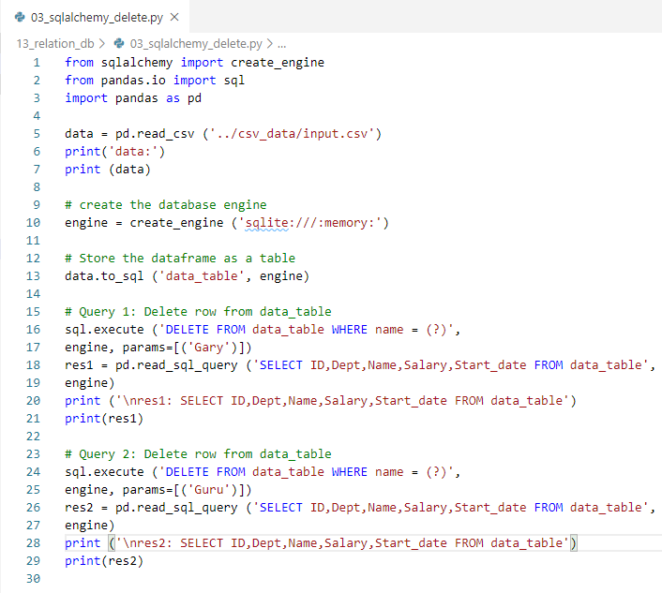
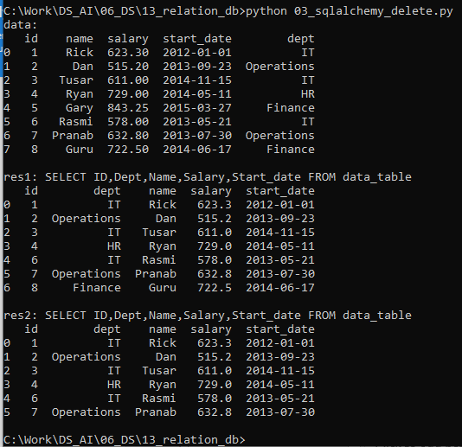
13 Relational Database
https://www.tutorialspoint.com/python_data_science/python_relational_databases.htm
Delete Data to Tables of Relational Database

Slide 7
End of Chapter

