Slide 1

26 Scatter Plot
Peter H. Chen

Slide 2
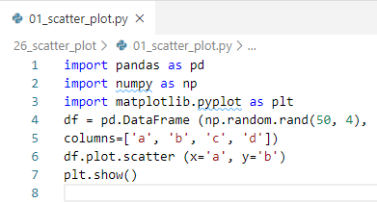
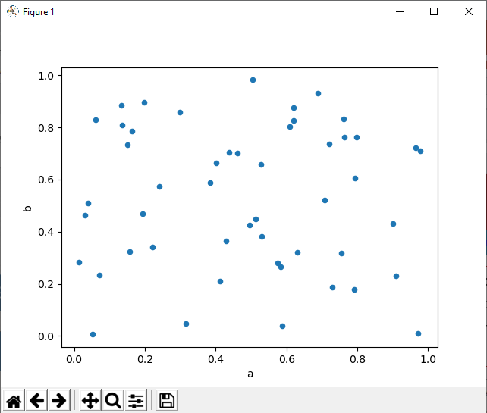
26 Scatter Plot
https://www.tutorialspoint.com/python_data_science/python_scatter_plots.htm
Scatter Plot
Scatter plot show the plot the Cartesian Plot.
Each point represents by two variables, on e for horizontal axis and another in vertical axis.

Slide 3
End of Chapter

