Slide 1

9 Data Clean
Peter H. Chen

Slide 2
9 Data Clean
https://www.tutorialspoint.com/python_data_science/python_data_cleansing.htm
Data Clean
Missing data is always a problem in real life scenarios.
Areas like machine learning and data mining face severe issues in the accuracy of their model predictions because of poor quality of data caused by missing values.
In these areas, missing value treatment is a major point of focus to make their models more accurate and valid.
When and Why Is Data Missed?
Let us consider an online survey for a product.
Many a times, people do not share all the information related to them.
Few people share their experience, but not how long they are using the product; few people share how long they are using the product, their experience but not their contact information.
Thus, in some or the other way a part of data is always missing, and this is very common in real time.

Slide 3
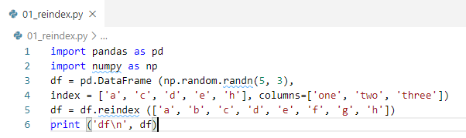
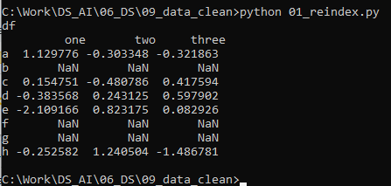
9 Data Clean
https://www.tutorialspoint.com/python_data_science/python_data_cleansing.htm
Handle missing values, e.g., NA or NaN, using Pandas
Using reindexing, we have created a DataFrame with missing values. In the output, NaN means Not a Number.

Slide 4
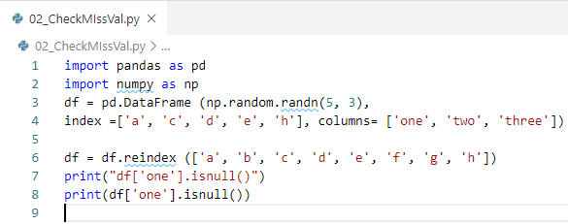
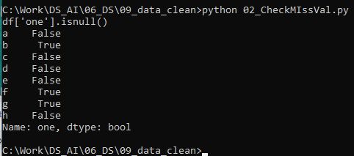
9 Data Clean
https://www.tutorialspoint.com/python_data_science/python_data_cleansing.htm
Check for Missing Values
To make detecting missing values easier (and across different array dtypes), Pandas provides the isnull() and notnull() functions, which are also methods on Series and DataFrame objects.

Slide 5
9 Data Clean
https://www.tutorialspoint.com/python_data_science/python_data_cleansing.htm
Clean/Fill Missing Data
Pandas provides various methods for cleaning the missing values.
The fillna function can “fill in” NA values with non-null data in a couple of ways.

Slide 6
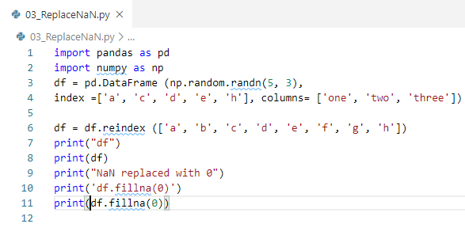
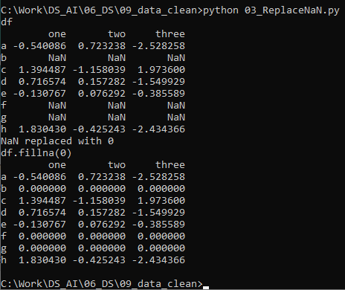
9 Data Clean
https://www.tutorialspoint.com/python_data_science/python_data_cleansing.htm
Replace NaN with Scalar Value

Slide 7
9 Data Clean
https://www.tutorialspoint.com/python_data_science/python_data_cleansing.htm
Fill NaN Forward and Backward
Method | Action
pad/fill | Fill methods Forward
bfill/backfill | Fill methods Backward

Slide 8
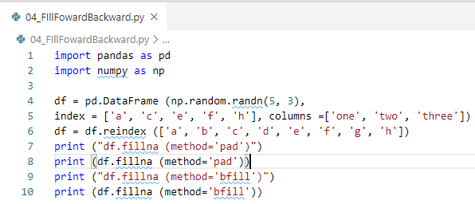
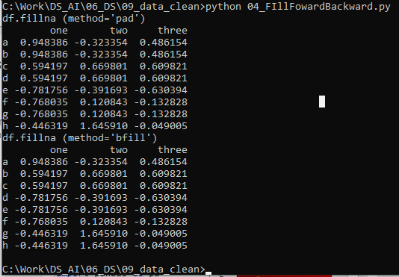
9 Data Clean
https://www.tutorialspoint.com/python_data_science/python_data_cleansing.htm
Fill NaN Forward and Backward

Slide 9
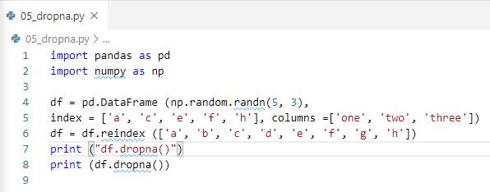
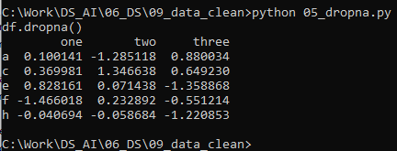
9 Data Clean
https://www.tutorialspoint.com/python_data_science/python_data_cleansing.htm
Drop Missing Values
You can drop the missing values by dropna function.

Slide 10
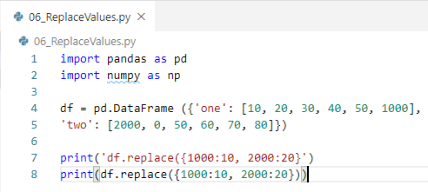
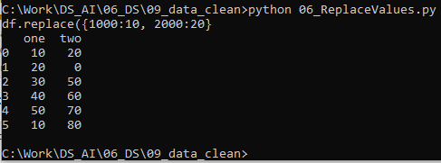
9 Data Clean
https://www.tutorialspoint.com/python_data_science/python_data_cleansing.htm
Replace Values
We can replace value into some other value.

Slide 11
End of Chapter

