Slide 1

7 Matplotlib Library
Peter H. Chen

Slide 2
7 Matplotlib Library
https://www.tutorialspoint.com/python_data_science/python_matplotlib.htm
Matplotlib Library
The Matplotlib is a python library used to create 2D graphs and plots by using python scripts.
The Matplotlib library has a module named pyplot which makes things easy for plotting by providing feature to control line styles, font properties, formatting axes etc.
The Matplotlib library supports a very wide variety of graphs and plots namely - histogram, bar charts, power spectra, error charts etc.
The Matplotlib library is used along with NumPy to provide an environment that is an effective open source alternative for MATLAB.
The Matplotlib library can also be used with graphics toolkits like PyQt and wxPython.
Conventionally, the package is imported into the Python script by adding the following statement
from matplotlib import pyplot as plt

Slide 3
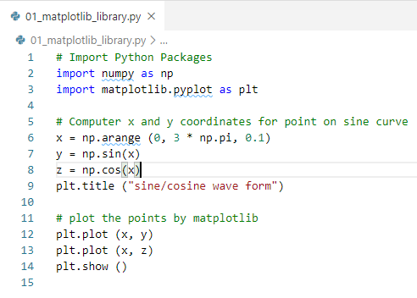
7 Matplotlib Library
https://www.tutorialspoint.com/python_data_science/python_matplotlib.htm
Matplotlib Library Example
The following script produces the sine wave plot using matplotlib

Slide 4
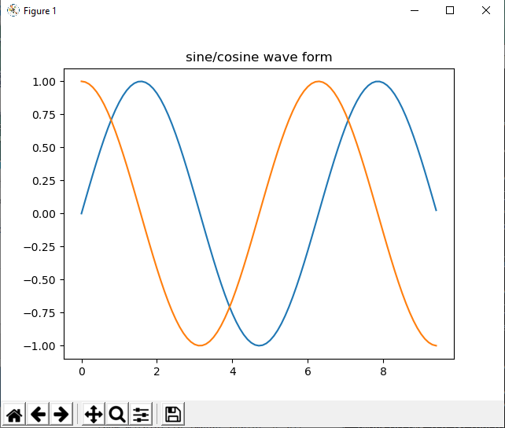
7 Matplotlib Library
https://www.tutorialspoint.com/python_data_science/python_matplotlib.htm
Matplotlib Library Example
Display Result
> python 01_matplotlib_library.py

Slide 5
7 Matplotlib Library
https://www.tutorialspoint.com/python_data_science/python_matplotlib.htm
Matplotlib Library Example
We will discuss more examples of using matplotlib in Data Science.

Slide 6
End of Chapter

