Slide 1

16 Data Wrangle
Peter H. Chen

Slide 2
16 Data Wrangle
https://www.tutorialspoint.com/python_data_science/python_data_wrangling.htm
Data Wrangle
Data wrangling process the data in various formats, such as, merging, grouping, concatenating, and etc.

Slide 3
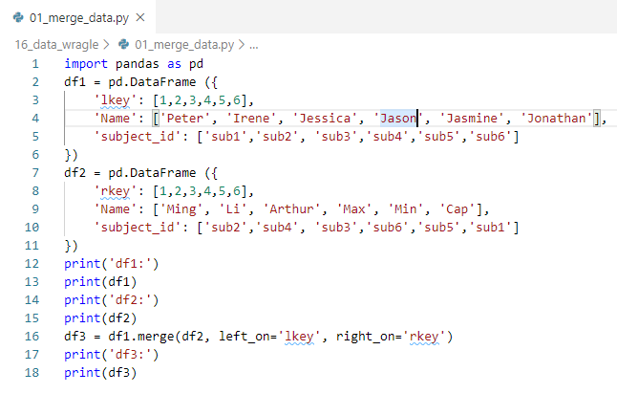
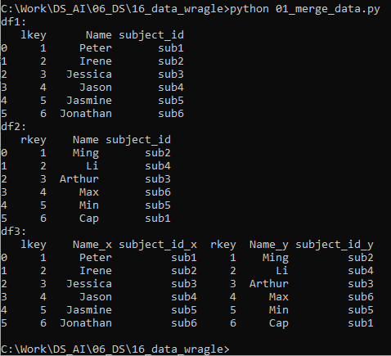
16 Data Wrangle
https://www.tutorialspoint.com/python_data_science/python_data_wrangling.htm
Merge Data
https://pandas.pydata.org/pandas-docs/stable/reference/api/pandas.DataFrame.merge.html

Slide 4
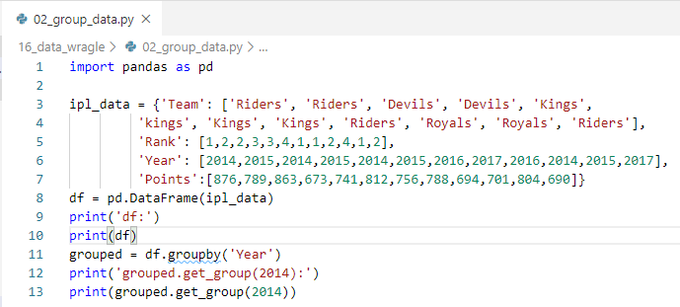
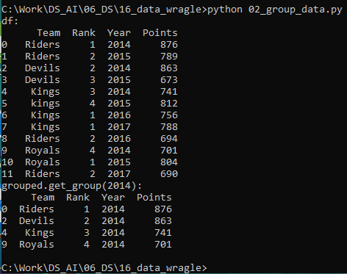
16 Data Wrangle
https://www.tutorialspoint.com/python_data_science/python_data_wrangling.htm
Group Data

Slide 5
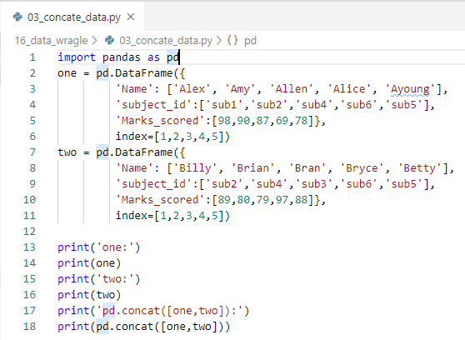
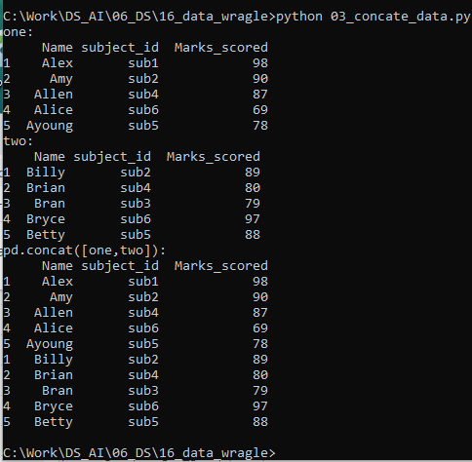
16 Data Wrangle
https://www.tutorialspoint.com/python_data_science/python_data_wrangling.htm
Concatenate Data
The columns order (Name, subjct_id, Makers_scored) keep the same.

Slide 6
End of Chapter

