Slide 1

40 Chi-Square Test
Peter H. Chen

Slide 2
40 Chi-Square Test
https://www.tutorialspoint.com/python_data_science/python_chi_square_test.htm
Chi-Square Test
Chi-Square test is a statistical method to determine if two categorical variables have a significant correlation between them.
Both those variables should be from same population and they should be categorical like − Yes/No, Male/Female, Red/Green etc. For example, we can build a data set with observations on people's ice-cream buying pattern and try to correlate the gender of a person with the flavor of the ice-cream they prefer.
If a correlation is found we can plan for appropriate stock of flavors by knowing the number of gender of people visiting.

Slide 3
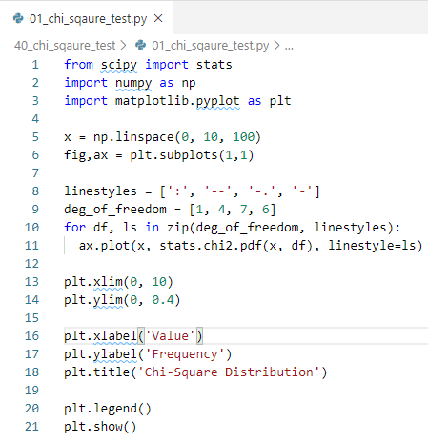
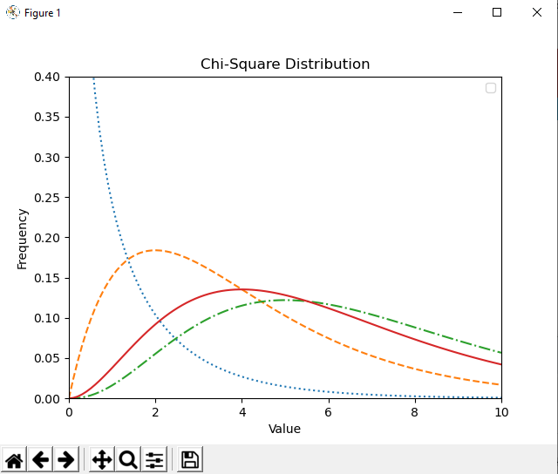
40 Chi-Square Test
https://www.tutorialspoint.com/python_data_science/python_chi_square_test.htm
Chi-Square Test
We use various functions in numpy library to carry out the chi-square test.
The zip () function loop pairs of (deg_of_freedom, linestyles), i.e., (1, ‘:’), (4, ‘—’), (7, ‘-.’), (6, ‘-’) of stats.chi2.pdf function.

Slide 4
End of Chapter

