Slide 1
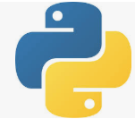
14 NoSQL Database
Peter H. Chen

Slide 2
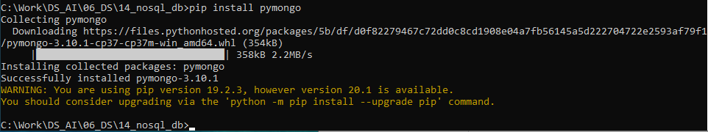
14 NoSQL Database
https://www.tutorialspoint.com/python_data_science/python_nosql_databases.htm
NoSQL Database
NoSQL databases increases as more unstructured or semi-structured increased.
Python interacts with NoSQL databases as interact with Relational SQL Database.
We use MongoDB for NoSQL Database.
Python uses the pymongo as library.
We can add the library to python environment by
> pip install pymondo
Or
> conda install pymongo

Slide 3
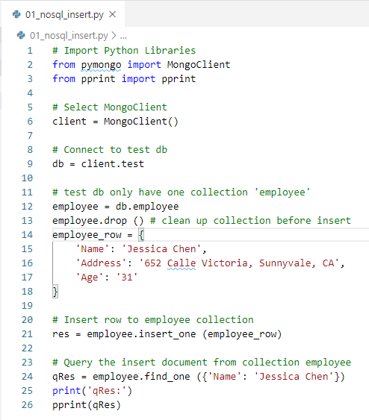
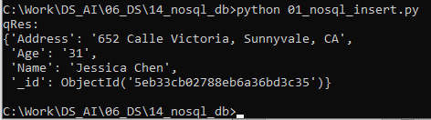
14 NoSQL Database
https://www.tutorialspoint.com/python_data_science/python_nosql_databases.htm
Insert Data to NoSQL MongoDB Database

Slide 4
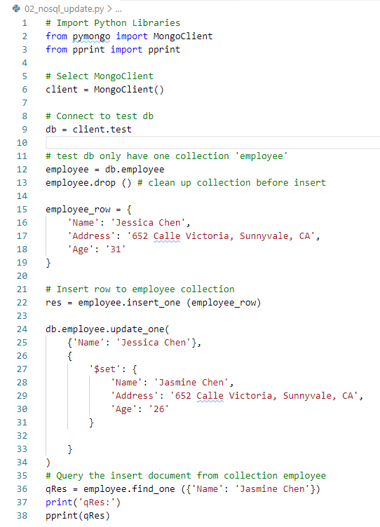
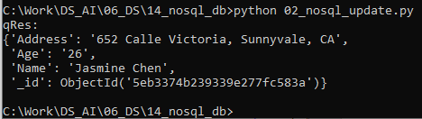
14 NoSQL Database
https://www.tutorialspoint.com/python_data_science/python_nosql_databases.htm
Update Data to NoSQL MongoDB Database

Slide 5
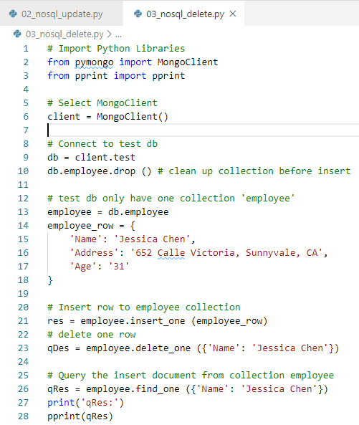

14 NoSQL Database
https://www.tutorialspoint.com/python_data_science/python_nosql_databases.htm
Delete Data to NoSQL MongoDB Database

Slide 6
End of Chapter

