Slide 1

25 Heat Map
Peter H. Chen

Slide 2
25 Heat Map
https://www.tutorialspoint.com/python_data_science/python_box_plots.htm
Heat Map
A heatmap contains several area. Each area contain value of the same color.
Usually the darker color with higher values than the lighter color.
A different value display by different color.

Slide 3
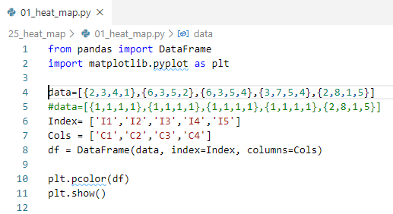
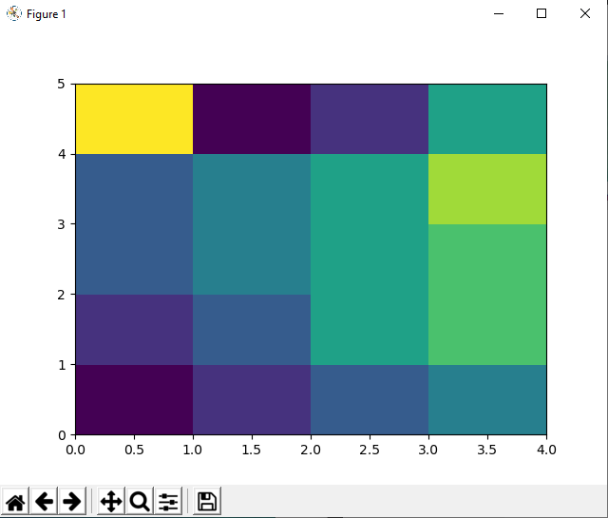
25 Heat Map
https://www.tutorialspoint.com/python_data_science/python_box_plots.htm
Heat Map
A heatmap contains several area. Each area contain value of the same color.
Usually the darker color with higher values than the lighter color.
A different value display by different color.

Slide 4
End of Chapter

