Slide 1

10 CSV Data
Peter H. Chen

Slide 2
10 CSV Data
https://www.tutorialspoint.com/python_data_science/python_processing_csv_data.htm
Read CSV Data
Reading data from CSV (comma separated values) is a fundamental necessity in Data Science.
We read data from various sources which can get exported to CSV format so that they can be used by other systems.
The Panadas library provides features to read the full CSV file and partial data in a selected group of columns and rows.

Slide 3
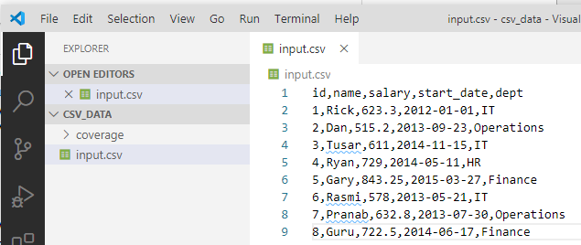
10 CSV Data
https://www.tutorialspoint.com/python_data_science/python_processing_csv_data.htm
File input.csv
The csv file is a text file with extension *.csv. In the csv file, the values in the columns are separated by a comma.
Create a csv_data folder with file input.csv:

Slide 4
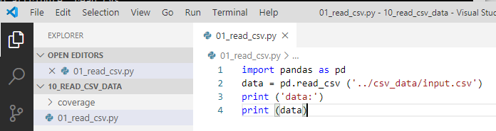
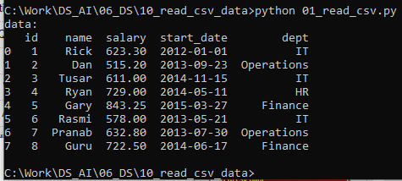
10 CSV Data
https://www.tutorialspoint.com/python_data_science/python_processing_csv_data.htm
Read CSV File
> import pands as pd
> data = pd. read_csv (‘../csv_data/input.csv’)
> print (data)

Slide 5
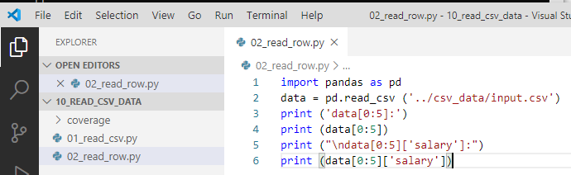
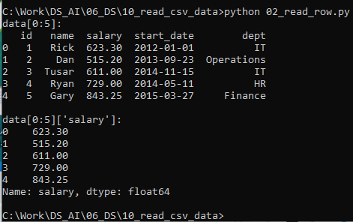
10 CSV Data
https://www.tutorialspoint.com/python_data_science/python_processing_csv_data.htm
Read Selected Row
> import pands as pd
> data = pd. read_csv (‘../csv_data/input.csv’)
> print (data[0:5]) # print row 0 to row 5
> print (data[0:5][‘salary’]) # print row 0 to ro2 5 of column ‘salary’

Slide 6
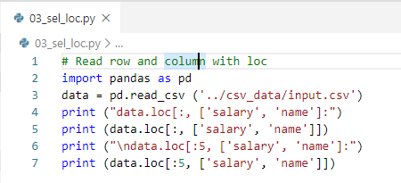
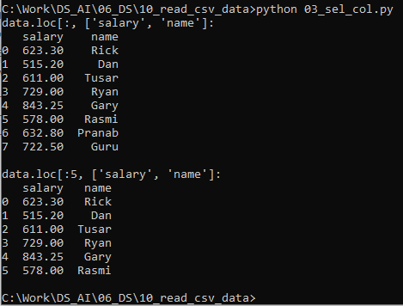
10 CSV Data
https://www.tutorialspoint.com/python_data_science/python_processing_csv_data.htm
Select row and Column with loc[]
> import pands as pd
> data = pd. read_csv (‘../csv_data/input.csv’)
> print (data.lo[:5,[‘slaray’, ‘name’]]) # select ‘slaray’ and ‘name’ columns

Slide 7
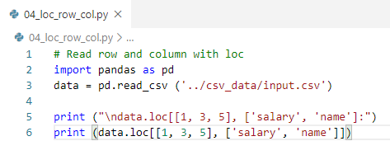
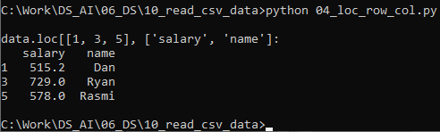
10 CSV Data
https://www.tutorialspoint.com/python_data_science/python_processing_csv_data.htm
Select rows and Columns with loc[]
> import pands as pd
> data = pd. read_csv (‘../csv_data/input.csv’)
> print (data.lo[[1, 3, 5],[‘slaray’‘name’]]) # select ‘slaray’ and ‘name’ columns

Slide 8
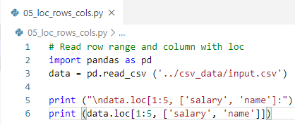
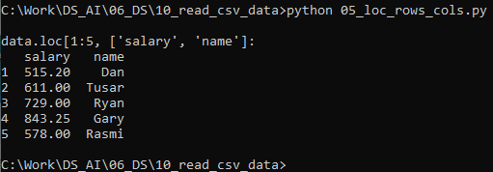
10 CSV Data
https://www.tutorialspoint.com/python_data_science/python_processing_csv_data.htm
Select rows range and Columns with loc[]
> import pands as pd
> data = pd. read_csv (‘../csv_data/input.csv’)
> print (data.lo[[1: 5],[‘slaray’‘name’]]) # select ‘slaray’ and ‘name’ columns

Slide 9
End of Chapter

