Slide 1

17 Data Aggregate
Peter H. Chen

Slide 2
17 Data Aggregate
https://www.tutorialspoint.com/python_data_science/python_data_aggregation.htm
Data Aggregate
The “Data Aggregate” is to perform the summation, count, destruction, and etc. for data (in array or matrix) with specified window size and period.
Pandas and numpy libraries have methods for Data aggregate.

Slide 3
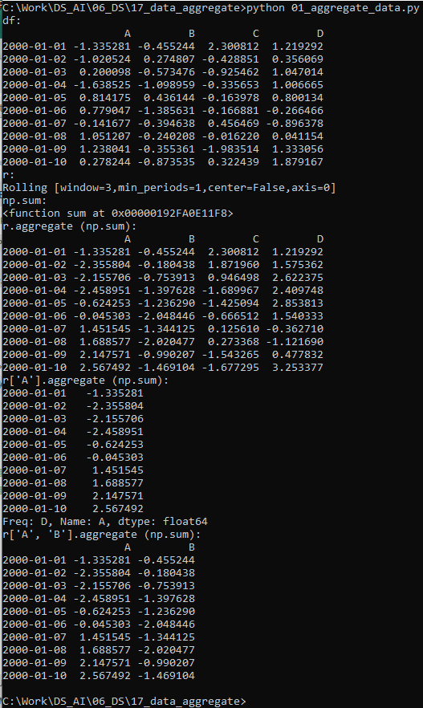
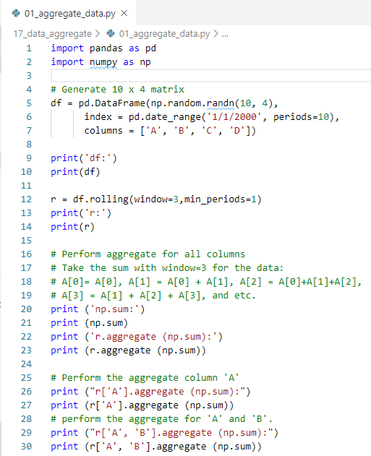
17 Data Aggregate
https://www.tutorialspoint.com/python_data_science/python_data_aggregation.htm
Data Aggregate
Pandas and numpy libraries have methods for Data aggregate.

Slide 4
End of Chapter

