Slide 1

35 Binominal Distribution
Peter H. Chen

Slide 2
35 Binominal Distribution
https://www.tutorialspoint.com/python_data_science/python_binomial_distribution.htm
Binominal Distribution
The binomial distribution model deals with finding the probability of success of an event which has only two possible outcomes in a series of experiments.
For example, tossing of a coin always gives a head or a tail.
The probability of finding exactly 3 heads in tossing a coin repeatedly for 10 times is estimated during the binomial distribution.
The seaborn python library has in-built functions to create such probability distribution graphs.
Also, the scipy package creates the binomial distribution.

Slide 3
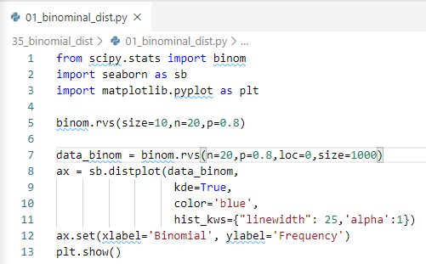
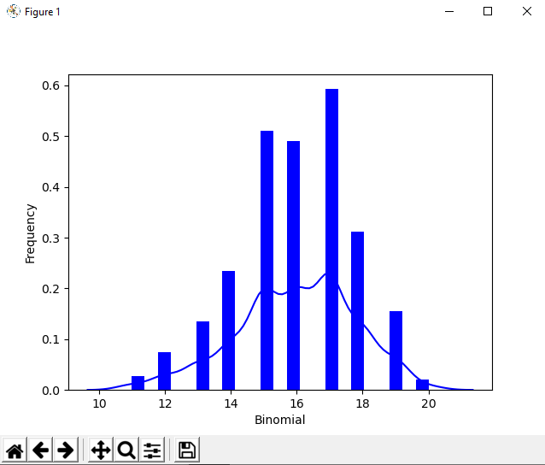
35 Binominal Distribution
https://www.tutorialspoint.com/python_data_science/python_binomial_distribution.htm
Binominal Distribution
> python 01_binomial_dist.py

Slide 4
End of Chapter

