Slide 1

32 Measure Central Tendency
Peter H. Chen

Slide 2
32 Measure Central Tendency
https://www.tutorialspoint.com/python_data_science/python_measuring_central_tendency.htm
Measure Central Tendency
Mathematically, the central tendency means measuring the center or distribution of location of values of a data set.
The central tendency gives an idea of the average value of the data in the data set and also an indication of how widely the values are spread in the data set.
The central tendency helps in evaluating the chances of a new input fitting into the existing data set and hence probability of success.
There are three main measures of central tendency which can be calculated using the methods in pandas python library.
Mean - It is the Average value of the data which is a division of sum of the values with the number of values.
Median - It is the middle value in distribution when the values are arranged in ascending or descending order.
Mode - It is the most commonly occurring value in a distribution.

Slide 3
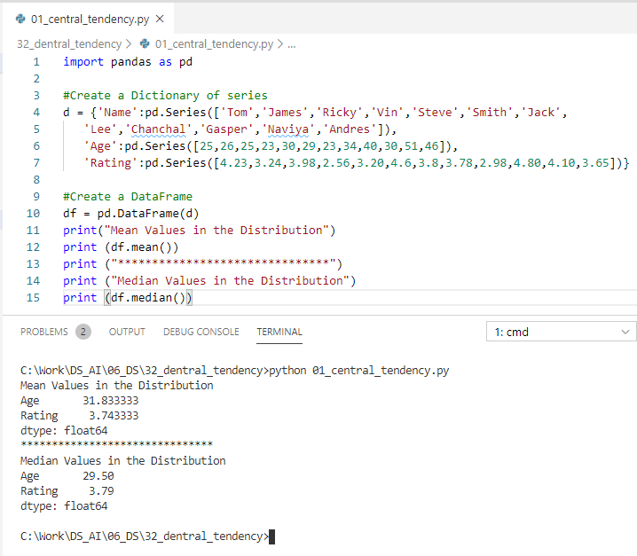
32 Measure Central Tendency
https://www.tutorialspoint.com/python_data_science/python_measuring_central_tendency.htm
Measure Central Tendency
Mean and Median

Slide 4
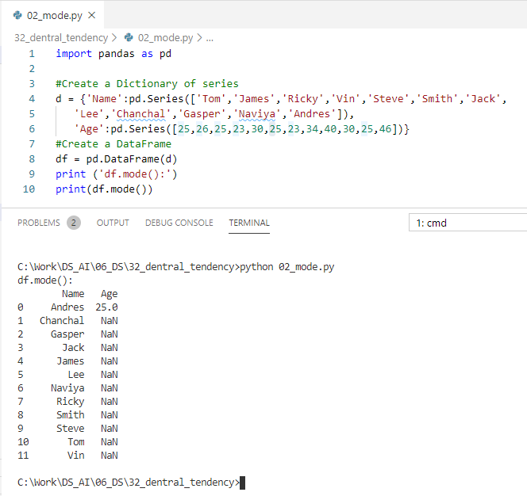
32 Measure Central Tendency
https://www.tutorialspoint.com/python_data_science/python_measuring_central_tendency.htm
Measure Central Tendency
Mode

Slide 5
End of Chapter

