Slide 1

38 P Value
Peter H. Chen

Slide 2
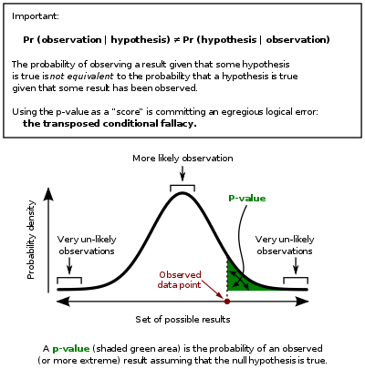
38 P Value
https://www.tutorialspoint.com/python_data_science/python_bernoulli_distribution.htm
P value
The p-value is about the strength of a hypothesis.
We build hypothesis based on some statistical model and compare the model's validity using p-value.
One way to get the p-value is by using T-test.
This is a two-sided test for the null hypothesis that the expected value (mean) of a sample of independent observations ‘a’ is equal to the given population mean, popmean.

Slide 3
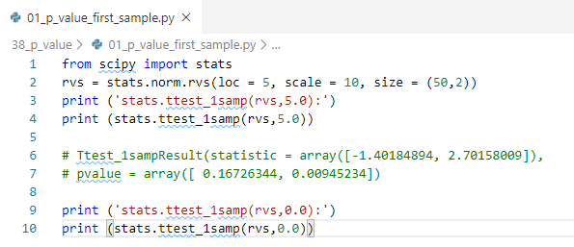
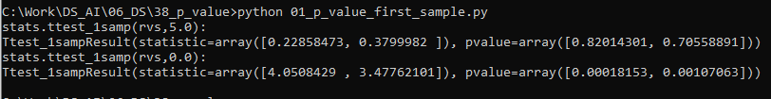
38 P Value
https://www.tutorialspoint.com/python_data_science/python_bernoulli_distribution.htm
P value
First sample:
https://docs.scipy.org/doc/scipy/reference/generated/scipy.stats.ttest_1samp.html
Calculate the T-test for the mean of ONE group of scores.
This is a two-sided test for the null hypothesis that the expected value (mean) of a sample of independent observations a is equal to the given population mean, popmean.

Slide 4
38 P Value
https://www.tutorialspoint.com/python_data_science/python_bernoulli_distribution.htm
P value
Comparing two samples
https://www.youtube.com/watch?v=0Pd3dc1GcHc
What is t-test?
A t-test is a statistic that check if two means (averages) are reliably different from ach other.
In the following examples, there are two samples, which can come either from the same or from different distribution, and we want to test whether these samples have the same statistical properties.
ttest_ind − Calculates the T-test for the means of two independent samples of scores. This is a two-sided test for the null hypothesis that two independent samples have identical average (expected) values. This test assumes that the populations have identical variances by default.
We can use this test, if we observe two independent samples from the same or different population.

Slide 5
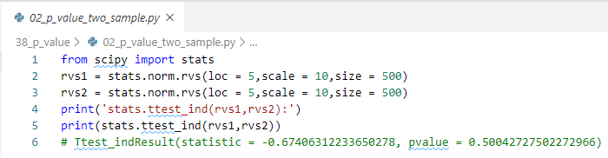

38 P Value
https://www.tutorialspoint.com/python_data_science/python_bernoulli_distribution.htm
P value
Comparing two samples
Example:

Slide 6
End of Chapter

