Slide 1

27 Bubble Chart
Peter H. Chen

Slide 2
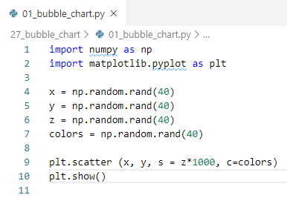
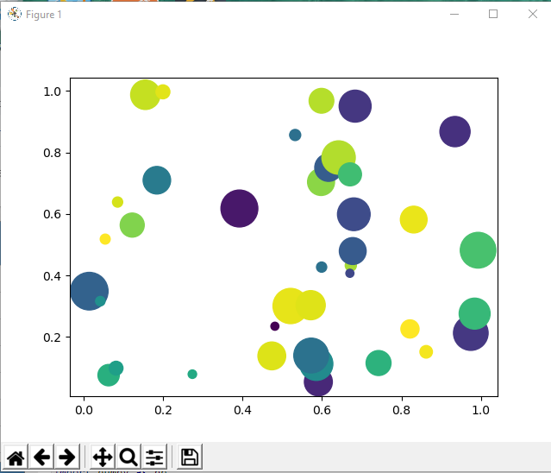
27 Bubble Chart
https://www.tutorialspoint.com/python_data_science/python_bubble_charts.htm
Bubble Chart
Bubble Charts display data in a cluster of circles.
The bubble location need (x,y) coordinate and size/color for each bubble.

Slide 3
End of Chapter

