Slide 1

18 Read HTML
Peter H. Chen

Slide 2
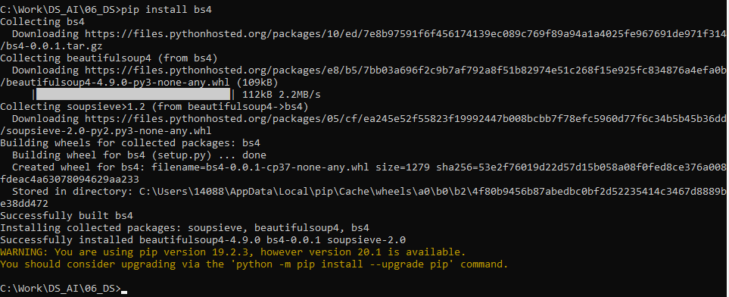
18 Read HTML
https://www.tutorialspoint.com/python_data_science/python_reading_html_pages.htm
Read HTML
The Library Beautifulsoup is used to read HTMP Page.
Install beautiful soup
> pip install bs4
Or
> conda install bs4

Slide 3
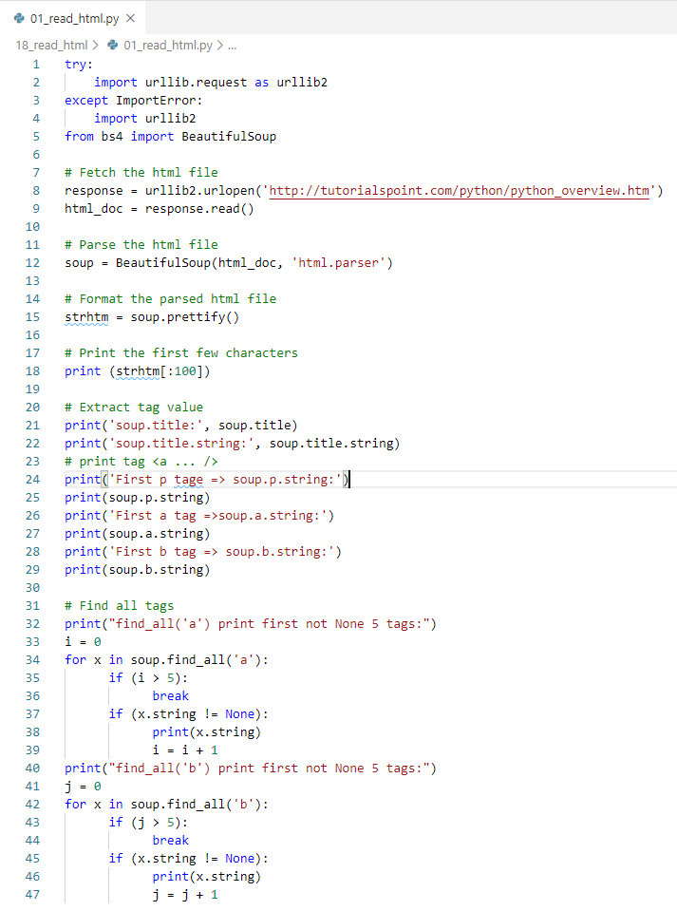
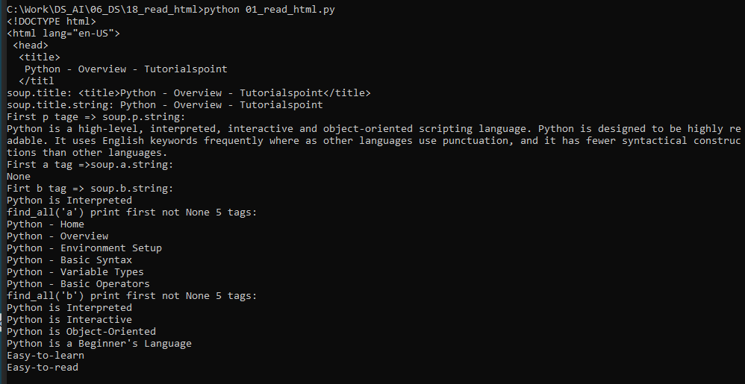
18 Read HTML
https://www.tutorialspoint.com/python_data_science/python_data_aggregation.htm
Read HTML
Read HTML
Read first <p>, <a>, and <b>
Print the first 5 of tag <a> and tag <b>
> python 01_read_html.py

Slide 4
End of Chapter

