Slide 1

19 Process Unstructured Data
Peter H. Chen

Slide 2
19 Process Unstructured Data
https://www.tutorialspoint.com/python_data_science/python_processing_unstructured_data.htm
Process Unstructured Data
In the previous discussion, the data present in a row and column format are known as structured data, for example, CSV, JSON, XLSX, and etc.
These files have a delimiter and either fixed or variable width where the missing values are represented as blanks in between the delimiters.
Sometimes, we get data where the lines are not fixed width, or they are just HTML, image or pdf files, such data is known as unstructured data.
The HTML file can be handled by processing the HTML tags, a feed from twitter or a plain text document from a news feed can without having a delimiter does not have tags to handle. In such scenario we use different in-built functions from various python libraries to process the file.

Slide 3
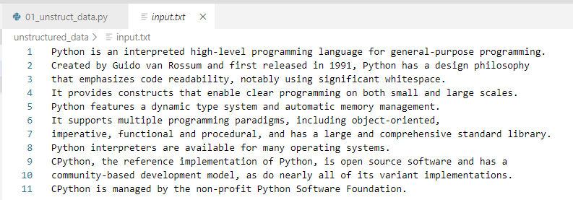
19 Process Unstructured Data
https://www.tutorialspoint.com/python_data_science/python_processing_unstructured_data.htm
Process Unstructured Data
../unstructured_data/input.txt

Slide 4
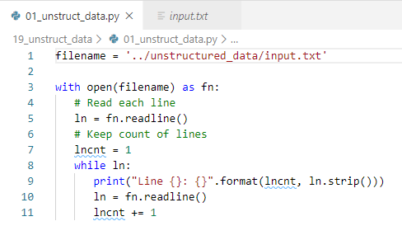
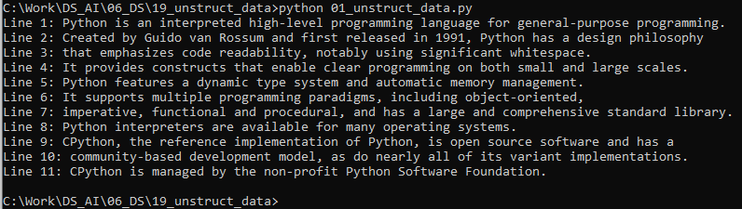
19 Process Unstructured Data
https://www.tutorialspoint.com/python_data_science/python_processing_unstructured_data.htm
Process Unstructured Data
> python 01_unstruct_data.py

Slide 5
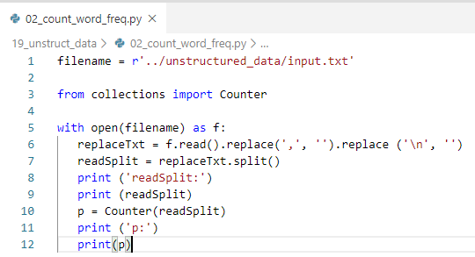
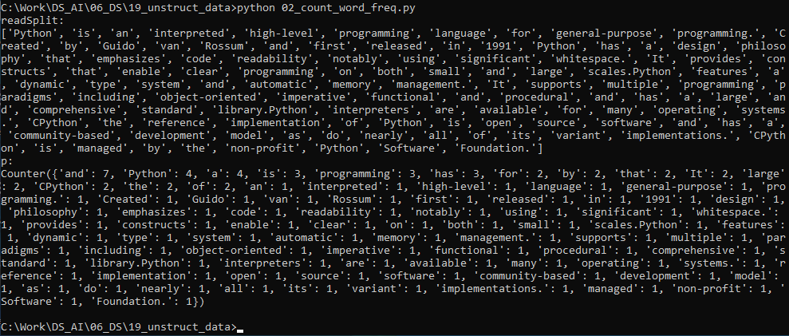
19 Process Unstructured Data
https://www.tutorialspoint.com/python_data_science/python_processing_unstructured_data.htm
Count Word Frequency
> python 02_count_word_freq.py

Slide 6
End of Chapter

