Slide 1

1 Data Science
Peter H. Chen

Slide 2
1 Data Science
https://www.youtube.com/watch?v=d11chG7Z-xk&list=PLZbbT5o_s2xrth-Cqs_R9-us6IWk9x27z&index=1
Data Science
What is Data Science?
Data Science Project for trading stocks.
How much programming is needed?
We will have the knowledge of what data science is end how to get started with data science.

Slide 3
1 Data Science
https://www.youtube.com/watch?v=d11chG7Z-xk&list=PLZbbT5o_s2xrth-Cqs_R9-us6IWk9x27z&index=1
What is Data Science
Data Science is an interdisciplinary study of data whose central focus is the data life cycle and how data is applied to the decision making process.
There are two terms need to high lighted:
interdisciplinary: multiple disciplines: Math, Computer Science, and Domain Discipline.
concept of data life cycle.

Slide 4
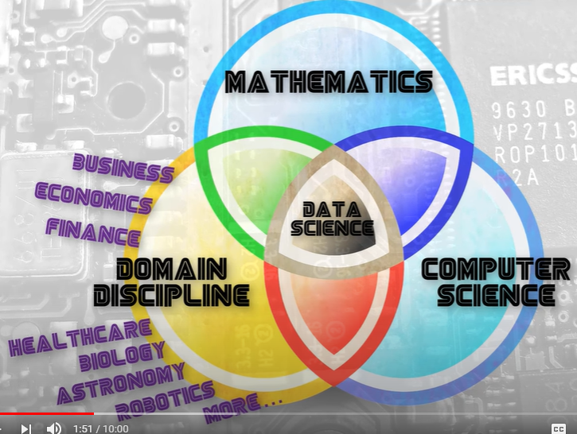
1 Data Science
https://www.youtube.com/watch?v=d11chG7Z-xk&list=PLZbbT5o_s2xrth-Cqs_R9-us6IWk9x27z&index=1
Interdisciplinary:
Multiple disciplines: Math, Computer Science, and Domain Discipline.

Slide 5
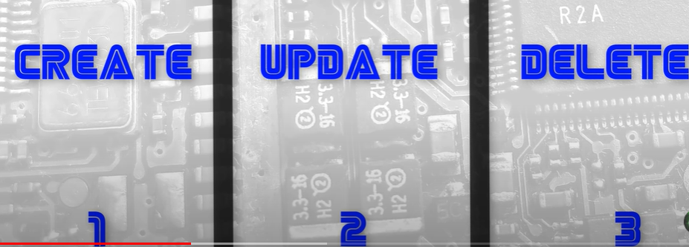
1 Data Science
https://www.youtube.com/watch?v=d11chG7Z-xk&list=PLZbbT5o_s2xrth-Cqs_R9-us6IWk9x27z&index=1
Concept of Data Life Cycle
Create
Update
Delete

Slide 6

1 Data Science
https://www.youtube.com/watch?v=d11chG7Z-xk&list=PLZbbT5o_s2xrth-Cqs_R9-us6IWk9x27z&index=1
Finance and Trading:
Goal is to identify an problem that the project seeks to solve.
Goal is to create a trading spot that buys and sells stocks based on price data.

Slide 7
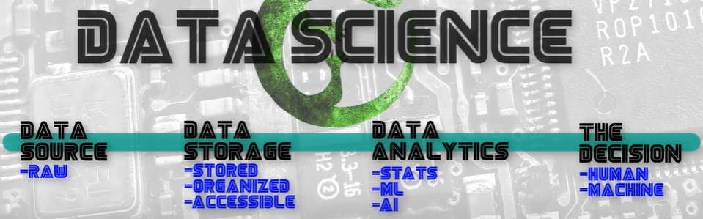
1 Data Science
https://www.youtube.com/watch?v=d11chG7Z-xk&list=PLZbbT5o_s2xrth-Cqs_R9-us6IWk9x27z&index=1
Finance and Trading:
The structure of this project will have an underlying framework with four parts:
Data Source: Raw Data
Data Storage: Stored data, organized, accessible.
Data Analysis: statistics, machine learning, and artificial intelligence operations are performed.
The Decision: determined by the goal and is performed either by humans or machines.

Slide 8
1 Data Science
https://www.youtube.com/watch?v=d11chG7Z-xk&list=PLZbbT5o_s2xrth-Cqs_R9-us6IWk9x27z&index=1
Finance and Trading:
These are data science framework. We call this a framework because it gives a structure way to do our work.
Our project is the price from stock trade.
Once we have the data, we have the data stored it, organize it, and make it accessible, organizing it is necessary because the data can varied in quality and structure depending on who is providing the actual data. In some cases, there are many possible providers. Providers are the entities that actually collect the data and make it accessible to us.
Analyze the data producing the information needed to make our buy and sell decision.
There are two way to buy and sell decision can be made. Human, such as, Warren Buffet and machine make the decision by algorithm .

Slide 9
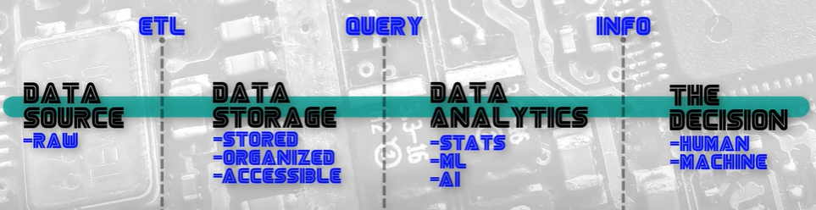
1 Data Science
https://www.youtube.com/watch?v=d11chG7Z-xk&list=PLZbbT5o_s2xrth-Cqs_R9-us6IWk9x27z&index=1
Finance and Trading:
The price data is generated at the exchange. The data flow through what we call an ETL pipeline. ETL stands for Extract, Transform, and Load. The Transform step organizes and prepare the data.
The load is load into the storage system to do data analysis.
We query the data ana analyze to produce information that can be used to make our buy and sell.

Slide 10
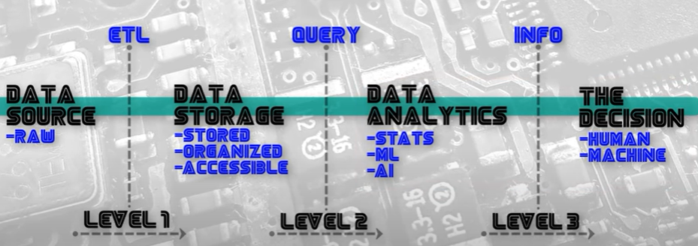
1 Data Science
https://www.youtube.com/watch?v=d11chG7Z-xk&list=PLZbbT5o_s2xrth-Cqs_R9-us6IWk9x27z&index=1
Programming point of view
ETL moves the data transforms data. This is done with simple update operations.
Connect the storage to analyze. It is all about query for specific data needed to do analysis. These are useful tool for finding specific pieces of data inside large dataset.
Create the information used to make the buy and sell decisions.

Slide 11
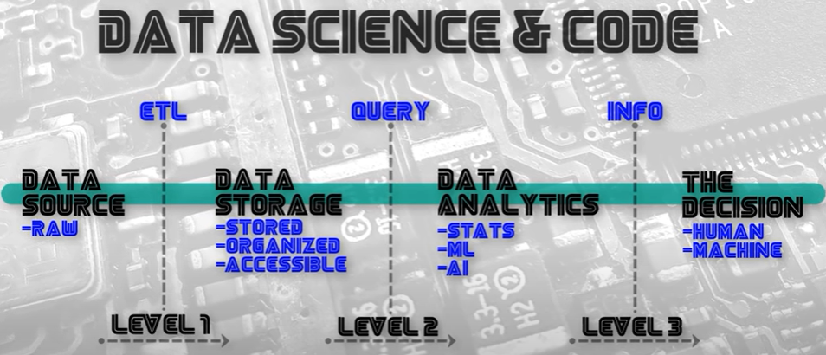
1 Data Science
https://www.youtube.com/watch?v=d11chG7Z-xk&list=PLZbbT5o_s2xrth-Cqs_R9-us6IWk9x27z&index=1
Deployed Product
The software product directly connect from data source to make decision in real time.
More computer science skills are required because the application will have to keep track of the state and programming requires more design considerations.
Application can be deployed in a commercial product.
Application can be very sophisticated with security. These requires more of a computer science background.

Slide 12

1.1 Quiz

Slide 13
1.1 Quiz
https://www.youtube.com/watch?v=d11chG7Z-xk&list=PLZbbT5o_s2xrth-Cqs_R9-us6IWk9x27z&index=1
Quiz:
Question 1:
What are the fours steps of data science?
Ans: The data sconce framework includes four parts:
Data Source: Raw Data
Data Storage: Stored data, organized, accessible.
Data Analysis: statistics, machine learning, and artificial intelligence operations are performed.
The Decision: determined by the goal and is performed either by humans or machines.

Slide 14
End of Chapter

