Slide 1

2 Program
Peter H. Chen

Slide 2
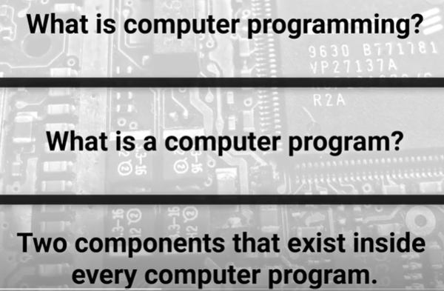
2 Program
https://www.youtube.com/watch?v=x2H9cy-rrPg&list=PLZbbT5o_s2xrth-Cqs_R9-us6IWk9x27z&index=2
Program
What is a Computer Programming?
What is a computer program?
What is two things inside the every computer program?
We will have the knowledge of computer programming.

Slide 3
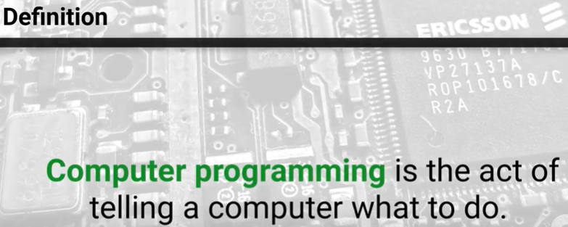
2 Program
https://www.youtube.com/watch?v=x2H9cy-rrPg&list=PLZbbT5o_s2xrth-Cqs_R9-us6IWk9x27z&index=2
Computer Programming Definition

Slide 4
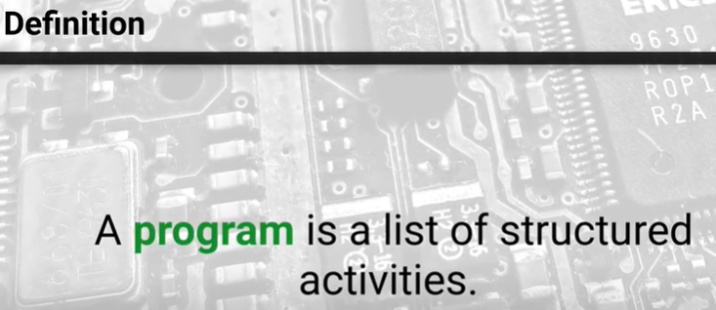
2 Program
https://www.youtube.com/watch?v=x2H9cy-rrPg&list=PLZbbT5o_s2xrth-Cqs_R9-us6IWk9x27z&index=2
Computer Program definition: a List of structured the activities. A organized way to achieve an outcome we are seeking.

Slide 5
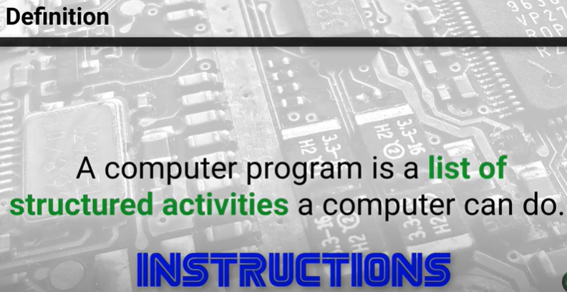
2 Program
https://www.youtube.com/watch?v=x2H9cy-rrPg&list=PLZbbT5o_s2xrth-Cqs_R9-us6IWk9x27z&index=2
Computer Program definition:
The structured activities are instructions.
The instructions are defined in the computer programs.

Slide 6

2 Program
https://www.youtube.com/watch?v=x2H9cy-rrPg&list=PLZbbT5o_s2xrth-Cqs_R9-us6IWk9x27z&index=2
Two important components inside the computer program:

Slide 7
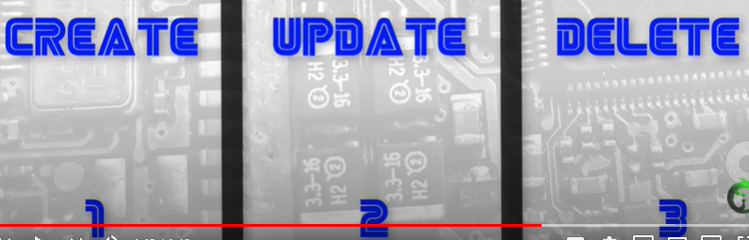
2 Program
https://www.youtube.com/watch?v=x2H9cy-rrPg&list=PLZbbT5o_s2xrth-Cqs_R9-us6IWk9x27z&index=2
Data Life cycle: computer program operations always involve the data.

Slide 8
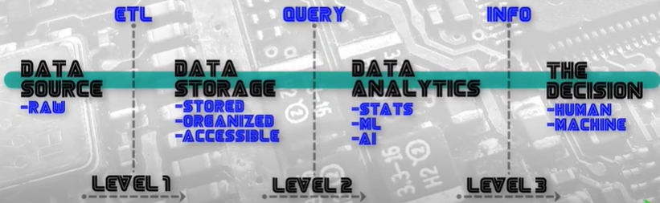
2 Program
https://www.youtube.com/watch?v=x2H9cy-rrPg&list=PLZbbT5o_s2xrth-Cqs_R9-us6IWk9x27z&index=2
Data Science Framework:
Data source, data storage, data analytics, the decision
ETL, Query, Info
The framework is program itself. Inside the project, we create code and data.
We have two options to tell computer what to do: code and data.

Slide 9

2.1 Quiz

Slide 10
2.1 Quiz
https://www.youtube.com/watch?v=x2H9cy-rrPg&list=PLZbbT5o_s2xrth-Cqs_R9-us6IWk9x27z&index=2
Quiz:
Question 1:
What are two important thing in every computer program?
1. Code: a list of instructions
2. Data: tell computer what to do.

Slide 11
End of Chapter

