Slide 1
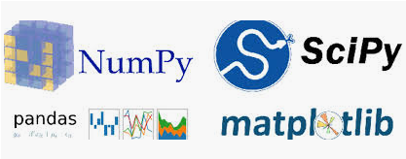
3 CLI
Peter H. Chen

Slide 2
3 CLI
https://www.youtube.com/watch?v=oBP_umJb_2U&list=PLZbbT5o_s2xrth-Cqs_R9-us6IWk9x27z&index=3
CLI
CLI (Command Line Interface) provide us a text based interface with computers opposed to the Graphical way that most of us used to.
CLI allows programmers to interact with code and data directly.
Three examples of CLI:
Windows PowerShell
JavaScript Console
Bash Terminal

Slide 3
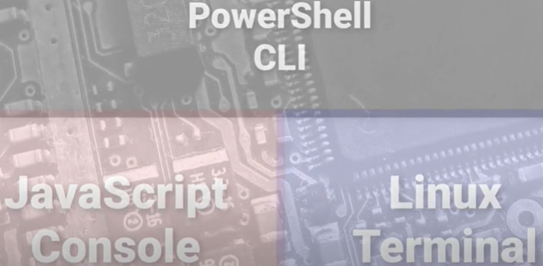
3 CLI
https://www.youtube.com/watch?v=oBP_umJb_2U&list=PLZbbT5o_s2xrth-Cqs_R9-us6IWk9x27z&index=3
CLI: Shell, Console, and Terminal are all refer to CLI.

Slide 4
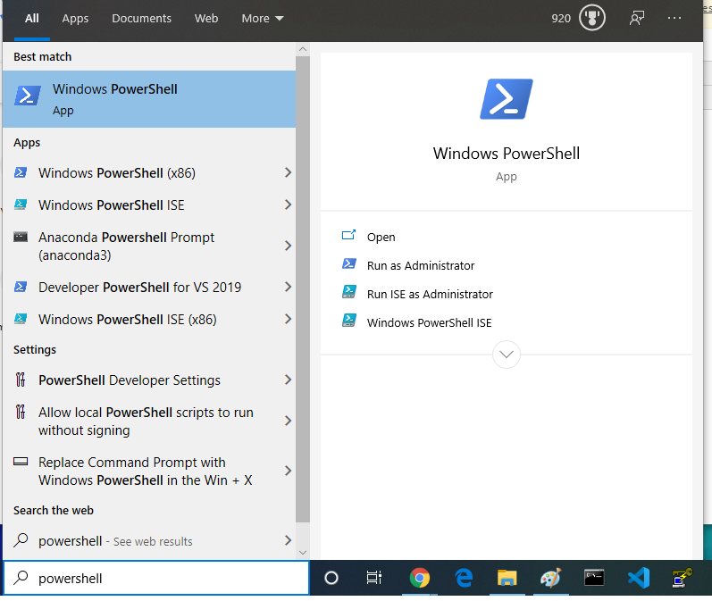
3 CLI
https://www.youtube.com/watch?v=oBP_umJb_2U&list=PLZbbT5o_s2xrth-Cqs_R9-us6IWk9x27z&index=3
Window PowerShell
Search: PowerShell
PowerShell gives us a certain set of code and data available.

Slide 5
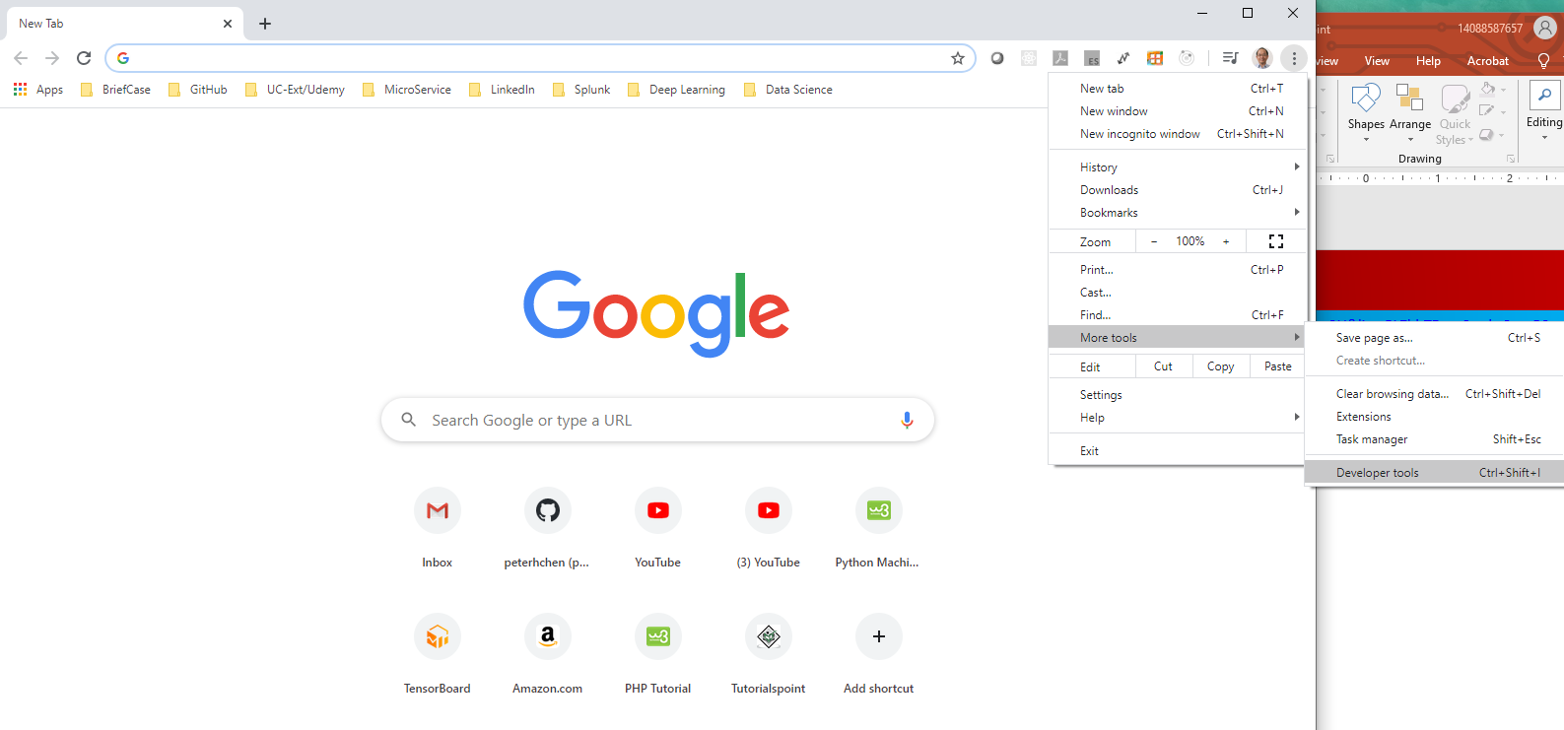
3 CLI
https://www.youtube.com/watch?v=oBP_umJb_2U&list=PLZbbT5o_s2xrth-Cqs_R9-us6IWk9x27z&index=3
JavaScript Console:
Open Chrome: Three dot Menu > More Tools > Developer Tools
This is the JavaScript console.

Slide 6
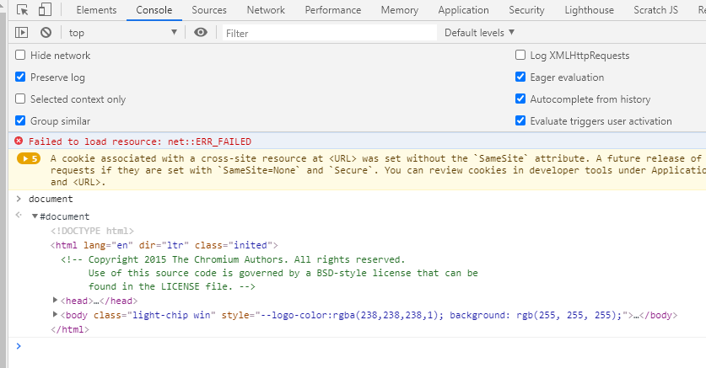
3 CLI
https://www.youtube.com/watch?v=oBP_umJb_2U&list=PLZbbT5o_s2xrth-Cqs_R9-us6IWk9x27z&index=3
JavaScript Console:
> document
Document display the actual web page.
It gives us another set of code and data available to us.

Slide 7
3 CLI
https://www.youtube.com/watch?v=oBP_umJb_2U&list=PLZbbT5o_s2xrth-Cqs_R9-us6IWk9x27z&index=3
Linux terminal is similar to Window PowerShell and JavaScript Console.
Linux terminal allows us to administrate the Linux system.
There are other CLI out there. They provide the code and data.
We type in the command opposed the graphical pointing and clicking with GUI.

Slide 8
3 CLI
https://www.youtube.com/watch?v=oBP_umJb_2U&list=PLZbbT5o_s2xrth-Cqs_R9-us6IWk9x27z&index=3
Linux terminal is similar to Window PowerShell and JavaScript Console.
Linux terminal allows us to administrate the Linux system.
There are other CLI out there. They provide the code and data.
We type in the command opposed the graphical pointing and clicking with GUI.
Python CLI Setup
Install Python: Google “Python download”. Python come with pip (Python Installation Package).
Install SciPy
> pip install scipy
Install numpy
> pip install numpy
Install matplotlib
> pip install matplotlib
Install panda
> pip install panda

Slide 9

3.1 Quiz

Slide 10
3.1 Quiz
https://www.youtube.com/watch?v=oBP_umJb_2U&list=PLZbbT5o_s2xrth-Cqs_R9-us6IWk9x27z&index=3
Quiz:
Question 1:
What are the three popular CLI?
Window PowerShell
JavaScript Console
Linux Terminal

Slide 11
End of Chapter

