Slide 1

29 Time Series
Peter H. Chen

Slide 2
29 Time Series
https://www.tutorialspoint.com/python_data_science/python_time_series.htm
Time Series
Time series is a series of data points. Each data point is associated with a timestamp.
For example, the price of a stock in the stock market at different points of time on a given day.
Another example, the amount of rainfall in a region at different months of the year.

Slide 3
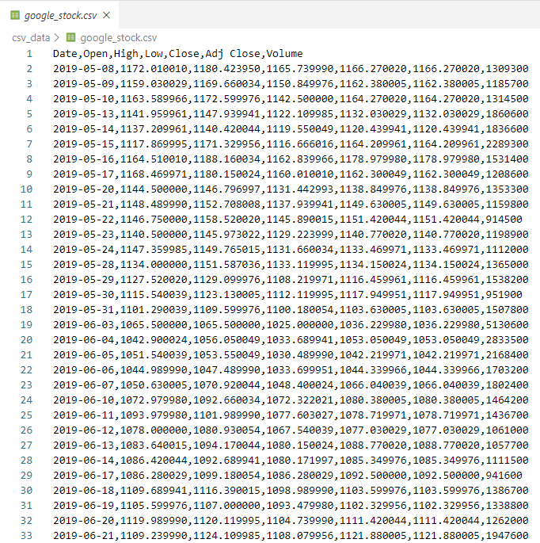
29 Time Series
https://www.tutorialspoint.com/python_data_science/python_time_series.htm
Time Series
Below is ../csv_data/google_stock.csv

Slide 4
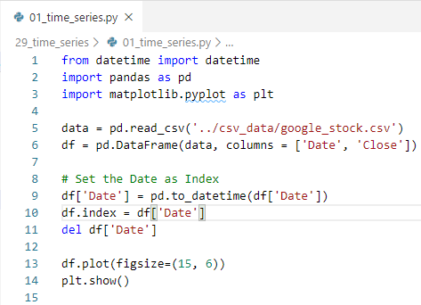
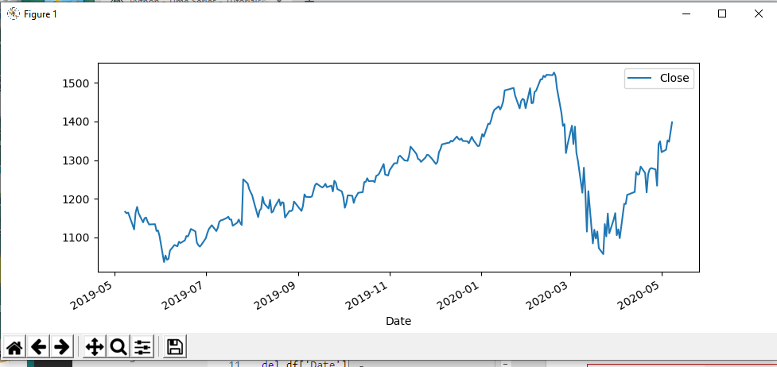
29 Time Series
https://www.tutorialspoint.com/python_data_science/python_time_series.htm
Time Series
Below is ../csv_data/google_stock.csv

Slide 5
End of Chapter

