Slide 1

8 Data Operation
Peter H. Chen

Slide 2
8 Data Operation
https://www.tutorialspoint.com/python_data_science/python_data_operations.htm
Data Operation
Python handles data of various formats mainly through the two libraries: Pandas and NumPy.
We discuss some examples for each libraries to operate on data.
Data Operations in Numpy
The most important object defined in NumPy is an N-dimensional array type called ndarray.
NumPy describes the collection of items of the same type.
Items in the collection can be accessed using a zero-based index.
An instance of ndarray class can be constructed by different array creation routines described later.
The basic ndarray is created using an array function in NumPy as follows:
numpy.array

Slide 3
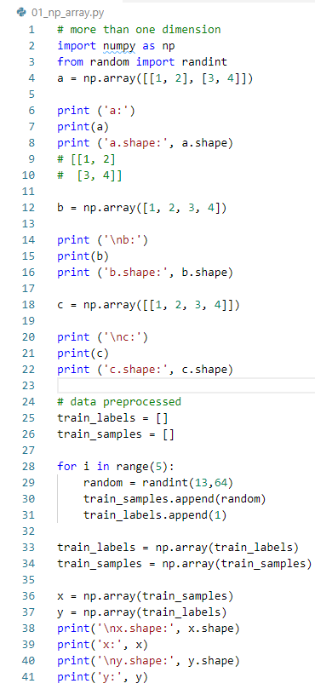
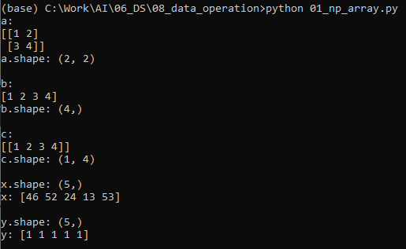
8 Data Operation
https://www.tutorialspoint.com/python_data_science/python_data_operations.htm
numpy Data Operation Example 1:

Slide 4
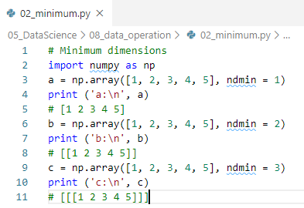
8 Data Operation
https://www.tutorialspoint.com/python_data_science/python_data_operations.htm
numpy Data Operation Example 2:

Slide 5
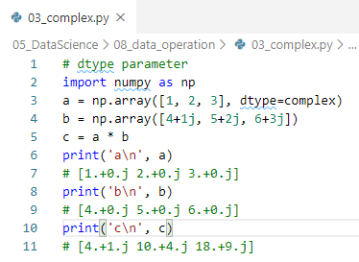
8 Data Operation
https://www.tutorialspoint.com/python_data_science/python_data_operations.htm
numpy Data Operation Example 3: Complex Number Operation

Slide 6
8 Data Operation
https://www.tutorialspoint.com/python_data_science/python_data_operations.htm
Data Operations in Pandas
Pandas handles data through Series, Data Frame, and Panel.

Slide 7
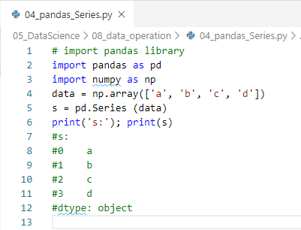
8 Data Operation
https://www.tutorialspoint.com/python_data_science/python_data_operations.htm
Pandas Series
Pandas Series is a one-dimensional labeled array capable of holding data of any type (integer string, float, python objects, and etc.).
The axis labels are collectively called index.
A Pandas Series can be created using the following constructor.
> pandas.Series (data, index, dtype, copy)

Slide 8
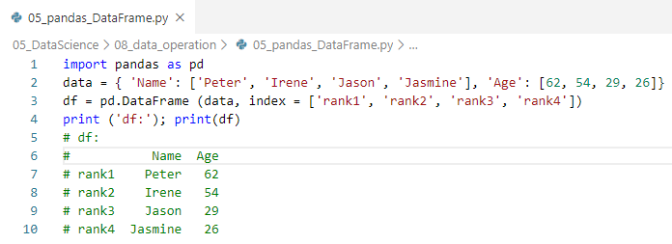
8 Data Operation
https://www.tutorialspoint.com/python_data_science/python_data_operations.htm
Pandas DataFrame
Pandas DataFrame is a two-dimensional structure, i.e., data is aligned in a tabular fashion in rows and columns.
A Pandas DataFrame can be created using the following constructor.
> pandas.DataFrame(data, index, columns, dtype, copy)

Slide 9
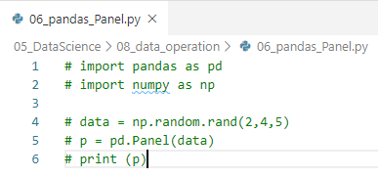
8 Data Operation
https://www.tutorialspoint.com/python_data_science/python_data_operations.htm
Pandas Panel
Pandas Panel is a 3D container of data. The term Panel data is derived from econometrics and is name pandas came from, i.e., pan(el)-da(ta)-s.
Note: Panel may not work in Python 3.7+

Slide 10
End of Chapter

