Slide 1

1 Data Science
Peter H. Chen

Slide 2
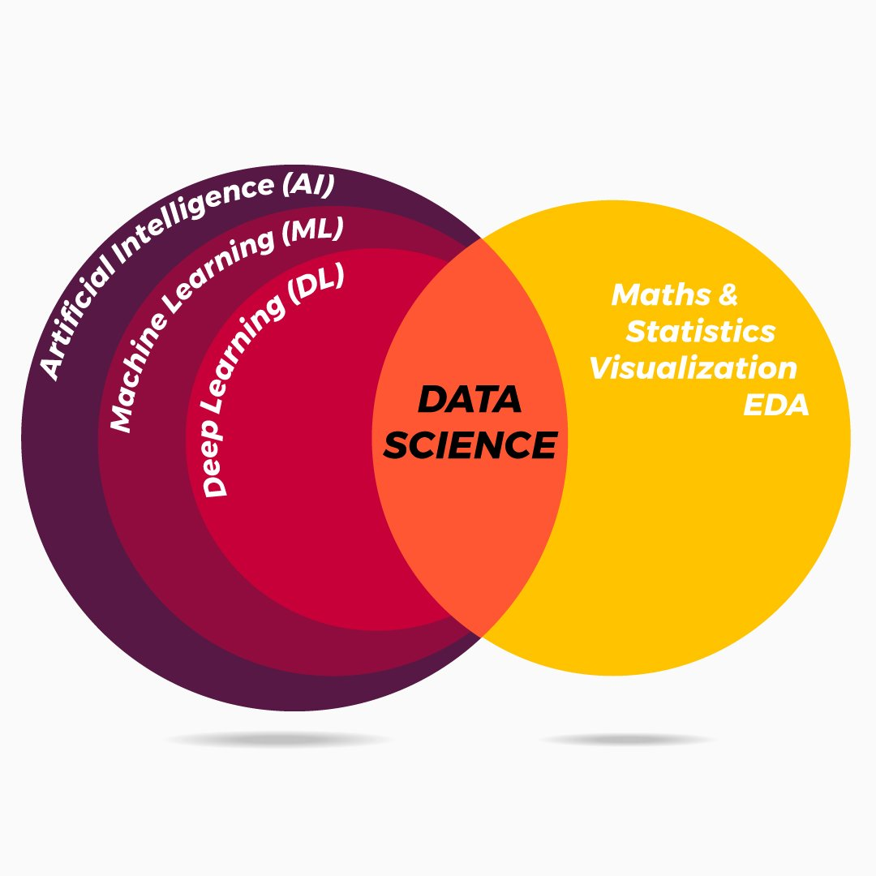
1 Data Science
https://www.tutorialspoint.com/python_data_science/index.htm
Data Science
We discuss Data Science.

Slide 3
End of Chapter

