Slide 1

41 Linear Regression
Peter H. Chen

Slide 2
41 Linear Regression
https://www.tutorialspoint.com/python_data_science/python_linear_regression.htm
Linear Regression
In Linear Regression these two variables are related through an equation, where exponent (power) of both these variables is 1. Mathematically a linear relationship represents a straight line when plotted as a graph. A non-linear relationship where the exponent of any variable is not equal to 1 creates a curve.
The functions in Seaborn to find the linear regression relationship is regplot. The below example shows its use.

Slide 3
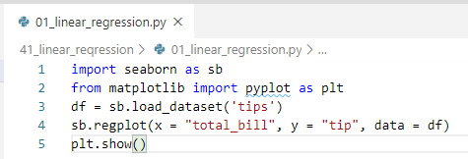
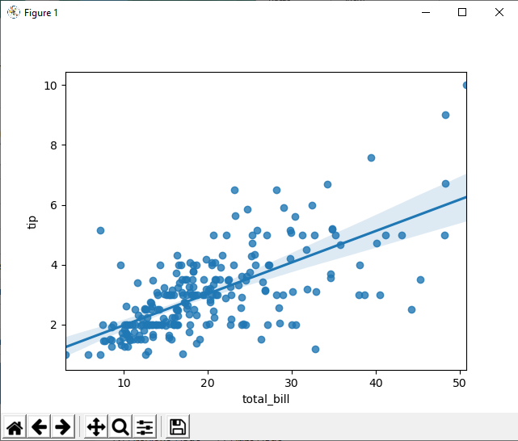
41 Linear Regression
https://www.tutorialspoint.com/python_data_science/python_linear_regression.htm
Linear Regression
The functions in Seaborn to find the linear regression relationship is regplot. The below example shows its use.

Slide 4
End of Chapter

