Slide 1
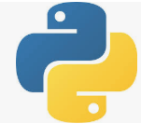
3 Setup
Peter H. Chen

Slide 2
3 Setup
https://www.tutorialspoint.com/python_data_science/python_data_science_environment_setup.htm
Setup
Install Python: Google “Python download”. Python come with pip (Python Installation Package).
Install SciPy
> pip install scipy
Install numpy
> pip install numpy
Install matplotlib
> pip install matplotlib
Install panda
> pip install panda

Slide 3
End of Chapter

