Slide 1

15 Date Time
Peter H. Chen

Slide 2
15 Date Time
https://www.tutorialspoint.com/python_data_science/python_nosql_databases.htm
Date and Time
Data Science analyze data based on temporal values.
Python handles various time and date format.
The datetime library provides the methods the following scenarios:
Date Time Representation
Date Time Arithmetic
Date Time Comparison

Slide 3
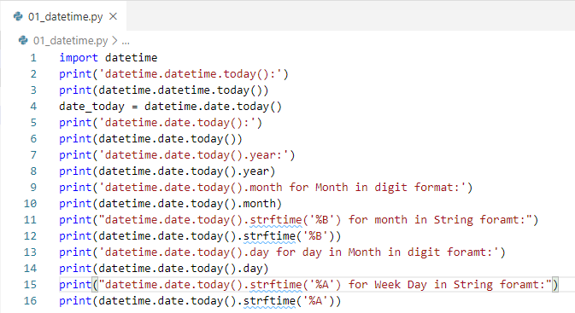
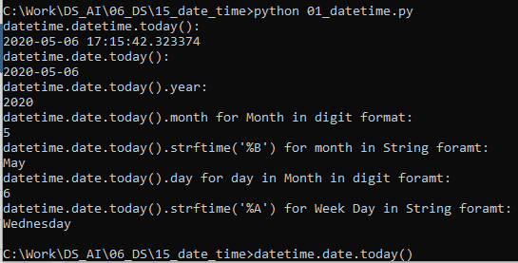
15 Date Time
https://www.tutorialspoint.com/python_data_science/python_nosql_databases.htm
Date Time Representation
There are various format for date and datetime.

Slide 4
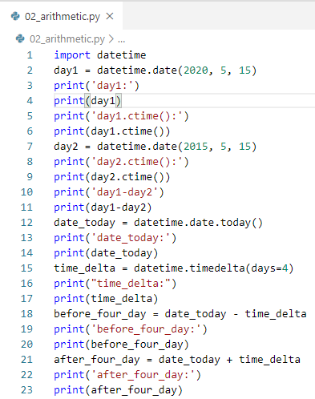
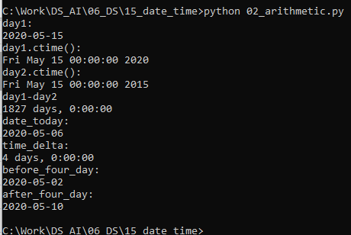
15 Date Time
https://www.tutorialspoint.com/python_data_science/python_nosql_databases.htm
Date Time Comparison
Date Time Arithmetic.

Slide 5
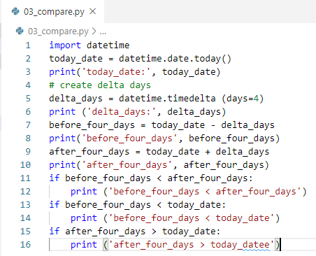
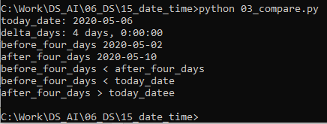
15 Date Time
https://www.tutorialspoint.com/python_data_science/python_nosql_databases.htm
Date Time Comparison
Date Time Compares by logical operators.

Slide 6
End of Chapter

