Slide 1
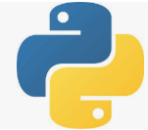
11 JSON Data
Peter H. Chen

Slide 2
11 JSON Data
https://www.tutorialspoint.com/python_data_science/python_processing_json_data.htm
Read JSON Data
Read JSON (JavaScript Object Notation) format data.
Pandas can read JSON files using the read_json function.

Slide 3
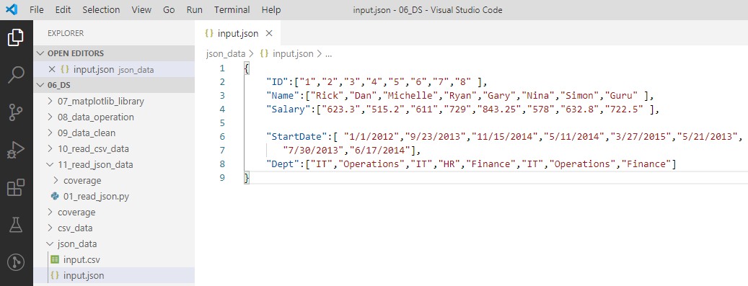
11 JSON Data
https://www.tutorialspoint.com/python_data_science/python_processing_json_data.htm
Create JSON Format file
Create json_data/input.json

Slide 4
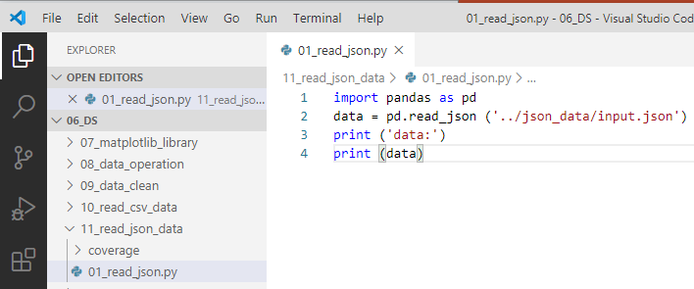
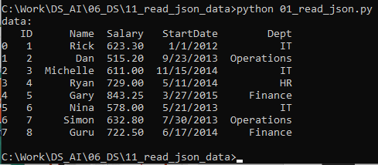
11 JSON Data
https://www.tutorialspoint.com/python_data_science/python_processing_json_data.htm
Read JSON file
> import pandas as pd
> data = pd.read_json (‘../json_data/input.data’)
> print (data)

Slide 5
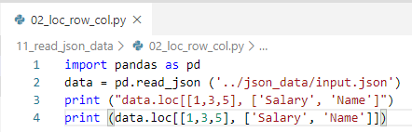
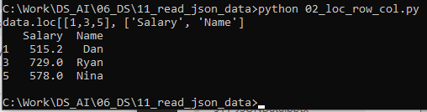
11 JSON Data
https://www.tutorialspoint.com/python_data_science/python_processing_json_data.htm
Read Selected Rows and Columns with loc
> import pandas as pd
> data = pd.read_json (‘../json_data/input.data’)
> print (data.loc[[1, 3, 5], [‘Salary’, ‘Name’])

Slide 6
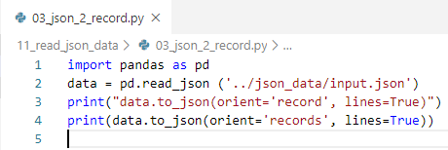
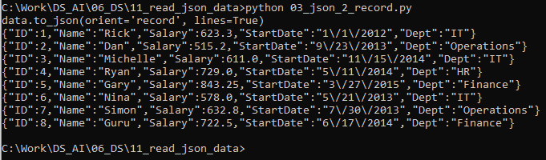
11 JSON Data
https://www.tutorialspoint.com/python_data_science/python_processing_json_data.htm
Translate JSON into Record
> import pandas as pd
> data = pd.read_json (‘../json_data/input.data’)
> print (data.to_json(orient=“recrods”, lines=True))

Slide 7
End of Chapter

