Slide 1

36 Poisson Distribution
Peter H. Chen

Slide 2
36 Poisson Distribution
https://www.tutorialspoint.com/python_data_science/python_poisson_distribution.htm
Poisson Distribution
The Poisson distribution is a distribution which shows the likely number of times that an event will occur within a pre-determined period of time.
The Poisson distribution is used for independent events which occur at a constant rate within a given interval of time.
The Poisson distribution is a discrete function, meaning that the event can only be measured as occurring or not as occurring, meaning the variable can only be measured in whole numbers.
The seaborn python library which has in-built functions to create such probability distribution graphs.
Also the scipy package creates the binomial distribution.

Slide 3
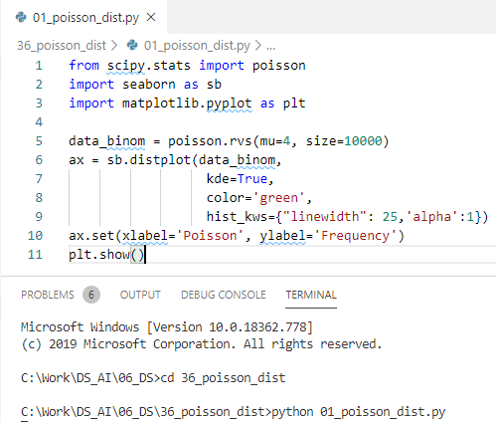
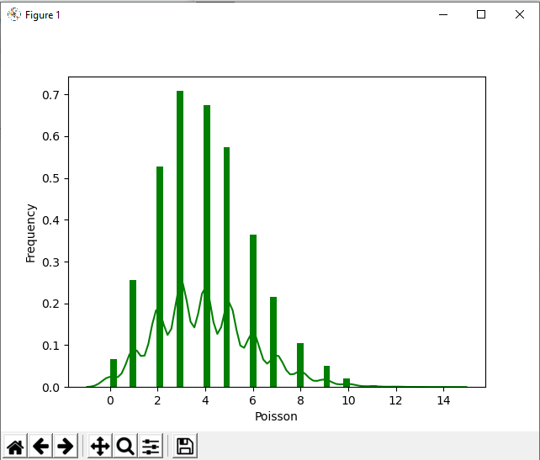
36 Poisson Distribution
https://www.tutorialspoint.com/python_data_science/python_poisson_distribution.htm
Poisson Distribution

Slide 4
End of Chapter

