Slide 1

20 Word Tokenization
Peter H. Chen

Slide 2
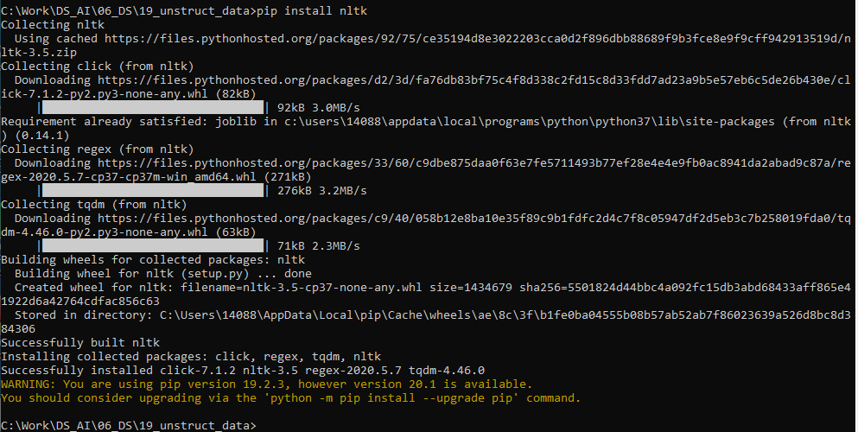
20 Word Tokenization
https://www.tutorialspoint.com/python_data_science/python_word_tokenization.htm
Word Tokenization
Word tokenization is the process of splitting a large sample of text into words.
This is a requirement in natural language processing tasks where each word needs to be captured and subjected to further analysis like classifying and counting them for a particular sentiment, and etc.
The Natural Language Tool Kit (NLTK) is a library used to achieve this.
Install NLTK before proceeding with the python program for word tokenization.
> pip install nltk

Slide 3
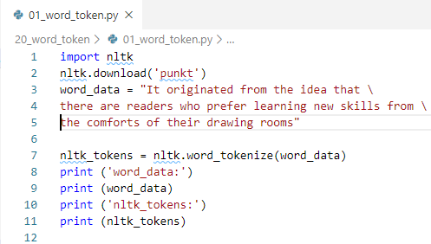
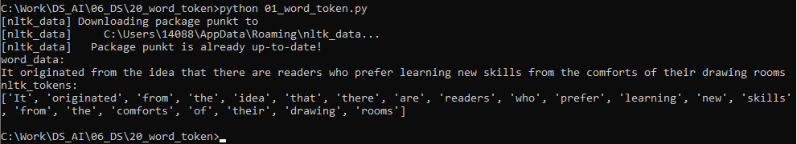
20 Word Tokenization
https://www.tutorialspoint.com/python_data_science/python_word_tokenization.htm
Word Tokenization

Slide 4
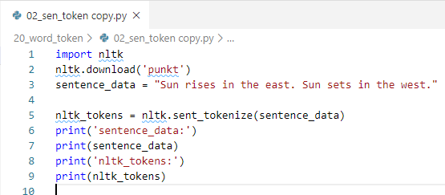
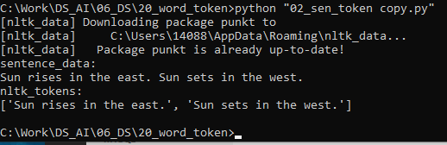
20 Word Tokenization
https://www.tutorialspoint.com/python_data_science/python_word_tokenization.htm
Sentence Tokenization

Slide 5
End of Chapter

