Slide 1
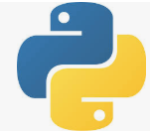
1 Python Deep Learning
Peter H. Chen

Slide 2
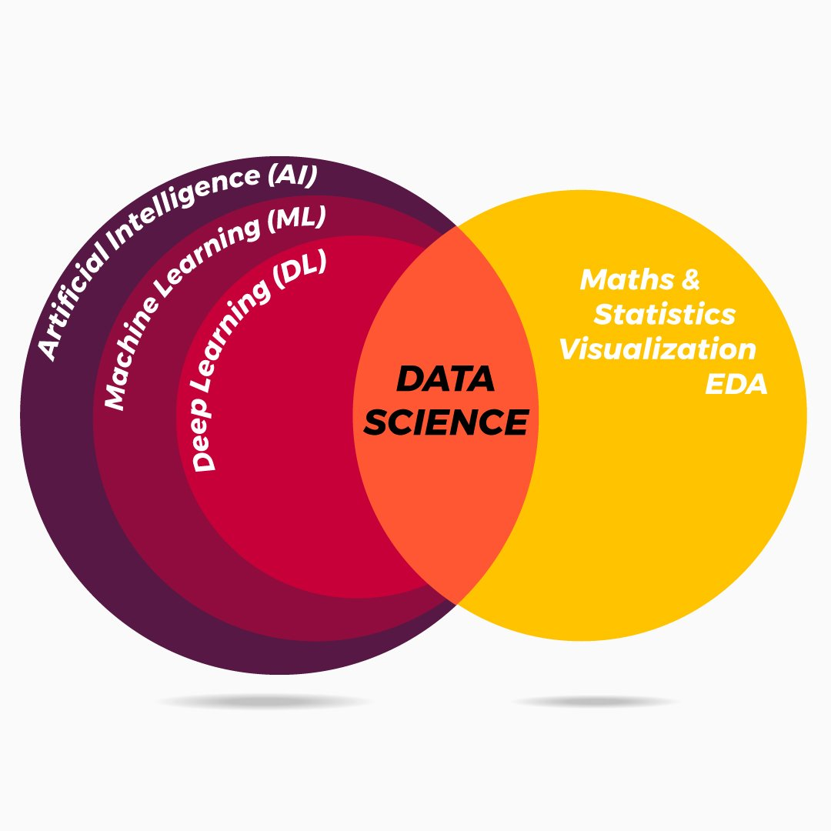
1 Python Deep Learning
https://www.tutorialspoint.com/python_deep_learning/index.htm
Python Deep Learning
We discuss
Python Deep Learning libraries, such as, Numpy, Scipy, Pandas, Matplotlib and
Python Deep Learning frameworks, such as, Theano, TensorFlow, and Keras.

Slide 3
End of Chapter

