Slide 1
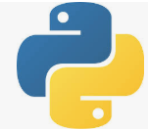
3 Environment
Peter H. Chen

Slide 2
3 Environment
https://www.tutorialspoint.com/python_deep_learning/python_deep_learning_environment.htm
Environment
Deep Learning Environment:
Python 2.7 – 3.7 (Tensorflow is not compatible with 3.8)
Scipy with numpy
Matplotlib
Theano
Keras
Tensorflow

Slide 3
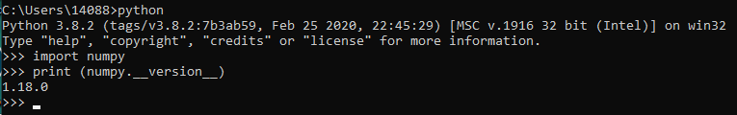
3 Environment
https://www.tutorialspoint.com/python_deep_learning/python_deep_learning_environment.htm
Environment
Check numpy
> python
>> import numpy
>> print (numpy.__version__)
1.18.0

Slide 4
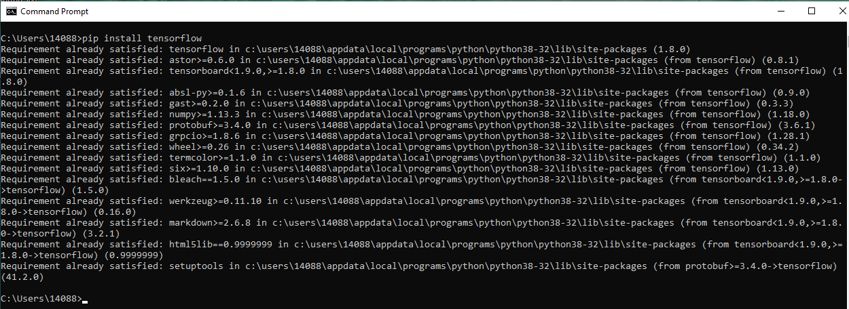
3 Environment
https://www.tutorialspoint.com/python_deep_learning/python_deep_learning_environment.htm
Environment
Install Theano, Tensorflow, and Keras
> pip install theano
> pip install keras
> pip install tensorflow

Slide 5
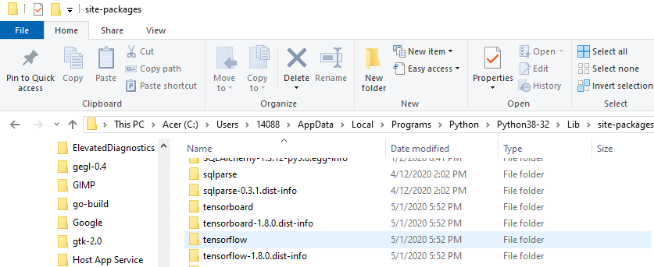
3 Environment
https://www.tutorialspoint.com/python_deep_learning/python_deep_learning_environment.htm
Environment
Check Tensorflow folder in Python 3.8.

Slide 6
3.1 Python 3.7 and Tensorflow

Slide 7
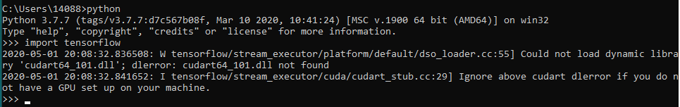
3 Environment
https://www.tutorialspoint.com/python_deep_learning/python_deep_learning_environment.htm
Environment
Check Tensorflow folder
https://www.google.com/search?q=which+python+version+work+with+tensorflow&rlz=1C1KDEC_enUS826US826&oq=which+python+version+work+with+tensorflow&aqs=chrome..69i57.15367j0j4&sourceid=chrome&ie=UTF-8
Note: TensorFlow supports Python 3.5, 3.6 and 3.7 on Windows 10. Although TensorFlow 2.1 will be the final version of TensorFlow that will support Python 2 (regardless of OS).
Note:
> import tensorflow ==> OK
> import keras ==> OK
> import theano ==> NG

Slide 8
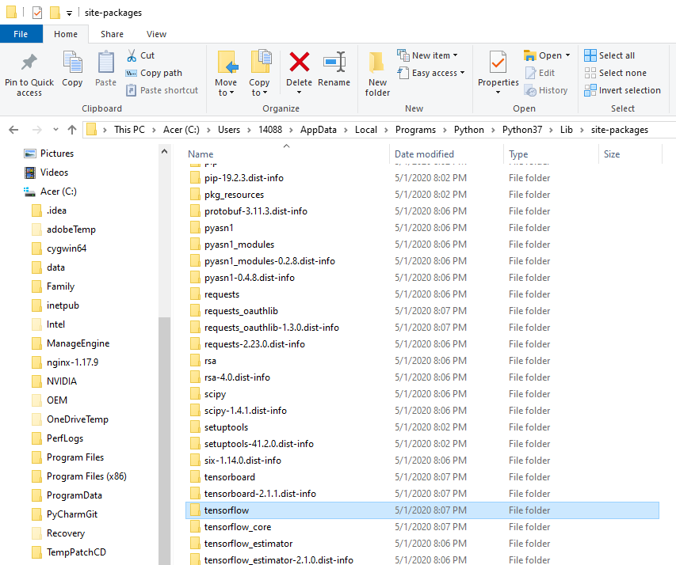
3 Environment
https://www.tutorialspoint.com/python_deep_learning/python_deep_learning_environment.htm
Environment
Check Tensorflow folder in Python 3.7 lib/site-packages

Slide 9
End of Chapter

