Slide 1

3 Setup
Peter H. Chen

Slide 2
3 Setup
https://www.youtube.com/watch?v=j8zDXBSfAAk&list=PLC3y8-rFHvwhI0V5mE9Vu6Nm-nap8EcjV&index=3
Setup:
First, we need the Editor: Visual Studio code.
Second, we need the Transpiler to compiler our code.
Finally, we need to combine the two together.
We need the editor with typescript compiler.
We can use typescript editor, such as, Visual Studio, Sublime, WebStorm, or Adam.
We will use VS (Visual Studio) Code for Editor. VS Code has a lot of plug-in library.
We install the typescript with npm (Node Package Manager).
Install node JS first that will come with npm.

Slide 3
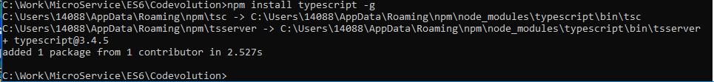
3 Setup
https://www.youtube.com/watch?v=j8zDXBSfAAk&list=PLC3y8-rFHvwhI0V5mE9Vu6Nm-nap8EcjV&index=3
Setup:
Go to the working folder and type:
> npm install transcript –g
For other machine, such as, Linux Ubuntu, make sure you use npm to install the typescript first.

Slide 4

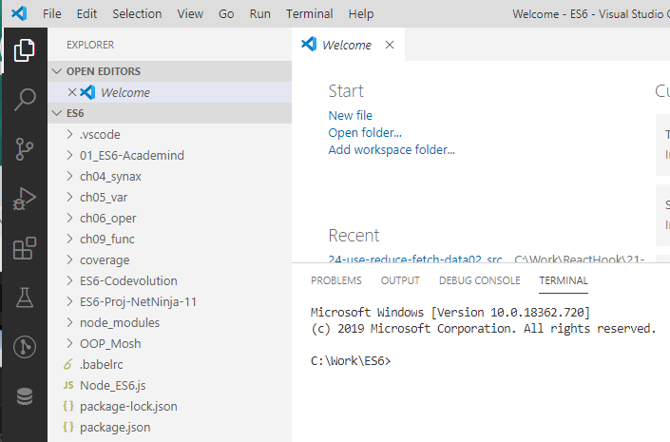
3 Setup
https://www.youtube.com/watch?v=j8zDXBSfAAk&list=PLC3y8-rFHvwhI0V5mE9Vu6Nm-nap8EcjV&index=3
Setup:
Open command prompt:
> code .
VS Code is bring up.

Slide 5
3 Setup
https://www.youtube.com/watch?v=j8zDXBSfAAk&list=PLC3y8-rFHvwhI0V5mE9Vu6Nm-nap8EcjV&index=3
Setup:
Open command prompt:
> code .
VS Code is bring up.

Slide 6

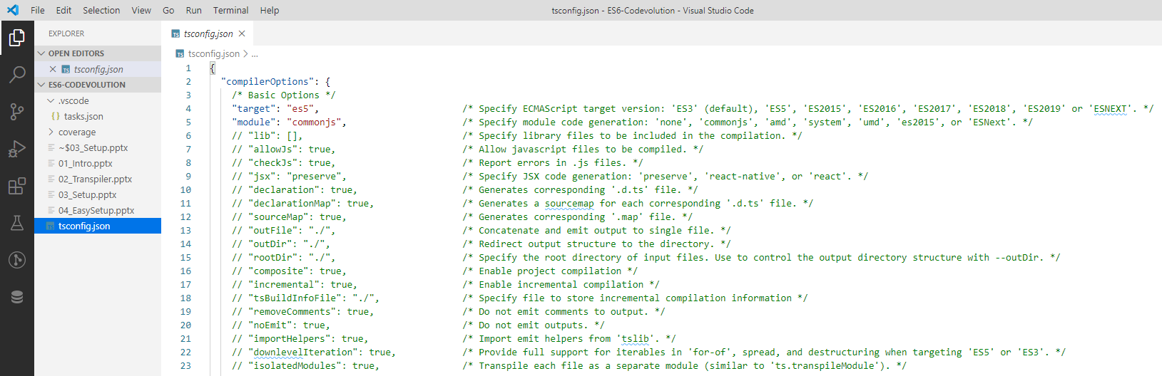
3 Setup
https://www.youtube.com/watch?v=j8zDXBSfAAk&list=PLC3y8-rFHvwhI0V5mE9Vu6Nm-nap8EcjV&index=3
In the command prompt:
> tsc –init
This will create a tsconfig.json file.

Slide 7
3 Setup
https://www.youtube.com/watch?v=j8zDXBSfAAk&list=PLC3y8-rFHvwhI0V5mE9Vu6Nm-nap8EcjV&index=3
We have some configuration like target is “ES5” and etc.

Slide 8
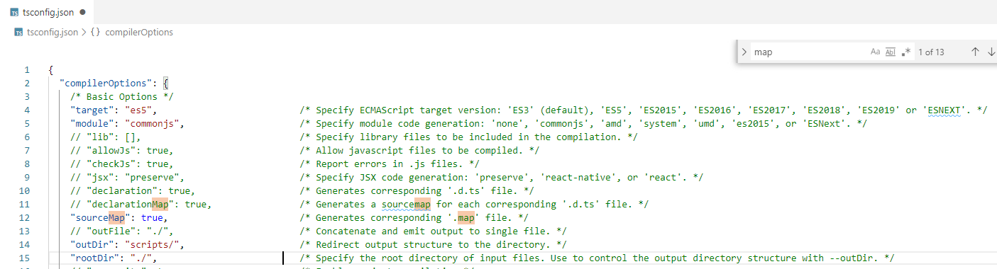
3 Setup
https://www.youtube.com/watch?v=j8zDXBSfAAk&list=PLC3y8-rFHvwhI0V5mE9Vu6Nm-nap8EcjV&index=3
We have some configuration like target is “ES5”.
“sourceMap: true” since we have a mapping from the TypeScript 5 to JavaScript file. That help us to debugging.
Set “outDir”: “scripts/”, this folder contains the compiled JavaScript folder.

Slide 9
3.1 demo.ts

Slide 10
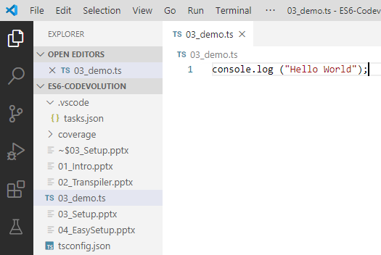
3.1 Demo.ts
https://www.youtube.com/watch?v=j8zDXBSfAAk&list=PLC3y8-rFHvwhI0V5mE9Vu6Nm-nap8EcjV&index=3
Create a file called demo.ts
> console.log (‘Hello world”)

Slide 11
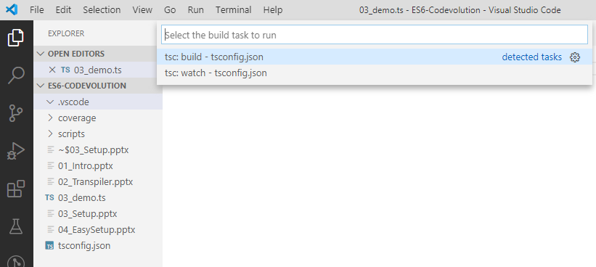
3.1 Demo.ts
https://www.youtube.com/watch?v=j8zDXBSfAAk&list=PLC3y8-rFHvwhI0V5mE9Vu6Nm-nap8EcjV&index=3
Compiled the ts script to javaScript.
> control+shift+B and select “tsc: build – tscondig.json”

Slide 12
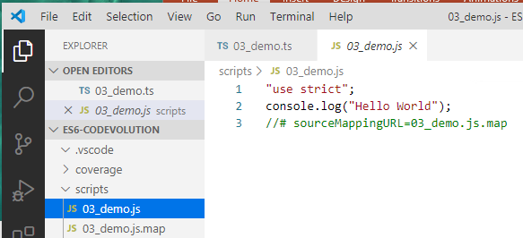
3.1 Demo.ts
https://www.youtube.com/watch?v=j8zDXBSfAAk&list=PLC3y8-rFHvwhI0V5mE9Vu6Nm-nap8EcjV&index=3
Check the compiled JavaScript in scripts folder.

Slide 13
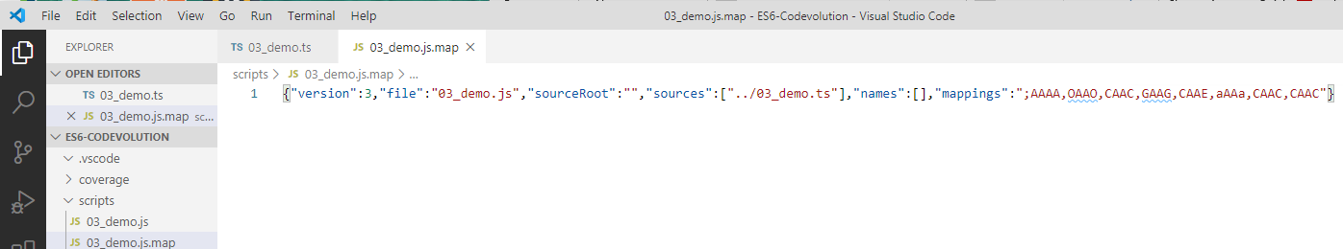
3.1 Demo.ts
https://www.youtube.com/watch?v=j8zDXBSfAAk&list=PLC3y8-rFHvwhI0V5mE9Vu6Nm-nap8EcjV&index=3
We also have the mapping file.
This file is only used for debugging.

Slide 14
3.2 index.html

Slide 15
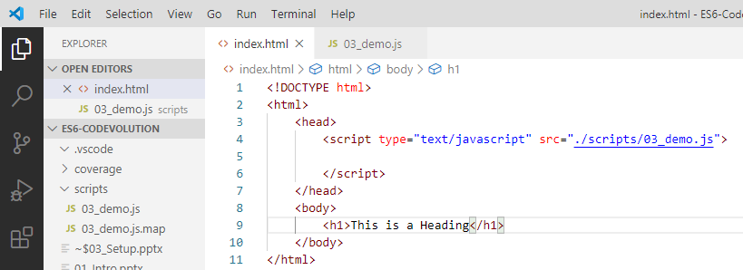
3.2 index.html
https://www.youtube.com/watch?v=j8zDXBSfAAk&list=PLC3y8-rFHvwhI0V5mE9Vu6Nm-nap8EcjV&index=3
We have VS Code editpr.
We have typescript compiler
We have add a build step to compile the TypeScript into JavaScript.
Finally, we need a HTML to reference this compiled JavaScript.
We create the index.html in the scripts folder.

Slide 16
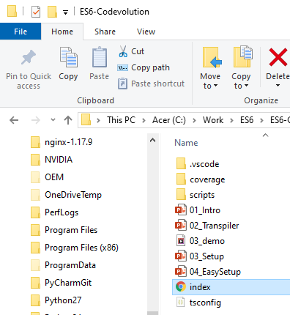
3.2 index.html
https://www.youtube.com/watch?v=j8zDXBSfAAk&list=PLC3y8-rFHvwhI0V5mE9Vu6Nm-nap8EcjV&index=3
Use the file explore.
Double the index.html.

Slide 17
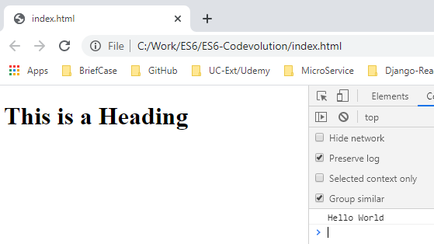
3.2 index.html
https://www.youtube.com/watch?v=j8zDXBSfAAk&list=PLC3y8-rFHvwhI0V5mE9Vu6Nm-nap8EcjV&index=3
The Browser display “This is a Heading”
Fn+F12 to bring up the console.
You will see “Hello World” displayed in the console.

Slide 18
3.3 Lite Server

Slide 19
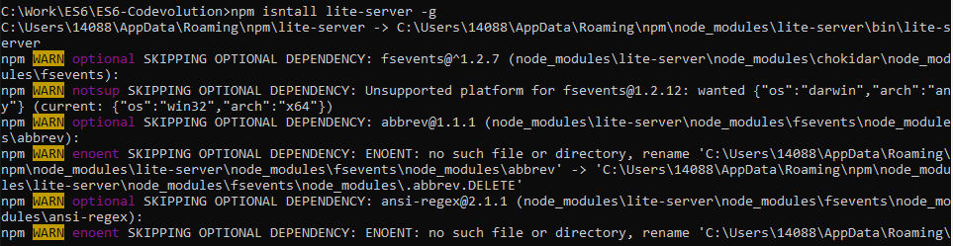
3.3 Lite Server
https://www.youtube.com/watch?v=j8zDXBSfAAk&list=PLC3y8-rFHvwhI0V5mE9Vu6Nm-nap8EcjV&index=3
You can install a lite server.
> npm install lite-server -g

Slide 20
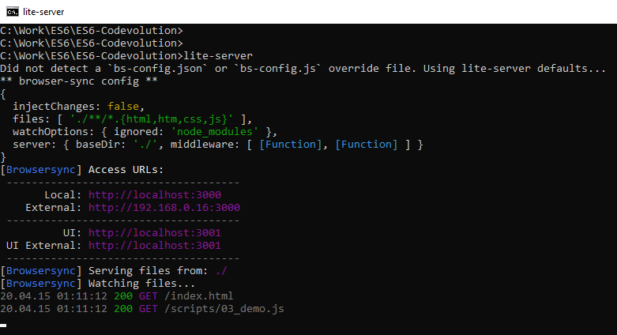
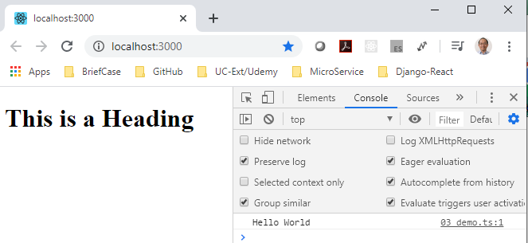
3.3 Lite Server
https://www.youtube.com/watch?v=j8zDXBSfAAk&list=PLC3y8-rFHvwhI0V5mE9Vu6Nm-nap8EcjV&index=3
You can type lite-server
> lite-server
The index.html and associated JavaScript are automatically bring up.

Slide 21
End of Chapter

