Slide 1

4 ScratchJS
Peter H. Chen

Slide 2
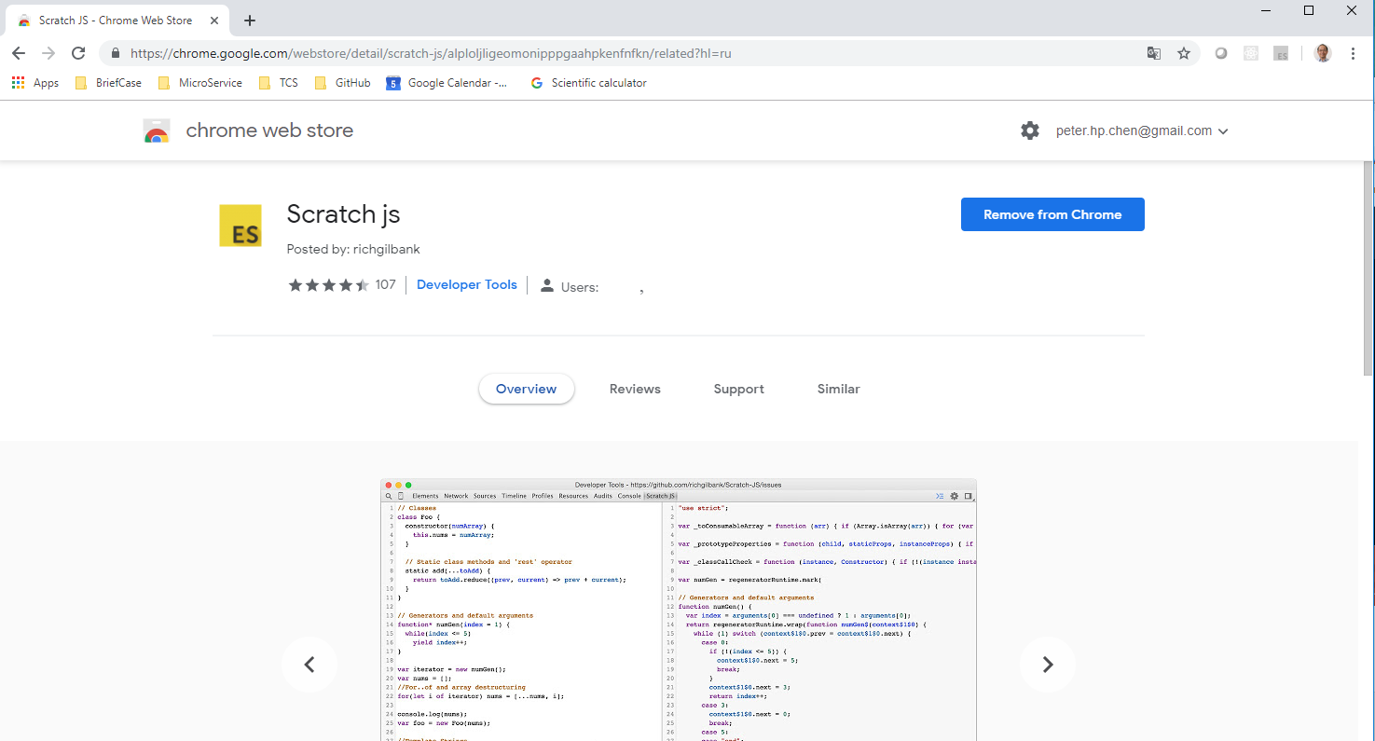
4 ScratchJS
https://www.youtube.com/watch?v=L8Rd7nWXRxI&list=PLC3y8-rFHvwhI0V5mE9Vu6Nm-nap8EcjV&index=4
Open Chrome and search “Scratch JS”
https://chrome.google.com/webstore/detail/scratch-js/alploljligeomonipppgaahpkenfnfkn?hl=en-US

Slide 3
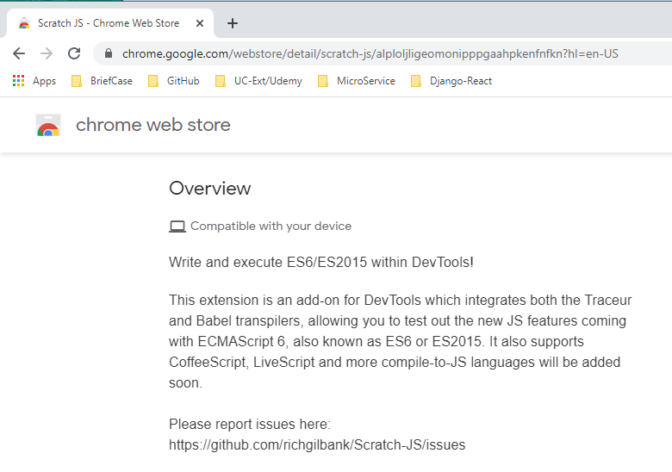
4 ScratchJS
https://www.youtube.com/watch?v=L8Rd7nWXRxI&list=PLC3y8-rFHvwhI0V5mE9Vu6Nm-nap8EcjV&index=4
ScratchJS allow you to write and execute ES6/2015 within the DevTools.
The ScratchJS is an extension and is an add-on for DevTools which integrates noth Traceur and Babel transpilers.
ScratchJS allows you to test out the new JS feature coming with ECMAScript 6 (ES6 or ES2015).
ScratchJS supports CoffeeScript, LiveScript, and more compile-to-JS languages.

Slide 4
4 ScratchJS
https://www.youtube.com/watch?v=L8Rd7nWXRxI&list=PLC3y8-rFHvwhI0V5mE9Vu6Nm-nap8EcjV&index=4
ScratchJS allow you to write and execute ES6/2015 within the DevTools.
The ScratchJS is an extension and is an add-on for DevTools which integrates noth Traceur and Babel transpilers.
ScratchJS allows you to test out the new JS feature coming with ECMAScript 6 (ES6 or ES2015).
ScratchJS supports CoffeeScript, LiveScript, and more compile-to-JS languages.

Slide 5
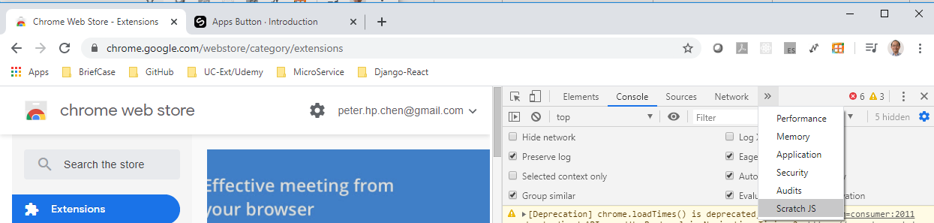
4 ScratchJS
https://www.youtube.com/watch?v=L8Rd7nWXRxI&list=PLC3y8-rFHvwhI0V5mE9Vu6Nm-nap8EcjV&index=4
How to access the ScratchJS?
Open Chrome, click “Fn+F12”.
Click “>>” and find “ScarcthJS” as below.

Slide 6
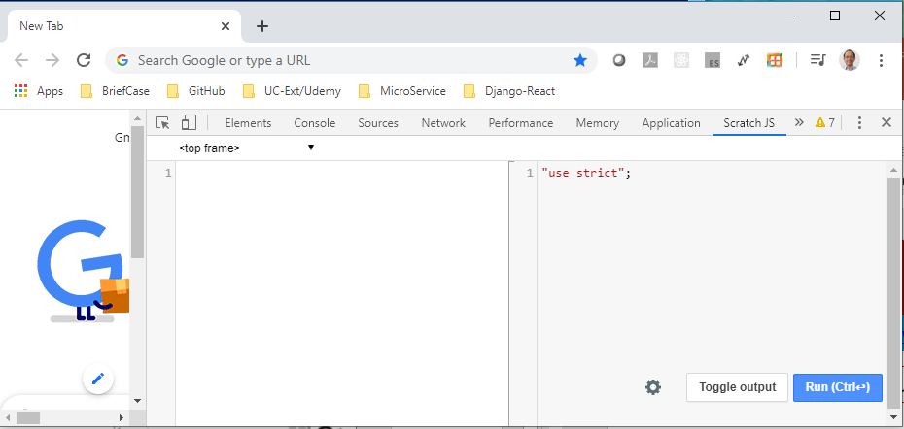
4 ScratchJS
https://www.youtube.com/watch?v=L8Rd7nWXRxI&list=PLC3y8-rFHvwhI0V5mE9Vu6Nm-nap8EcjV&index=4
After you “Toggle Output”, we have split browser screens.
On the left screen is the ES6 (ES2015) script code.
On the right screen, display the ES5 code (Transpile from ES6 into ES5).

Slide 7
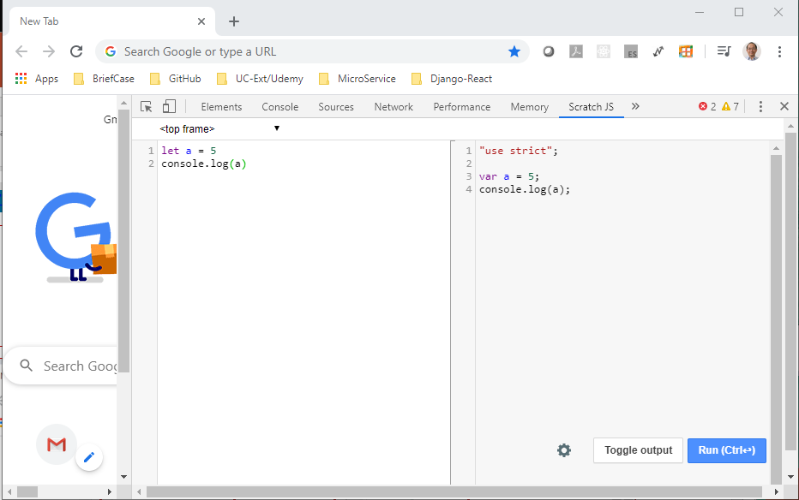
4 ScratchJS
https://www.youtube.com/watch?v=L8Rd7nWXRxI&list=PLC3y8-rFHvwhI0V5mE9Vu6Nm-nap8EcjV&index=4
For example, you type in ES6 on the left screen:
> let a = 5
The right screen will display ES6 code on the right screen:
> var a = 5

Slide 8
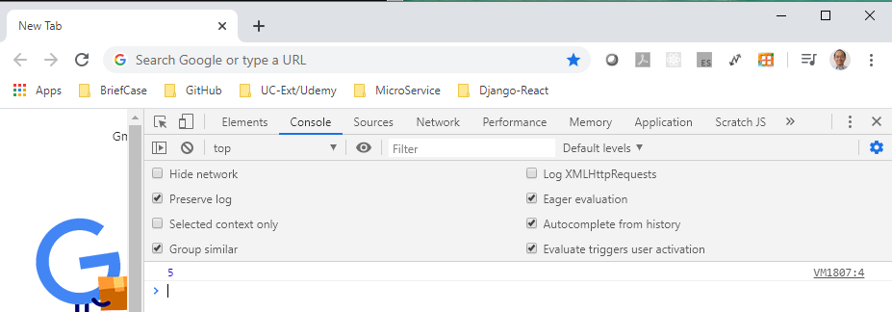
4 ScratchJS
https://www.youtube.com/watch?v=L8Rd7nWXRxI&list=PLC3y8-rFHvwhI0V5mE9Vu6Nm-nap8EcjV&index=4
You can click run and click “console” to see the.

Slide 9
End of Chapter

